Slide 1
Xpect to Achieve
Author: Jean B. Schumaker
Presentation Compiled by Bonnie Palasak
Revised July 2020

Slide 2
DAY ONE

Slide 3
Bell Ringer
Please find a seat anywhere you like today.
On the lined side of your index card, please tell me the following:
On the top line: Name you would like to be called + last name.
Skip one Line
On the third line: List your parents’ or guardians’ names.
On the fourth line: Tell me how many siblings you have and their names and ages.
On the fifth line: Do you have any after-school activities throughout the school year? If so, list them all.
PLEASE DO NOT WRITE ANYTHING ELSE ON YOUR INDEX CARD
EXAMPLE:
Erika Thomas
Wanda and Leland Thomas
1 brother, Ben, age 10 and 1 sister, Eliza, age 7
Piano.Baseball.Gymastics

Slide 4
Welcome to Xtreme Reading! This course is about learn Xtremely well!

Slide 5
Mrs. Xtreme
From Anytown, USA
University of Kansas
7th year in Lawrence
English, Reading, World History, and Geography
Love to read
Enjoy playing tennis and corn hole

Slide 6
AGENDA
Introduction
What’s this course about?
What will we expect?
How will we leave the classroom?

Slide 7
Seating Charts
This will be our temporary seating chart until I get to know you better.

Slide 8
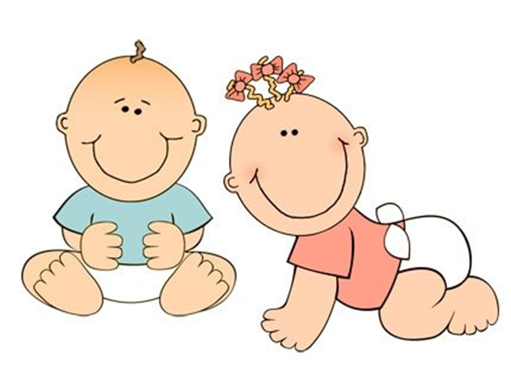
Mrs. Xtreme
Why do you think these three things are important to Mrs. Xtreme?

Slide 9
On the blank, back side of your card draw three things that are important to you and your name (make the name BIG).
Don’t discuss them with your neighbors yet. We will share in a few minutes.
You may use the markers that are on the counter.
Please put them back in the correct spots when you finish.
Notes:
Digital option: Create a Flipgrid Video

Slide 10
PAIR SHARE
Turn to your partner next to you, and the tallest partner will share first.
Please pay close attention to everything your partner says, because you will introduce them later.
I will be taking pictures of you as you share. Try not to be distracted.

Slide 11
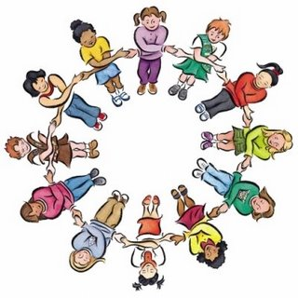
Introduce your partner to the class and tell two things that you learned about your partner.

Slide 12
Notes:
This graph shows how being able to read well is related to the kind of job you will be able to do. These Lexile scores down at the bottom show the difficulty of the reading materials that people can read. As a person learns to read materials written at higher and higher levels, his or her job opportunities expand to more and more skilled jobs. For example, a laborer reads at the 1000 Lexile level, a nurse at the 1300 leve, and a scientist close to the 1500 level.

Slide 13
Notes:
Now this graph shows how being able to read well is related to the yearly salary that you will earn in the future. Laborers, or those who read at the 1000 Lexile level, earn between $5000 and $9900 per year, while people reading above the 1400 Lexile level earn more than $75,000 per year.

Slide 14
Given what I know about teaching people like yourselves how to read, you will be able to boost your ability to read this year by leaps and bounds, as long as you put effort into this course. In short, what you do in this class will affect your ability to fulfill your hopes and dreams for the future with regard to where you will work, what your salary will be, and what your life will be like.

Slide 15
Anecdotal Story
Notes:
Malcom X or Rubin “Hurricane” Carter

Slide 16
What you can expect from me
I will uphold high standards
I will be fair
I will do my very best to help you become an Xtremely skilled reader

Slide 17
What I Expect of You
Set high standards for yourself for:
Always coming to class
Being on time
Working as hard as you possibly can

Slide 19
Weightlifters develop big muscles by:
Setting goals
Gaining Knowledge about bodies and how to build them
Using different strategies to build different muscles
Having good work habits

Slide 20
All successful weightlifters push themselves as hard as they possibly can.
They go to the Xtreme by lifting as much as they can for as long as they can until they are exhausted.

Slide 21
In this course, you won’t be building your bodies, but you will be building your ability to become great readers.
You will be doing the four things that great bodybuilders do

Slide 22
To become an Xtreme reader, you will need to:
Establish goals
Develop good habits of learning
Build knowledge
Use and combine a variety of reading strategies

Slide 23
This course will be demanding
I am going to push you, and I want you to push yourselves to the Xtreme.
When you step up to these challenges, you are going to become a very good reader!

Slide 24
Ending Class
Transition
Prepare for departure (clean up, put away all materials, return to desk)
Time
No more than three minutes
Appropriate Participation
Clean up or put away materials
Move to your desk
Ask teacher quick question or make an appointment
Wait to be dismissed
Inappropriate Behaviors
Staying at a station
Talking
Leaving materials out
Going to someone else’s desk

Slide 25
DAY TWO

Slide 26
Bell Ringer - INDEX CARD
On the sixth line:
Write two sentences about how you feel about yourself as a reader.
On a scale from 1-10, rank how you feel about reading
1 = I hate it
10 = I love it
5 = I don’t mind, but I don’t choose to read

Slide 27
Agenda
Review
What are parts of this course?
What will we read?
How will we enter the classroom?

Slide 28
Review
What’s the name of this course?
What’s Xtreme about it?
What is this course like?
How is reading related to the jobs you will be ready to do?
How is reading related to the salary you can earn?

Slide 29
Course Syllabus
By the end of this class, you will be able to:
Read long multi-syllable words
Understand what you read (in grade-level materials)
Use strategies while you read such as:
Word Mapping Strategy
Word Identification
Self-Questioning
Visual Imagery
Paraphrasing
Inferencing

Slide 30
Course Syllabus
By the end of this class, you will be able to:
Learn and be able to use new vocabulary words
Read aloud smoothly and with expression
Take reading tests with more confidence and perform better on those tests
Be a productive member of a Learning Community
Set and achieve long-term goals

Slide 31
Course Syllabus
To accomplish the above skills and strategies will require cooperation and the development of a Learning Community.
Think of this class like a challenge course in the forest. You will have to work hard independently, but you will also have to work effectively with other students and me. Together we will create a community of people where taking risks is rewarded with success.

Slide 32
Course Syllabus
Guidelines for Success (Winners make their own luck. They achieve.)
It takes:
Preparation
Responsibility
Integrity
Dedication
Effort
to be successful!

Slide 33
Course Syllabus
Classroom Rules (Winners know there are rules and follow the rules.)
1. Come to class every day that you are not seriously ill.
2. Arrive on time with work materials.
3. Raise your hand to speak or ask a question.
4. Follow directions the first time given.
5. Stay on task during all work times.

Slide 34
Course Syllabus
Learning Activities (Winners participate and strive to ACHIEVE.)
All of the activities below will involve practicing new skills. Think of these activities as the type of practice an athlete, dancer, or musician does to improve skills. Your grades will be based on these activities.
Whole Class Lesson & Discussion
Small Group Work
Paired Practice
Independent Work
Teacher Conferencing

Slide 35
GRADING PROCEDURE

Slide 36
Course Organizer

Slide 37
Teacher:
The
Course Organizer
Student:
Time:
Course Dates:
This Course: Xtreme Reading
Grading Procedures
is
about
building the knowledge, strategies, and habits of learning that will make you a great reader and help you reach important goals.
Start-Up Activities
Participation & Discussion
Classroom Skills
Assignments
Book Study
Tests & Quizzes
Course Questions:
1. How does thinking about your dreams and possibilities for your life change the way you approach learning?
2. Why do good learners know and use several different reading strategies?
3. How can learning new words and spending lots of time reading improve the knowledge that you have?
4. Why is reading fluently important?
5. Why is developing good habits of learning important?
6. How does improving your reading help you reach your goals and dreams?

Slide 38
Course Map
This Course:
Xtreme Reading
Student:
includes
Classroom
Expectations
Learning Routines
Tasks/Activities
Teamwork
Respect
Tolerance
Voice
Choice
Hard work
Discussions
Products
Quizzes
Classroom procedures Guided practice
Daily agenda Partner practice
Start-up activities Feedback sessions
Group participation Progress charting
Critical Concepts
Hopes and Dreams
Reading Strategies
Habits of Learning
Expert Reading
Learning
Community
Reading
Strategies
Learned in these
Units
Hopes
and Dreams
through
through
Highly Engaging
Literature
Highly Engaging
Literature
through
Highly Engaging Literature

Slide 39
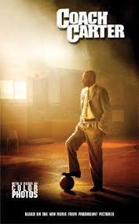

Slide 40
ACHIEVE
In this class, you will be asked to do a variety of activities, and each activity will have its own set of expectations.
Understanding the expectations for each of the activities will help you ACHIEVE in this course and do your best.

Slide 41
ACHIEVE
A – Activity
C – Conversation
H – Help
I – Integrity
E – Effort
V – Value
E - Efficiency

Slide 42
A - Activity
Types of activities we will do in this class:
Whole Class Lesson & Discussion
Small Group Work
Paired Practice
Independent Work
Teacher Conferencing
We will discuss the expectations for each activity more as we proceed through the course.

Slide 43
C - Conversation
Each activity will have its own expectations regarding the level of conversation that should take place during the activity.
Some activities, such as independent practice, will require very little conversation.
Other activities will involve a lot more.

Slide 44
H - Help
During an activity, you might need to get help from me.
Unless I am working with you individually, the best way to get help during activities is to raise your hand and quietly wait until I am free to help you.
During some activities, you might help each other, and we will talk about how you will do that in the future.

Slide 45
I - Integrity
Integrity – living by a code of principles such as being honest and responsible.
It basically means “do the right thing.”
If you are ever unsure about how you are to behave in this course, the letter I in ACHIEVE should remind you to do what you believe is right.

Slide 46
E - Effort
The best results are always achieved when an individual works hard and puts forth his or her best effort.
I promise that I will always give you my best effort in this classroom, and I ask that you give your best effort also.
Nothing great is ever achieved without hard work and effort.

Slide 47
V - Value
Every activity that we conduct in this course has value.
If you participate in the activity, you will get something out of it.
All of the activities are valuable and contribute to you becoming a stronger reader.

Slide 48
E - Efficiency
Efficiency means acting in a way that doesn’t waste energy or time.
We have a lot to accomplish in this course, and we will need to stay focused and stay on task.
Efficient work behaviors support success.

Slide 49
Entering Class
Transition
Move from the hallway into the classroom
Be ready to work on warm-up activity when the bell rings
Time
No more than length of passing time (door to seat)
Appropriate Participation
Move directly to desk
Sharpen pencil
Get supplies
Talk quietly at desk with another student until the bell rings
Inappropriate Behaviors
Moving around classroom without a purpose
Continuing to move after the bell has rung
Talking loudly, yelling, or continuing to react to a situation from the hallway

Slide 50
POST-ORGANIZER
Today, you learned more about what we will cover in this course. Next time we meet, we will begin to read our first novel together.

Slide 51
Day 3

Slide 52
Start-Up Activity Day 3
In your journal, write two complete sentences about what you expect to learn in this class.

Slide 53
Day 3
Start up activity
Advance organizer
ACHIEVE Unit
Organizer
Whole class discussion expectations
Running Dream Guided Reading
Closing

Slide 54
Whole Class Discussion
Conversation
Speak when called upon
Look and listen
Help
Raise hand; wait to be called upon
Integrity
Ask teacher to slow down or repeat information
Wait your turn to speak; support your classmates
Effort
Sit up and listen
Keep eyes on presenter…
Value
Improve reading, speaking and writing skills
Efficiency
Keep mind on lesson; stay in seat

Slide 55
Extreme Sports
Name all of the extreme sports you can think of
Do the athletes automatically know how to perform their stunts?
How do you think those athletes train?
How long do you think it takes to learn?
How often do they practice?

Slide 56
https://www.youtube.com/watch?v=uAz9hZmcr58

Slide 57
We are going to compare extreme sports to Xtreme reading…
What are similarities between the two?

Slide 58
Course Organizer

Slide 59
Guided Reading
Notes:
Page 31 Xpect to Achieve Manual

Slide 60
Day 4

Slide 61
Start Up Activity Day 4
In your journal write 2 sentences about what you predict Coach Carter will have to do to be sure that the team comes together and wins.

Slide 62
Agenda
Reading Test (ACT Aspire or other)
Guided Reading
ACHIEVE Expectations

Slide 63
Guided Reading

Slide 64
Moving From and Back to Whole Class
Transition
Move from your desk to the appropriate work area designated by the teacher
When moving back to Whole Class, leave the work area and return to your desk quickly
Time
One minute
Appropriate Participation
Move directly to work area or desk
Ask teacher question or make appointment
Sharpen pencil
Get supplies
Immediately get to work
Inappropriate Behaviors
Staying at desk or work area
Talking
Going to the wrong location
Not getting to work immediately

Slide 65
ACHIEVE
A – Activity
C – Conversation
H – Help
I – Integrity
E – Effort
V – Value
E - Efficiency

Slide 66
Ending Class
Transition
Prepare for departure (clean up, put away all materials, return to desk)
Time
No more than three minutes
Appropriate Participation
Clean up or put away materials
Move to your desk
Ask teacher quick question or make an appointment
Wait to be dismissed
Inappropriate Behaviors
Staying at a station
Talking
Leaving materials out
Going to someone else’s desk

Slide 67
Day 5

Slide 68
Start-Up Activity Day 5
In your journal, write two complete sentences about whether you think Coach Carter’s high expectations will help the team and why.

Slide 69
Talking Together and Our Learning Community
Notes:
Read Talking Together Lesson 1 Pages 11 & 12 (#’s 1 -2)

Slide 70
Talking Together Lesson 1
What is a community?
What is a learning community?
Whole Group Participation
Non-verbal participation
Discussion skills
Notes:
Pages 11 & 12
Talking Together manual

Slide 71
Talking Together Lesson 3
Notes:
Talking Together pages 25-28, #’s 1 - 5

Slide 72
Respect-Pair Share
With your shoulder partner (or table of 3), discuss different types of respect for people and respect for living and non-living things around you.
Tell your partner ways you can show respect to people.
Tell your partner how you can show respect in school.
Notes:
Talking Together Pages 31 - 35

Slide 73
Share Out
Types of respect for people and living and non-living things
Ways you can show respect
Ways you can show respect in school

Slide 74
Cue Card #6

Slide 75
Review

Slide 76
Guided Reading

Slide 77
Day 6

Slide 78
Start-Up Activity Day 6
In your journal, write two complete sentences about examples of respect or disrespect in the novel, Coach Carter.

Slide 79
DISTRICT VOCABULARY TESTING

Slide 80
Talking Together Lesson 4
Notes:
Talking Together pages 25-28, #’s 1 - 5

Slide 81
Diversity
When people come together, such as in a classroom or community, there is usually a lot of diversity.
Show me (thumbs up/thumbs down) whether or not you have ever heard the word diversity.
Diversity means differences or not alike.

Slide 82
Today we are going to talk about how our differences contribute to a learning community.
Please remember to use the Discussion skills and show respect to your classmates.

Slide 83
Diversity
Prior knowledge
Viewpoints
Strengths and weaknesses
Likes and dislikes
Looks, ways of acting, and beliefs
Family backgrounds and cultures
The ways we are different often affect how we learn or perform in school

Slide 84
Prior Knowledge
When you came to this class, you came with prior knowledge.
You already knew some things before you got here.
Turn to your shoulder partner and tell them one thing you knew how to do before you started school this year.

Slide 85
Differing Viewpoints
Our past experiences and prior knowledge give us differing views of the world.
Your view can be different from the view of other people.
Think about how a farmer and a child might view a rabbit.
Sometimes there are many different ways to look at something. By understanding the different views that people have about a certain issue, you get a more complete picture of that issue.

Slide 86
Strengths and Weaknesses
As learners, we also have different strengths and weaknesses.
Strengths are things you do well.
Tell your partner one strength you have.
Not everyone has the same strengths.
In fact, all of us are good at some things and not good at others.
Some may struggle in school and some may not be able to catch a football.

Slide 87
Likes and Dislikes
We all also like different things and dislike different things.
Let’s see how different or alike we are.
I am going to read some sentences. Show me thumbs up if you agree, and thumbs down if you disagree.
I love broccoli.
I like to play football more than any other sport.
I like listening to rock & music.
I like listening to country music.

Slide 88
Likes and Dislikes
We did not all agree with all of the statements.
It’s okay to disagree.
We can learn a lot by listening to others’ opinions and ideas.
We don’t always have to agree with other people’s opinions and ideas.

Slide 89
Tolerance
Being willing to listen to different opinions.
Being willing to accept that others may be different.
Not making negative remarks or put-downs when someone is different.

Slide 90
Day 7

Slide 91
Start-Up Activity Day 7
In your journal, write two sentences about what you want to learn more about .
For example, you might write about an interest or a subject area.

Slide 92
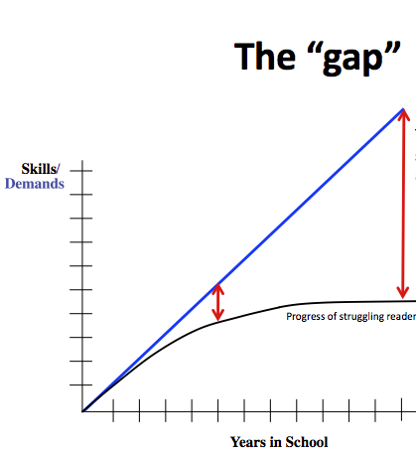
Day 7
Start up activity
Discuss “closing the gap”
Introduce lexile levels.
Administer the pretests for Word Mapping and Word Identification

Slide 93
The “gap”
The achievement gap for our struggling readers grows larger and larger throughout the years.
Skills
/
Demands
Progress of struggling readers
Years in School

Slide 94
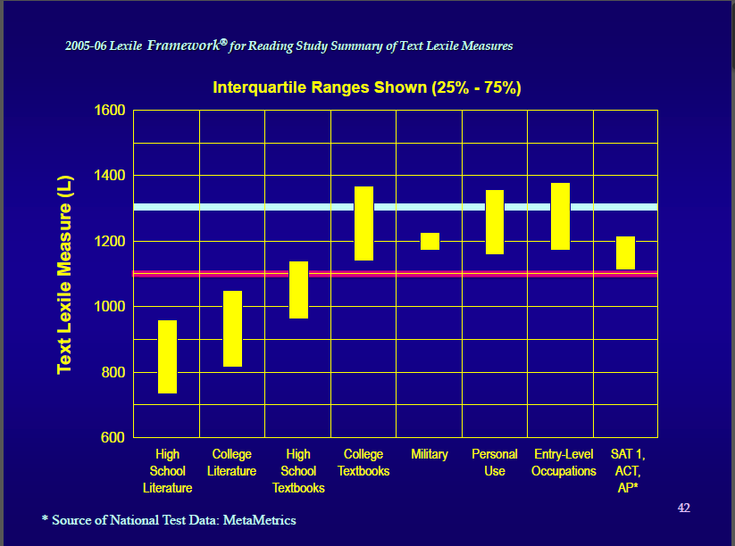

Slide 95
Lexile Reading Levels
What are Lexile Reading Levels
Lexile scores match reader ability and text difficulty, allowing individualized monitoring of student progress.
How does it work?
Lexile measures are based on two well-established predictors of how difficult a text is to comprehend: semantic difficulty (word frequency) and syntactic complexity (sentence length).
Lexile Score Table from www.lexile.com:
Age | School Year | Typical Lexile Level
7 8 9 10 11 12 13 14 15 16 | 3 4 5 6 7 8 9 10 11 12 | 300- 800 400- 900 500-1000 600-1100 700-1200 800-1300 900-1400 1000-1700 1100-1700 1200-1700

Slide 96
Word ID Pretest

Slide 97
Word Mapping Pretest

Slide 98
Day 8

Slide 99
Start-Up Activity Day 8
In your journal, write two complete sentences about the parts of a learning community that you would like to see in place in this classroom.

Slide 100
DISTRICT COMPREHENSION TESTING

Slide 101
Talking Together Lesson 6

Slide 102
Learning Community
What have we learned so far about learning communities?

Slide 103
The first thing we will do today is make a chart that describes a learning community (see Cue Card #10 in your binder).
Think about what we should always see in a learning community.
For example: people support others or people care about others.

Slide 104
Always Present
Another example of something that is always present in a learning community is that all members of the community want to see others do well.
Help me continue to create the list of what is always present in a good learning community.

Slide 105
Never Present
Now we’re going to talk about those things that we would NEVER see in a safe and caring learning community.
For example, people do not laugh at someone else’s mistake.
Help me continue to create the list of what is never present in a good learning community.

Slide 106
Having a place where you can feel safe and comfortable to learn is so important that we are going to sign a contract saying that we ALL agree that we want to build a learning community in our class with all of the “always present” characteristics we have discussed.

Slide 107
Learning Community Contract
Notes:
Talking Together page 60 Digital Option in Padlet

Slide 108
As your teacher, I commit to being a positive part of your success as a learner and a person. You can see me before and after school and during seminar if you have questions or need additional help. I look forward to working with you. Welcome to our Xtreme Reading class!

Slide 109
How are we doing entering and leaving the classroom?

