Slide 1
Let’s
Take A
Look At
Teacher
Notebook
#1.

Slide 2
Day 1
Start up activity
Advance organizer
Ice breaker
Course rationale
Course metaphor
Closing – ending class routine

Slide 3
Ending Class
Transition
Prepare for departure (clean up, put away all materials, return to desk)
Time
No more than three minutes
Appropriate Participation
Clean up or put away materials
Move to your desk
Ask teacher quick question or make an appointment
Wait to be dismissed
Inappropriate Behaviors
Staying at a station
Talking
Leaving materials out
Going to someone else’s desk

Slide 4
Day 2
Start up activity
Advance organizer
Course syllabus
Course Organizer
Overview of books
Closing and entering class expectations

Slide 5
Teacher:
The
Course Organizer
Student:
Time:
Course Dates:
This Course: Xtreme Reading
Grading Procedures
is
about
building the knowledge, strategies, and habits of learning that will make you a great reader and help you reach important goals.
Start-Up Activities
Participation & Discussion
Classroom Skills
Assignments
Book Study
Tests & Quizzes
Course Questions:
1. How does thinking about your dreams and possibilities for your life change the way you approach learning?
2. Why do good learners know and use several different reading strategies?
3. How can learning new words and spending lots of time reading improve the knowledge that you have?
4. Why is reading fluently important?
5. Why is developing good habits of learning important?
6. How does improving your reading help you reach your goals and dreams?

Slide 6
Course Map
This Course:
Xtreme Reading
Student:
includes
Classroom
Expectations
Learning Routines
Tasks/Activities
Teamwork
Respect
Tolerance
Voice
Choice
Hard work
Discussions
Products
Quizzes
Classroom procedures Guided practice
Daily agenda Partner practice
Start-up activities Feedback sessions
Group participation Progress charting
Critical Concepts
Hopes and Dreams
Reading Strategies
Habits of Learning
Expert Reading
Learning
Community
Reading
Strategies
Learned in these
Units
Hopes
and Dreams
through
through
Highly Engaging
Literature
Highly Engaging
Literature
through
Highly Engaging Literature

Slide 7
Entering Class
Transition
Move from the hallway into the classroom
Be ready to work on warm-up activity when the bell rings
Time
No more than length of passing time (door to seat)
Appropriate Participation
Move directly to desk
Sharpen pencil
Get supplies
Talk quietly at desk with another student until the bell rings
Inappropriate Behaviors
Moving around classroom without a purpose
Continuing to move after the bell has rung
Talking loudly, yelling, or continuing to react to a situation from the hallway

Slide 8
Day 3
Start up activity
Advance organizer
ACHIEVE Unit
Organizer
Whole class discussion expectations
Coach Carter – Guided Reading
Closing

Slide 9
Whole Class Discussion
Conversation
Speak when called upon
Look and listen
Help
Raise hand; wait to be called upon
Integrity
Ask teacher to slow down or repeat information
Wait your turn to speak; support your classmates
Effort
Sit up and listen
Keep eyes on presenter…
Value
Improve reading, speaking and writing skills
Efficiency
Keep mind on lesson; stay in seat

Slide 10
Day 4
Start up activity
Advance organizer
Guided Reading - Coach Carter
Give the Sentence Comprehension Subtest of the GRADE.
Moving from/back to whole class routine
Discuss expectations
Closing

Slide 11
Moving From and Back to Whole Class
Transition
Move from your desk to the appropriate work area designated by the teacher
When moving back to Whole Class, leave the work area and return to your desk quickly
Time
One minute
Appropriate Participation
Move directly to work area or desk
Ask teacher question or make appointment
Sharpen pencil
Get supplies
Immediately get to work
Inappropriate Behaviors
Staying at desk or work area
Talking
Going to the wrong location
Not getting to work immediately

Slide 12
Rely on the ACHIEVE Expectations:
Activity
Conversation
Help
Integrity
Effort
Value
Efficiency

Slide 13
Set Up Your Expectations using the ACHIEVE Planning Sheets for:
Whole Group Activities: Teacher leads the activity
Paired or Small Group Activities: Students working together
Independent Activities: Students working alone

Slide 14
Three Major Components of Xpect to Achieve
Set clear expectations
Build a strong learning community.
Provide positive feedback.

Slide 15
How Do We Build A Learning Community?

Slide 16
Day 5
Start up activity
Advance organizer
Introduce the concept of “Learning Community” with a Talking Together Lesson
Introduce the concept of “Respect.”
Guided Reading
RESPECT

Slide 17
Talking Together
A learning community is
“ … an environment that fosters
mutual cooperation, emotional support,
and personal growth as
(people) work together to achieve
what they cannot accomplish
alone.”
DuFour and Eaker, 1998

Slide 18
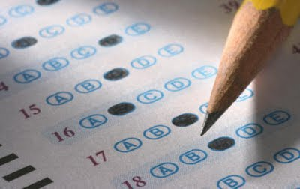
Day 6
Start up activity
Advance organizer
Begin pretests with the GRADE vocabulary subtest.
Introduce the concept of “tolerance” with a Talking Together lesson.

Slide 19
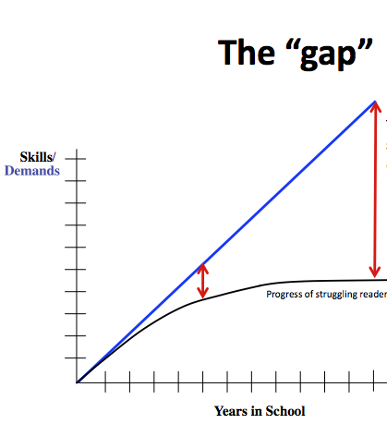
Day 7
Start up activity
Discuss “closing the gap”
Introduce lexile levels.
Administer the pretests for Word Mapping and Word Identification

Slide 20
The “gap”
The achievement gap for our struggling readers grows larger and larger throughout the years.
Skills
/
Demands
Progress of struggling readers
Years in School

Slide 21
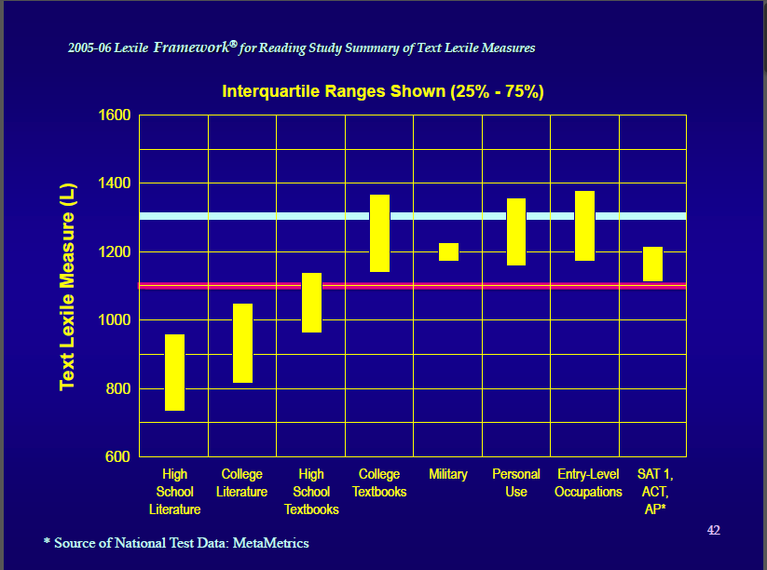

Slide 22
Lexile Reading Levels
What are Lexile Reading Levels
Lexile scores match reader ability and text difficulty, allowing individualized monitoring of student progress.
How does it work?
Lexile measures are based on two well-established predictors of how difficult a text is to comprehend: semantic difficulty (word frequency) and syntactic complexity (sentence length).
Lexile Score Table from www.lexile.com:
Age | School Year | Typical Lexile Level
7 8 9 10 11 12 13 14 15 16 | 3 4 5 6 7 8 9 10 11 12 | 300- 800 400- 900 500-1000 600-1100 700-1200 800-1300 900-1400 1000-1700 1100-1700 1200-1700

Slide 23
Day 8
Start up activity
Administer the reading comprehension subtest of GRADE.
Review the concept of learning community.
Teach Lesson 6 in Talking Together.

