Slide 1
To Xtreme Reading
Our session begins at 10:00.

Slide 2
Three Major Components of Xpect to Achieve
Set clear expectations
Build a strong learning community.
Provide positive feedback.

Slide 3
Students can’t live up to expectations they don’t know have been set for them.
Set
Expectations

Slide 4
Set expectations in the following areas:
Activity
Conversation
Help
Integrity
Effort
Value
Efficiency

Slide 5
Clear Expectations …
Without using any vulgar language or slang terms, please list 10 body parts that have only 3 letters.

Slide 6
Let’s compare lists ….
How’s this list ?
Toe
Toe
Toe
Toe
Toe
Toe
Toe
Toe
Toe
Toe

Slide 7
Three Major Components of Xpect to Achieve
Set clear expectations
Build a strong learning community.
Provide positive feedback.

Slide 8
Talking Together
A learning community is
“ … an environment that fosters
mutual cooperation, emotional support,
and personal growth as
(people) work together to achieve
what they cannot accomplish
alone.”
DuFour and Eaker, 1998

Slide 9
Three Major Components of Xpect to Achieve
Set clear expectations
Build a strong learning community.
Provide positive feedback.

Slide 10
3. Provide Feedback
Positive Feedback
Accurate
Specific & Descriptive
Contingent
Immediate
Fits your style
Corrective Feedback
Immediate
Calm
Consistent
3 to 1

Slide 11
Ratio of Interactions
The single most important thing teachers can do to improve the overall behaviors of students in their classroom and connect with students is:
Increase the number of positive or non-contingent
interactions they have with each student.

Slide 12
Rapport, rapport, rapport!
Greeting students
Showing interest in student work
Inviting students to ask for assistance
Having conversations with students when possible
Learning about likes/dislikes
Genuine interest
Making a special effort to talk with any student with whom you have given corrective feedback for misbehavior

Slide 13
They may forget what you said, but …
they will not forget how you
made them feel.
Carl Buechner

Slide 14
Daily Lessons

Slide 15
Three Major Components of Xpect to Achieve
Set clear expectations
Build a strong learning community.
Provide positive feedback.

Slide 16
Day 1
Start up activity
Advance organizer
Ice breaker
Course rationale
Course metaphor
Closing – ending class routine

Slide 19
Ending Class
Transition
Prepare for departure (clean up, put away all materials, return to desk)
Time
No more than three minutes
Appropriate Participation
Clean up or put away materials
Move to your desk
Ask teacher quick question or make an appointment
Wait to be dismissed
Inappropriate Behaviors
Staying at a station
Talking
Leaving materials out
Going to someone else’s desk

Slide 20
Day 2
Start up activity
Advance organizer
Course syllabus
Course Organizer
Overview of books
Closing and entering class expectations
Xtreme Reading

Slide 23
Teacher:
The
Course Organizer
Student:
Time:
Course Dates:
This Course: Xtreme Reading
Grading Procedures
is
about
building the knowledge, strategies, and habits of learning that will make you a great reader and help you reach important goals.
Start-Up Activities
Participation & Discussion
Classroom Skills
Assignments
Book Study
Tests & Quizzes
Course Questions:
1. How does thinking about your dreams and possibilities for your life change the way you approach learning?
2. Why do good learners know and use several different reading strategies?
3. How can learning new words and spending lots of time reading improve the knowledge that you have?
4. Why is reading fluently important?
5. Why is developing good habits of learning important?
6. How does improving your reading help you reach your goals and dreams?

Slide 24
Course Map
This Course:
Xtreme Reading
Student:
includes
Classroom
Expectations
Learning Routines
Tasks/Activities
Teamwork
Respect
Tolerance
Voice
Choice
Hard work
Discussions
Products
Quizzes
Classroom procedures Guided practice
Daily agenda Partner practice
Start-up activities Feedback sessions
Group participation Progress charting
Critical Concepts
Hopes and Dreams
Reading Strategies
Habits of Learning
Expert Reading
Learning
Community
Reading
Strategies
Learned in these
Units
Hopes
and Dreams
through
through
Highly Engaging
Literature
Highly Engaging
Literature
through
Highly Engaging Literature

Slide 26
Rely on the ACHIEVE Expectations:
Activity
Conversation
Help
Integrity
Effort
Value
Efficiency

Slide 28
Entering Class
Transition
Move from the hallway into the classroom
Be ready to work on warm-up activity when the bell rings
Time
No more than length of passing time (door to seat)
Appropriate Participation
Move directly to desk
Sharpen pencil
Get supplies
Talk quietly at desk with another student until the bell rings
Inappropriate Behaviors
Moving around classroom without a purpose
Continuing to move after the bell has rung
Talking loudly, yelling, or continuing to react to a situation from the hallway

Slide 29
Day 3
Start up activity
Advance organizer
ACHIEVE Unit
Organizer
Whole class discussion expectations
Begin the first class novel: Guided Reading
(page 31)
Closing

Slide 31
Whole Class Discussion
Conversation
Speak when called upon
Look and listen
Help
Raise hand; wait to be called upon
Integrity
Ask teacher to slow down or repeat information
Wait your turn to speak; support your classmates
Effort
Sit up and listen
Keep eyes on presenter…
Value
Improve reading, speaking and writing skills
Efficiency
Keep mind on lesson; stay in seat

Slide 32
Guided Reading is an
part of Xtreme Reading
Notes:
Guided Reading is an important part of Xtreme Reading because (click)

Slide 33
It will help students make the shift from….
Wanting to hide from or avoid reading.
To becoming engaged in reading.
Notes:
It will help students make the shift from (click) wanting to hide from or avoid reading to (click) becoming engaged in reading. Over the course of the year, you will read anywhere from 4-6 novels with your class, and you will notice that students will gradually become more and more comfortable reading aloud. Many of the students have never completed a novel, and Guided Reading allows them to do this.

Slide 34
Guided Reading also…
Allows teachers to model how good readers think about text.
Allows students to see how the teacher and other students use reading strategies.
Provides students oral opportunities to practice reading strategies.
Provides lots of opportunities for students to read novels.
Notes:
Guided Reading also
(click) allows teachers to model how good readers think about text. Built-in opportunities to provide modeling because we know it is much more powerful for students to see something than to just hear about it.
(click) It allows student to see how the teacher and other students use reading strategies.
(click) Provides students oral opportunities to practice reading strategies.
(click) Provides lots of opportunities for students to read novels.

Slide 35
Getting maximum benefits from Guided Reading takes careful planning.
Make sure you read the novel before reading it with your students.
As you read, look for vocabulary words to emphasize and places within the text to insert a strategy while reading the text.
Make notes on post-its that can be placed in the novel or make notes in the margin of your novel that remind you of your planned “stopping points” where you will allow yourself to conduct self-talk.
Notes:
Consider these steps:
(clcick)

Slide 36
The importance of
Self Talk

Slide 37
Let’s look at a passage from Coach Carter – Chapter 2
“What happens to me?” Damien asked the next morning as he sat in his father’s battered Mercedes which was idling in front of the pristine St. Francis exterior?”
I’ll probably miss most of your games,” Carter admitted, not bothering to point out that it wouldn’t make much of a difference, considering that Damien was mostly a bench-warmer.

Slide 38
Damien rubbed his sweaty palms against his gray wool slacks. “Then I’ll go to Richmond and play for you,” he said.
Carter shook his head.
“Why not?” Damien demanded. “You’ve always been my coach.”
Carter’s eyes flicked to the elegant St. Francis façade. “you know this is a great school that puts you in a great position for college.”
“Dad, I---”

Slide 39
“My coaching at Richmond does not change our plans for your future,” Carter said.
Damien set his jaw. He knew that there was no point in arguing with his father. Instead, he got out of the car and slammed the door in frustration. He hated St. Francis. No one from the neighborhood went there, and Damien felt conspicuous.
Carter watched as his son disappeared into the crowd of prep school kids streaming into the school. He was right about this – he was sure of it. He just hoped that Damien understood. ??

Slide 40
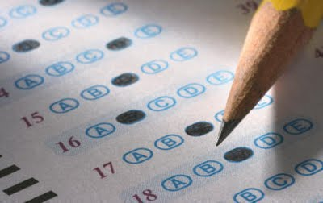
Day 4
Start up activity
Advance organizer
Guided Reading – Class Novel.
Give the Sentence Comprehension Subtest of the GRADE (or other assessment).
Moving from/back to whole class routine
Discuss expectations
Closing

Slide 41
Moving From and Back to Whole Class
Transition
Move from your desk to the appropriate work area designated by the teacher
When moving back to Whole Class, leave the work area and return to your desk quickly
Time
One minute
Appropriate Participation
Move directly to work area or desk
Ask teacher question or make appointment
Sharpen pencil
Get supplies
Immediately get to work
Inappropriate Behaviors
Staying at desk or work area
Talking
Going to the wrong location
Not getting to work immediately

Slide 42
Three Major Components of Xpect to Achieve
Set clear expectations
Build a strong learning community.
Provide positive feedback.

Slide 43
Day 5
Start up activity
Advance organizer
Introduce the concept of “Learning Community” with a Talking Together Lesson
Introduce the concept of “Respect.”
Guided Reading – Class Novel
RESPECT

Slide 45
Day 6
Start up activity
Advance organizer
Begin pretests with the GRADE vocabulary subtest (or other assessment).
Introduce the concept of “tolerance” with a Talking Together lesson.

Slide 46
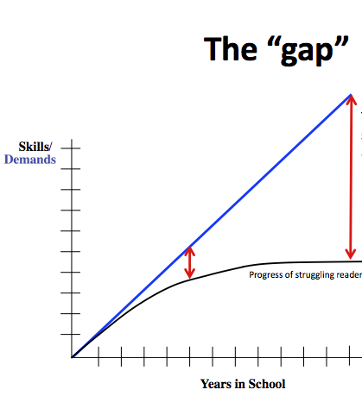
Day 7
Start up activity
Discuss “closing the gap”
Introduce lexile levels.
Administer the pretests for Word Mapping and Word Identification

Slide 47
The “gap”
Lexile levels for current
grade level materials.
Skills
/
Demands
Students’ current lexile levels
of reading performance.
Progress of struggling readers
Years in School

Slide 48
Lexile Reading Levels
What are Lexile Reading Levels
Lexile scores match reader ability and text difficulty, allowing individualized monitoring of student progress.
How does it work?
Lexile measures are based on two well-established predictors of how difficult a text is to comprehend: semantic difficulty (word frequency) and syntactic complexity (sentence length).
Lexile Score Table from www.lexile.com:
Age | School Year | Typical Lexile Level
7 8 9 10 11 12 13 14 15 16 | 3 4 5 6 7 8 9 10 11 12 | 300- 800 400- 900 500-1000 600-1100 700-1200 800-1300 900-1400 1000-1700 1100-1700 1200-1700

Slide 49
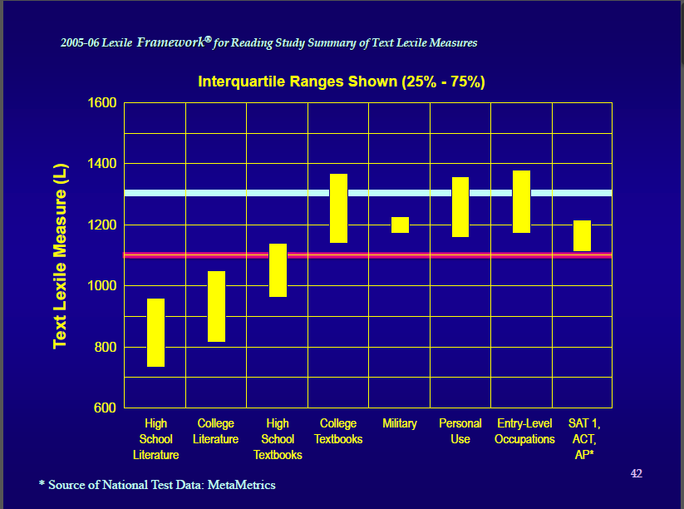

Slide 50
PRETESTS
Pages 43 - 50

Slide 51
Day 8
Start up activity
Administer the reading comprehension subtest of GRADE (or other assessment).
Review the concept of learning community.
Teach Lesson 6 in Talking Together.

Slide 52
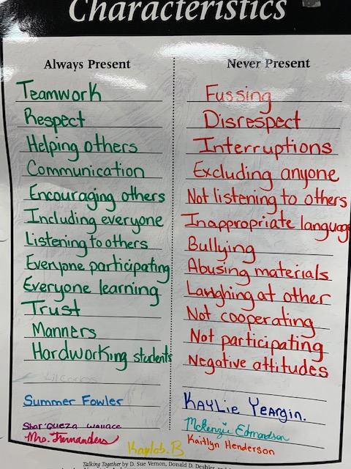
Characteristics of a Learning Community.
The classroom characteristics are defined by listing characteristics Never Present and characteristics Always Present.

Slide 53
Three Major Components of Xpect to Achieve
Set clear expectations
Build a strong learning community.
Provide positive feedback.

Slide 54
Positive Feedback is woven into every lesson.

Slide 55
Xpect to ACHIEVE sets up your class for

Slide 56
Independent Work
Go to the following link:
http://tinyurl.com/WM-Video-Series
Open the first folder titled: Part I – Introduction
Download the handout.
Watch the video titled: Word Mapping Series Part I – Introduction
Open the second and third folders (Morphemes and MAPS).
Download the handouts.
We will watch the videos in the second and third folders
tomorrow.

