Slide 1
WORD MAPPING
Authors: Monica L. Harris, Jean B. Schumaker, and Donald D. Deshler
Presentation Compiled by Bonnie Palasak
Revised July 2020

Slide 2
WORD MAPPING

Slide 3
Course Organizer

Slide 4
Teacher:
The
Course Organizer
Student:
Time:
Course Dates:
This Course: Xtreme Reading
Grading Procedures
is
about
building the knowledge, strategies, and habits of learning that will make you a great reader and help you reach important goals.
Start-Up Activities
Participation & Discussion
Classroom Skills
Assignments
Book Study
Tests & Quizzes
Course Questions:
1. How does thinking about your dreams and possibilities for your life change the way you approach learning?
2. Why do good learners know and use several different reading strategies?
3. How can learning new words and spending lots of time reading improve the knowledge that you have?
4. Why is reading fluently important?
5. Why is developing good habits of learning important?
6. How does improving your reading help you reach your goals and dreams?

Slide 5
Course Map
This Course:
Xtreme Reading
Student:
includes
Classroom
Expectations
Learning Routines
Tasks/Activities
Teamwork
Respect
Tolerance
Voice
Choice
Hard work
Discussions
Products
Quizzes
Classroom procedures Guided practice
Daily agenda Partner practice
Start-up activities Feedback sessions
Group participation Progress charting
Critical Concepts
Hopes and Dreams
Reading Strategies
Habits of Learning
Expert Reading
Learning
Community
Reading
Strategies
Learned in these
Units
Hopes
and Dreams
through
through
Highly Engaging
Literature
Highly Engaging
Literature
through
Highly Engaging Literature

Slide 6
Day 1

Slide 7
Start-Up Activity Day 1
In your journal, make a list of the classes you have that require you to know the meaning of words.
Notes:
Day 1 Word Mapping Strategy

Slide 9
Notes:
Unit Organizer student manual page 2

Slide 10
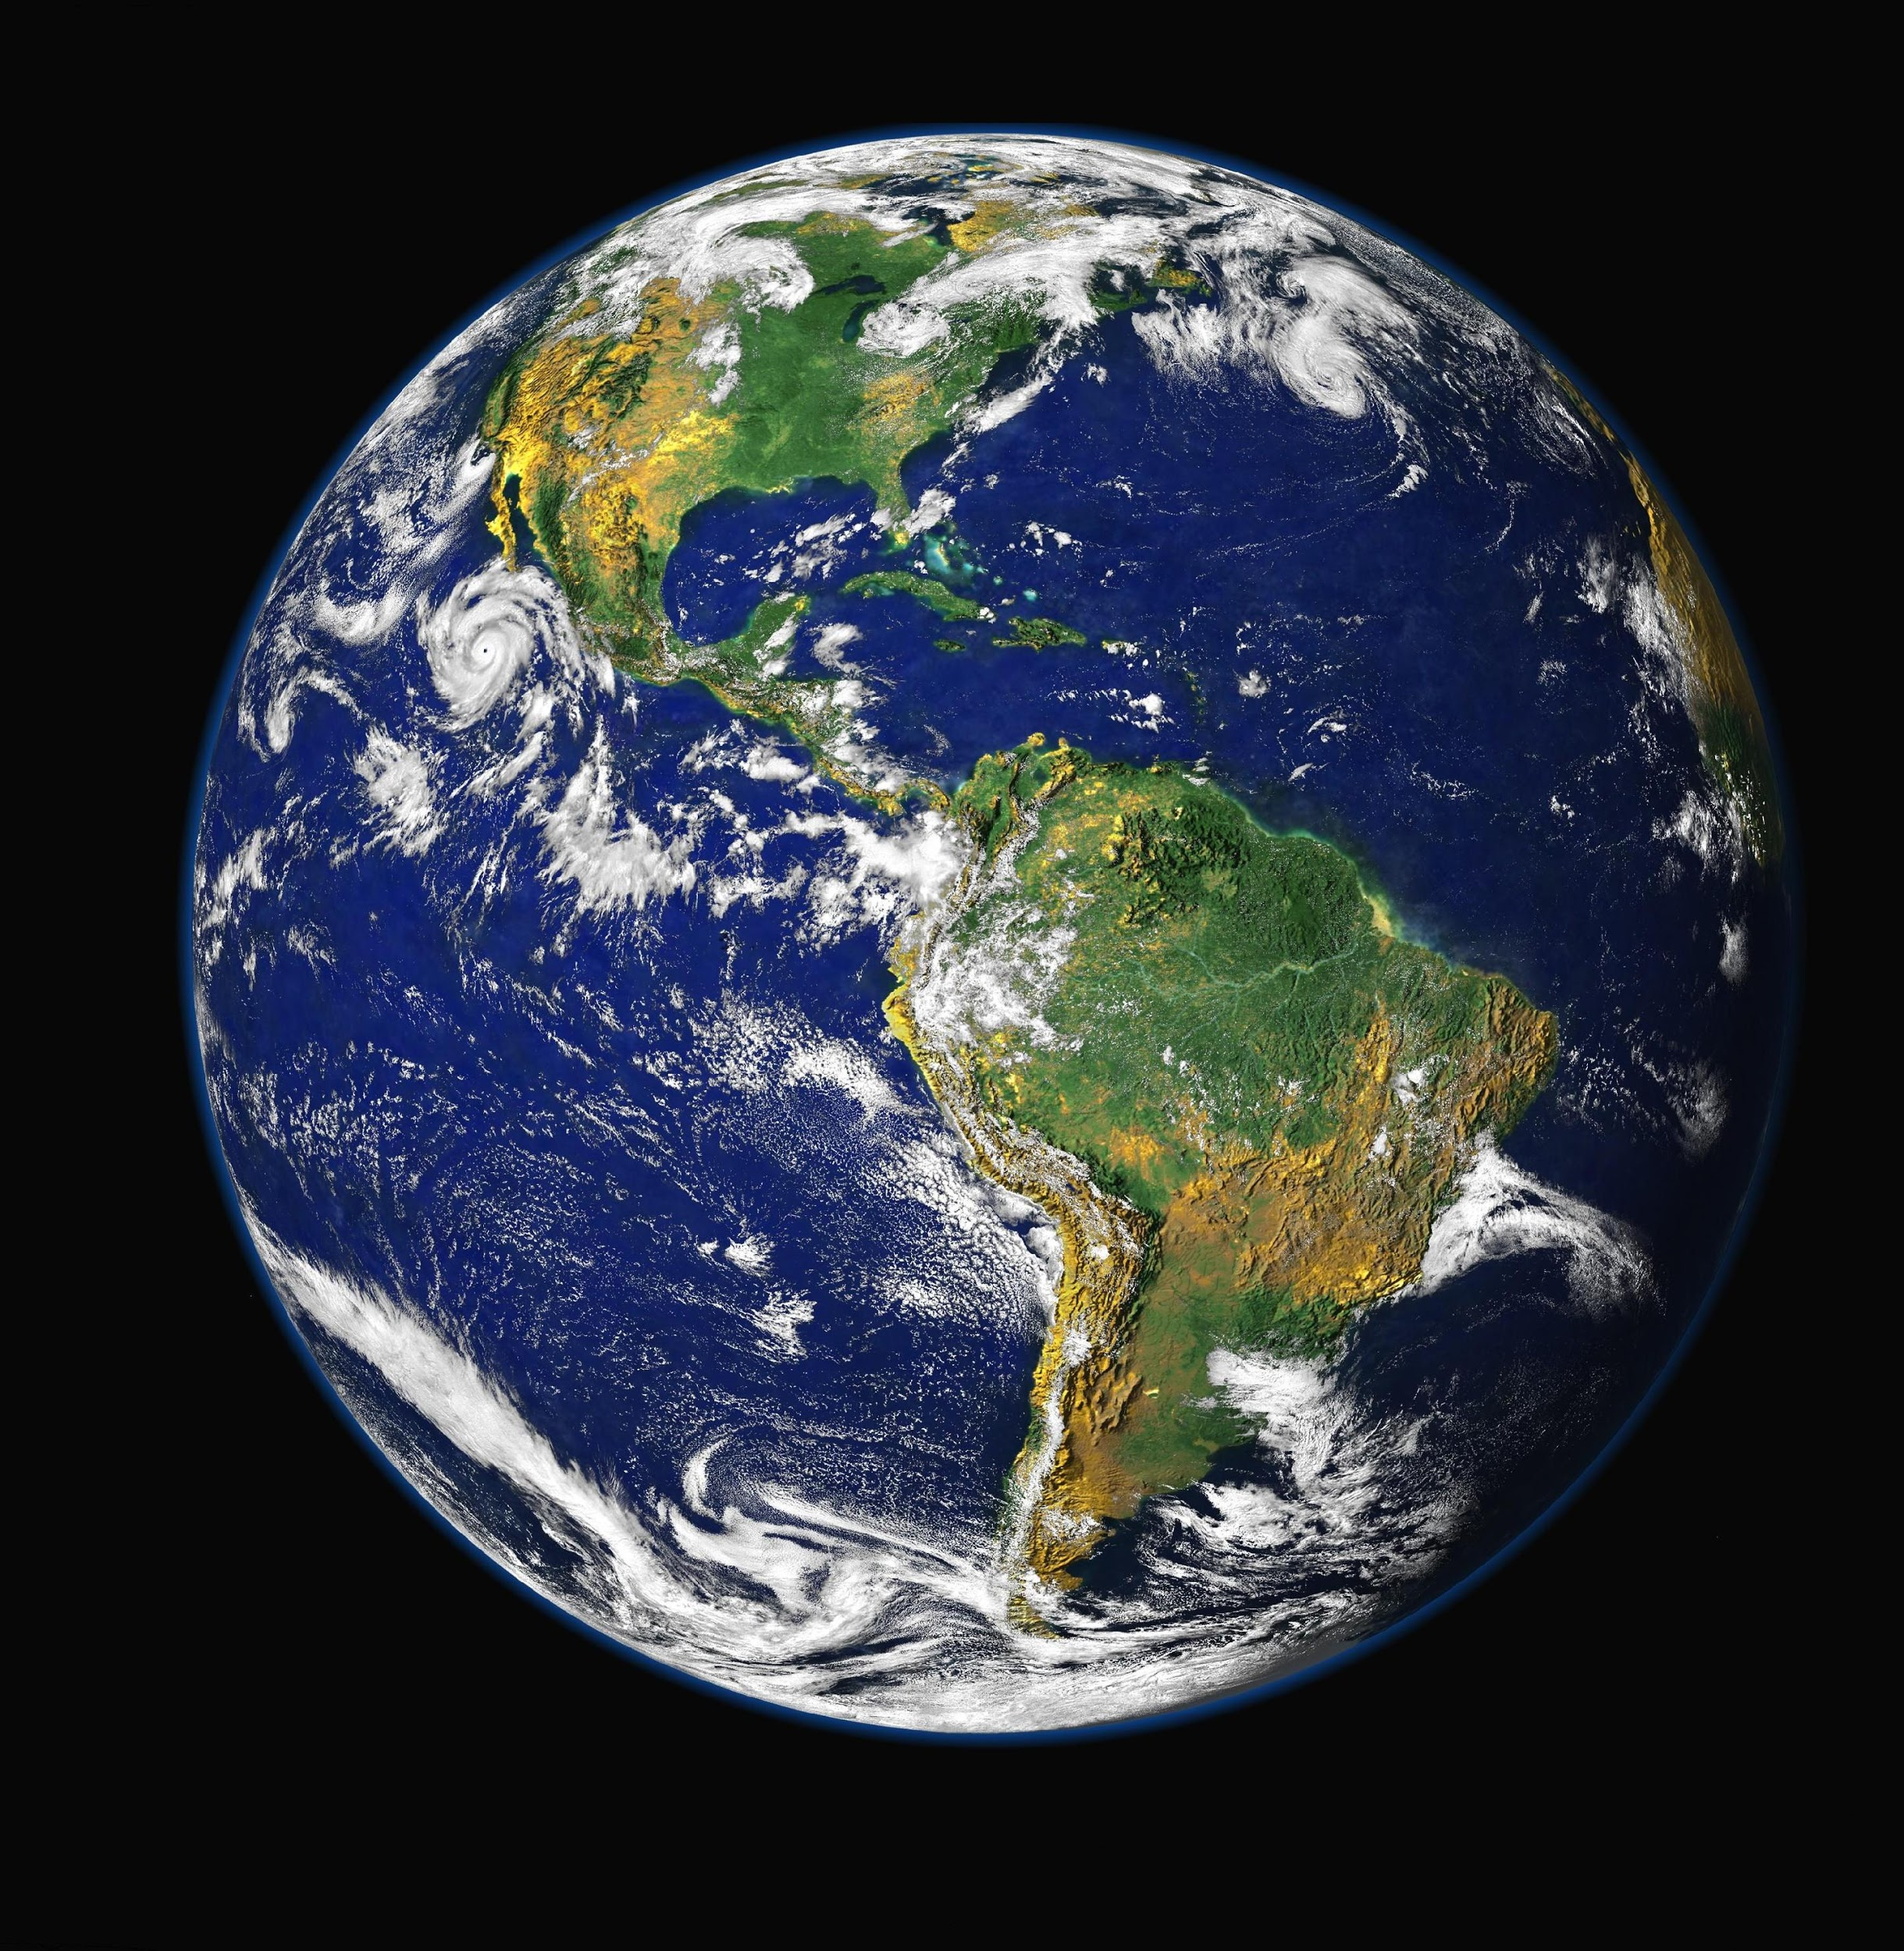
Our world is filled with words!

Slide 11
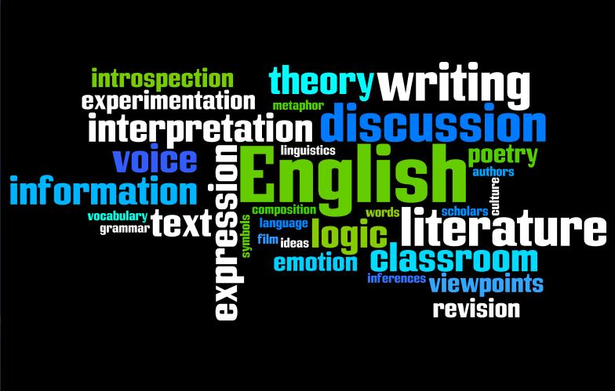
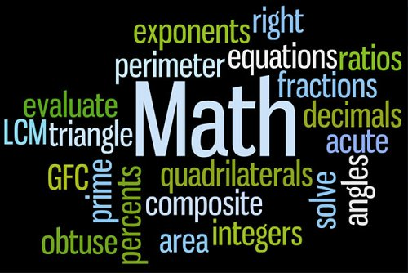
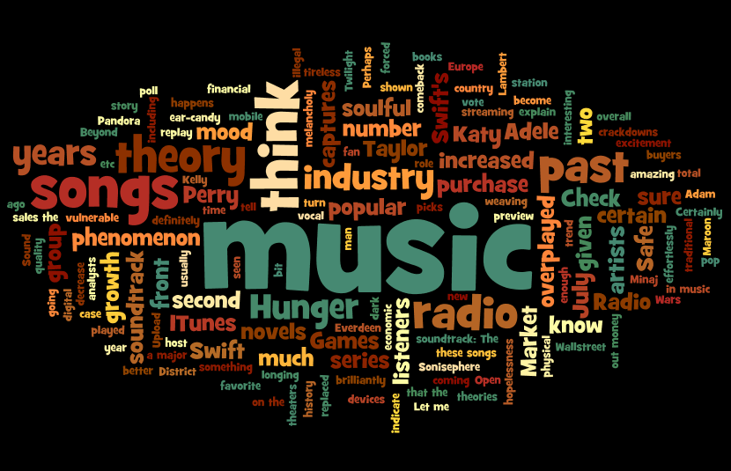
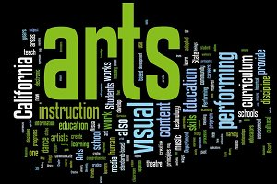
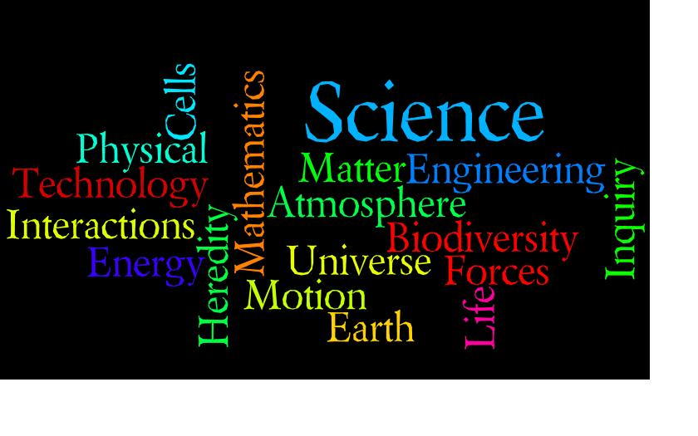

Slide 12
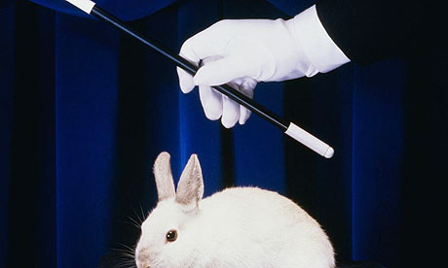
Figuring out words
isn’t
MAGIC!

Slide 13
The
WORD MAPPING STRATEGY
will help us
UNDERSTAND
Notes:
See next slide

Slide 14
Expectations for Class Today
Pay attention
Take notes
Participate in the discussion
Concentrate
Work carefully
Notes:
Lesson 1 Word Mapping Manual pages 14-27 Prefixes

Slide 15
Word Mapping Notes Sheet
#1
Notes:
Student Notebook Pg. 4 Answer Key WM manual pg. 188
Teacher Script pages 14-20

Slide 16
Let’s start by looking at parts of words

Slide 17
Word Parts
You need to learn a little about how words are built.
Just like a desk or a computer has parts, words have parts too.
These parts are made up of a combination of sounds.
Some of these parts have a special meaning.
Once you know the meaning of several word parts, you can start to figure out what the words mean.

Slide 18
Words are made of word parts called morphemes.

Slide 19
“un-” is a morpheme that we see in a lot of words.
Unable
Unafraid
Unreal
Uncluttered
Unexpected
Unbuttoned
The morpheme “un-” means not.

Slide 20
The morpheme ‘un-’ means ‘not’.
The morpheme ‘book’ means something that you read that has many pages.
Remember, a whole word can be a morpheme or just part of a word.

Slide 21
Morphemes are different from syllables.
Syllables are
word parts centered on a vowel sound that have no meaning.

Slide 22
Morphemes vs. Syllables
Let’s look at the word “Unladylike”
Syllables
un- la- dy- like
Morphemes
un lady like
4 syllables
3 morphemes

Slide 23
unamicable
un- amic -able

Slide 24
Prefixes
Are placed at the
beginning of a word.

Slide 25
Roots
Can be at the beginning, middle or end of a word.
Roots can be the entire word.

Slide 26
Suffixes
Are placed at the
end of a word.

Slide 27
If you know the meaning of all the parts, you can usually figure out what a word means.
Unfortunately, all words don’t have these parts, so sometimes we just have to learn the meaning of certain words because we won’t be able to figure them out.

Slide 28
The Word Mapping Strategy
Is the name of the strategy
that will help us
learn all about
prefixes, suffixes and roots.

Slide 29
Let’s start with prefixes …
The prefix
“re”
Means
back
or
again.
Prefixes are at the beginning of a word and change the meaning of the word.

Slide 30
Prefix Definitions List
Several prefixes are used over and over in the English language.
If you can pronounce these common prefixes, you will be better able to pronounce the words you encounter in your reading, and you will be able to figure out their meaning.
Let’s look at a list of some common prefixes on your prefix list.
Notes:
Student Notebook pages 5 &6 Word Mapping manual page s122-123 make copies for students on colored paper if available . They can be placed in plastic sleeves.

Slide 31
This list contains many of the common prefixes you will encounter, a definition for the prefix, and at least one word that starts with each prefix.
For example, one prefix on the list is ‘re-’. One word that starts with ’re-’ is ‘revise’. You can use this list as a handy reference guide as you learn to pronounce and identify prefixes.

Slide 32
What’s the definition for ‘re-’?
Right, it means again or back. The root of the word ‘revise’ is ‘vis’ which means ‘see’.
‘Revise’ means to ‘resee’ something or ’see something again’. You can revise something you have written by looking it over and finding the errors.

Slide 33
What other words do you know that start with ‘re-’ besides revise?
As you can see, a lot of words start with the prefix ’re-’. The same is true for the other prefixes on the list.
If you can pronounce and know the meaning of all these prefixes, you are one step closer to being able to read and understand the meaning of most words that you will encounter.
Let’s talk about a few more of the prefixes on the list.

Slide 34
Prefixes within prefixes
There is something else you need to know about prefixes.
Some prefixes are included in other prefixes.
For example, the prefix ‘de-’ is included in the prefix ‘dem-’. That means you have to be very careful when you see a word starting with ‘de-’. Before you isolate ‘de-’ from the rest of the word, you must make sure that it is not followed by an ‘m’. If an ‘m’ follows the ‘de’, the meaning will be different. Therefore, be sure to identify the biggest prefix you can.
What are some other prefixes on this list that are contained in other prefixes?

Slide 35
Be Careful.
Watch for Tricksters!
Tricksters
are words that start with the same letters as prefixes
but don’t really have prefixes.

Slide 36
Check out this word …
READ
It looks like it has the prefix “re” ………but does it?

Slide 37
Red
Return
Recycle
Real
Which words have a prefix and which are tricksters?
A prefix changes or adds to the meaning of the root. If you take the letters ‘re-’ off the words ‘Red’ and ‘Real’, nothing is left but a few letters.

Slide 38
Be careful when you look for the prefix of a word.
Always ask yourself whether the letters you think are a prefix are really part of the root.
We’ll be talking more about these tricksters throughout the year.

Slide 39
Compound Prefixes include 2 or more prefixes.
These words have compound prefixes:
dis•con•nect
dis•com•fort

Slide 40
When you are looking for the prefix of a word, you also need to be sure to check that there aren’t two prefixes at the beginning of the word.
Unrelenting

Slide 41
Guided Practice
Isolate the Prefix Worksheet #1
Notes:
Student Notebook Pg. 7 Answer Key WMS Manual pg. 190 Prefix Definitions List WPS manual pages 122-123

Slide 42
Let’s Practice
How do you say that?

Slide 43
Independent Practice
Isolate the Prefix Worksheet #2
Notes:
Student Notebook Pg. 8 Answer Key WMS Manual pg. 190 Prefix Definitions List WPS manual pages 122-123

Slide 44
Independent Practice
You need to determine whether there is a prefix on each word, and you must isolate the prefix using a backwards ‘L’.
Watch out, because some words on the worksheet do not have prefixes. You may use your Prefix Definitions List for reference.
80% correct is mastery

Slide 45
Today, you learned about three types of word parts or morphemes: prefixes, roots, and suffixes.
Next, you will learn about suffixes.
After that, you will learn about roots.

Slide 46
Day 2

Slide 47
Start-Up Activity
Use your prefix list, and separate as many prefixes in Worksheet # 3 as possible.
The worksheet is in your notebook.
Notes:
Student Notebook Pg. 9 Answer Key WMS Manual pg. 190 Prefix Definitions List WPS manual pages 122-123

Slide 48
In order to be able to use the Word mapping Strategy, you must be able to recognize prefixes, suffixes, and roots.
You have learned about prefixes, word parts with meaning that are located at the beginning of words.

Slide 49
Today we will begin a short unit on suffixes, word parts with meaning that are located at the end of words. You will see several examples of suffixes, and you will practice separating suffixes from the rest of the word and pronouncing them.

Slide 50
Expectations for Class Today
Pay attention
Take notes
Participate in the discussion
Concentrate
Work carefully

Slide 51
#2
Word Mapping Notes Sheet
Notes:
Student Notebook Page 11 WMS Manual Answer Key pg.188

Slide 52
Suffixes
Are morphemes that are at the
end of a word.

Slide 53
Suffix Definitions List
This Suffix Definitions List gives us many of the common suffixes that you will be encountering. If you can pronounce these suffixes and know their meaning, you will be better able to read and understand most of the words you encounter.
What’s the first suffix on the list?
Notes:
Suffix Definition List make copies for students WMS manual pgs. 129,130

Slide 54
A word that has the suffix “-able” is
Loveable

Slide 55
One word that ends with ‘-able’ is loveable. Since the list tells us that ‘-able’ means ‘that can be’, ‘loveable’ means ‘something that can be loved’.
What other words end with ‘-able’?
Read and discuss a few other suffixes on the list.

Slide 56
There
are
Types
Of
suffixes
Inflectional
Derivational

Slide 57
Inflectional suffixes are morphemes that change:
Number
Point of view
Tense
OR show
Possession (ownership) or comparison

Slide 58
Inflectional Suffixes Table
This list shows the most common inflectional suffixes in the left-hand column.

Slide 59
The suffix “s” means more than one.
Book Books
Teacher Teachers
Banana Bananas
Police Car Police cars

Slide 60
Inflectional suffixes do not change the meaning of the word.
Book Books
Teacher Teachers
Banana Bananas
Police Car Police cars

Slide 61
Derivational suffixes create a different form of a word, so the meaning of the word is changed.
Teach Teacher
Diction Dictionary
Victor Victory

Slide 62
Some derivational suffixes change the part of speech of the word.
For example, with the addition of the suffix ‘-fy’, the noun ‘glory’ can be changed into the verb ‘glorify’.
With the addition of the suffix ‘ion’, the verb ‘invent’ can be changed into the noun ‘invention’.

Slide 63
Some derivational suffixes do not change the part of speech of the word.
For example, the suffix ‘-er’ can be added to the noun ‘port’ (which means a place where ships come into shore) into another noun ‘porter’ (which means a person carries people’s luggage when they arrive on a ship, plane, or train).
The meaning of the word can change, but the part of speech does not.

Slide 64
-er
-en
-ing
There
are
Suffixes
that are
both
Inflectional
and
derivational

Slide 65
Keep in mind that some suffixes do not change the meaning of the word, and some do.
Some suffixes do not change the part of speech of a word, and others do.
If you know what suffixes mean and what they do or don’t do, that will help you figure out the meaning of words.

Slide 66
Suffix Guidelines
There are several guidelines you need to keep in mind as you add suffixes to words.
These guidelines are not ‘hard and fast’ rules. That is, they are not always used; they are sometimes used, but knowing about them might help you as you are guessing the meaning of a word.

Slide 67
Adding suffixes to words that end in “y”
If the letter before a final y is a vowel, the y doesn’t change when you add a suffix.
(Example: Play Playing)
If the letter before a final y is a consonant, the y changes to an i before you add the suffix.
(Example: Carry Carried)
EXCEPT when the suffix begins with an i.
(Example: Carry Carrying)

Slide 68
When adding suffixes to words that end in a single consonant with a single vowel in front of it …
Double the consonant if the suffix begins with a vowel.
(Example: Fit Fitting)
Don’t double the consonant if the suffix begins with a consonant.
(Example: Fit Fitness)

Slide 69
Another word that fits the consonant doubling guideline” is:
Run

Slide 70
Compound suffixes include more than one suffix at the end of the word.
Helplessness
Endlessly
Loveliness
Professionalism
Respectability

Slide 71
When you are looking for the suffix of a word, you need to determine whether there’s more than one suffix in a word, and separate them both from the rest of the word like this.
helplessness

Slide 72
Guided Practice
Separate the Suffix Worksheet #1
Notes:
Student Notebook pg.15

Slide 73
Let’s Practice
Some words on the list have suffixes, others do not.
Taking turns, we will state if there is a suffix or not on a word and what the suffix is.
After a suffix has been named, separate the suffix on your worksheet with a pencil mark as shown in the example of the top of the worksheet.

Slide 74
Independent Practice
You need to determine whether there is a suffix on each word, and you must separate the suffix using an ‘L’.
Watch out, because some words on the worksheet do not have suffixes. You may use your Suffix List for reference.
80% correct is mastery

Slide 75
Knowing how to pronounce the suffixes is very important.
We will be practicing how to pronounce them today. I will say some of the suffixes for you; then you will say them to me.
Listen carefully as I say the suffixes so you will be able to pronounce them in the same way.

Slide 76
Today, you learned about suffixes.
Next, you will learn about roots. After that, you will learn about the steps of the Word Mapping Strategy.

Slide 77
DAY 3

Slide 78
Start-Up Activity
Use your suffix list, and complete the Separate the Suffix Worksheet #2.
Do as many as you can in five minutes.
Notes:
Student Notebook pg. 16

Slide 79
Let’s
The 3 types of Morphemes

Slide 80
What is:
Definition for “morpheme:
Three types of morphemes
Definition for prefix and suffix
Definition for compound prefix and compound suffix
Example prefixes
Example suffixes
Example words with prefixes
Example words with suffixes

Slide 81
Expectations for Class Today
Pay attention
Take notes
Participate in the discussion
Concentrate
Work carefully

Slide 82
You’ve learned about two of the types of morphemes: prefixes and suffixes.
You’ve learned how to identify and pronounce them.
Today you will earn about roots, which will be the third piece of the puzzle that you need to have in order to use the Word Mapping Strategy.

Slide 83
#3
Word Mapping Notes Sheet
Notes:
Student Notebook page 19

Slide 84
Prefixes
Roots
Suffixes

Slide 85
Root
Is a word part with
meaning.

Slide 86
Roots can be located at the beginning, middle, or end of a word. A root can stand alone as the whole word.
SCOPE
Scoped Microscopic Telescope

Slide 87
(Hint: Look for the root. Each root gives a word it’s main meaning.)

Slide 88
Roots Definition List
Here is a list of roots, their definitions, and words in which they appear.
Let’s look at the root ‘aster’.
Notes:
WMS manual Pg. 137, 138 Make copies for students (colored paper is recommended)

Slide 89
“Aster” means “star”
At the beginning of a word: Asterisk
What is an asterisk?
In the middle of a word: Disastrous
‘Aster’ has been changed into ‘astro’. What’s the prefix?
At the end of a word: Disaster
A whole word: Aster
The word ‘aster’ is a type of flower.

Slide 90
Why do you think the people who named this flower named it ‘aster’?
It looks like a star. The petals radiate out like a star. Sometimes the connection between a root and its meaning is direct like this, as well as the case of ‘asterisk’ or ‘asteroid’.
Words were created originally in the Greek and Latin Language based on the meaning of the root.

Slide 91
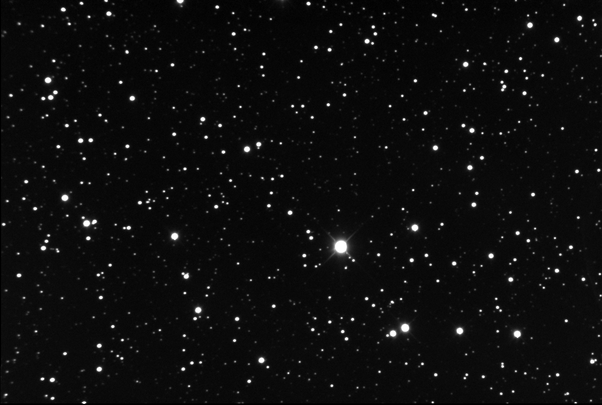
For example: Root words “Aster” or “astro” means star.
Asteroid
Astronaut
Astrosphere
Astronomy
Asterisk

Slide 92
One morpheme can have several meanings.
“Arch” can mean chief, most important or rule.
Examples:
Archbishop, Archenemy, Matriarch

Slide 93
Different morphemes can have the same meaning but different forms. (Example: “micro” and “min” both mean small.)
Different morphemes can have the
same meaning but similar forms.
(Example: “aster” and “astro” both mean space.)

Slide 94
Identifying Morphemes Sheet
#1
Notes:
Student notebook page 23

Slide 95
Let’s Practice
On this worksheet are words that have prefixes, suffixes, and roots. Be careful, though. Some of the words only have a prefix and a root. Some words only have a root and a suffix, some just have a root, and some have two roots.
Look for the prefix first, then the suffix, then the root.
Use a backwards ‘L’ to isolate the prefix and an ‘L’ to separate the suffix, and underline the root.
Let’s do the first word together.

Slide 96
Work with your table to identify the word parts in the rest of the words on this worksheet.
You may use your Prefix, Suffix, and Roots Definitions Lists, if you need assistance.
Remember, a small word like ‘planet’ that can stand alone is a root word.

Slide 97
I’ll collect and score your papers later.
You must score at least an 80% to reach mastery.
Today, you learned about roots.
The next time we meet, you will learn how to predict the meaning of words using prefixes, suffixes, and roots.

Slide 98
DAY 4

Slide 99
Start-Up Activity
On the Identifyinig Morphemes Worksheet #2, isolate the prefixes, separate the suffixes, and underline the roots in as many words as you can in 5 minutes.

Slide 100
Keep your prefix, roots, and suffix lists on your desk.
Get out the following:
Word Mapping Notes Sheet #4
Word Maps (only one sheet)
Memory Table
Notes:
Notes Sheet Student notebook page 27, Word Maps student notebook page 28 memory table student notebook page 29

Slide 101
#4
Word Mapping Notes Sheet
Notes:
Student Notebook page 27

Slide 102
Let’s
The 3 types of Morphemes

Slide 103
Prefixes
Roots
Suffixes

Slide 104
Word Mapping Strategy
Map the word parts
Attack the meaning of each part
Predict the word’s meaning
See if you’re right!

Slide 105
“Map the word parts” means that you find the word’s prefixes, suffixes, and roots.

Slide 106
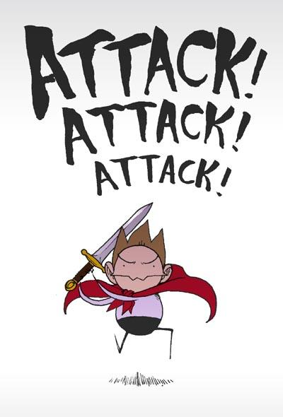
“Attack the meaning” means that you translate each word part into its meaning.

Slide 107
“Predict the word’s meaning” means that you put the three meanings together and make your best guess.

Slide 108
“See if you’re right” means that you check whether the definition fits in the context of the sentence.

Slide 109
The mnemonic device to remember the steps is:
M
A
P
S

Slide 110
Word Mapping Strategy
Map the word parts
Attack the meaning of each part
Predict the word’s meaning
See if you’re right!

Slide 111
You use a Word Map anytime you want to figure out a word’s meaning.
Word
Prefix
Root
Suffix
M Step
A Step
P Step
See if you’re right!
Meaning
Meaning
Meaning
Prediction
Definition
Notes:
Student notebook page 28

Slide 112
Day 5

Slide 113
Start-Up Activity
In your journal, isolate the prefix ad separate the suffix for the following words:
unthinkable
explosion
disappointment
investigating
Notes:
Us

Slide 114
Word Mapping Strategy
Map the word parts
Attack the meaning of each part
Predict the word’s meaning
See if you’re right!

Slide 115
Practice MAPS with a Partner
Map the word parts
Attack the meaning of each part
Predict the word’s meaning
See if you’re right!

Slide 116
Word Maps with a Partner
reloaded
uncomfortable
indescribable
unintentional
discovering
telepathy
Notes:
Use Word Maps pages 28 in Student Notebook (teacher make extra copies front/back…you can never have too many). This is a great activity to leave for a substitute.

Slide 117
QUIZ
WORD MAPPING STRATEGY QUIZ
Notes:
Students orally pronounce Prefixes, Suffixes and Roots. Mastery: 80% of morphemes pronounced correctly.

Slide 118
Day 6

Slide 119
Start-Up Activity
In your journal, isolate the prefix ad separate the suffix for the following words:
epidemic
community
nonintervention
malnutrition

Slide 120
BOOK STUDY
In the time we’ve spent together so far, we have become acquainted, you have learned something about the Xtreme Reading Course, and you have learned about some basic expectations associated with this course.
Notes:
Xpect to Achieve Binder: Book Study Section, Page 3

Slide 121
BOOK STUDY
Today, we will be talking about the Book Study activities that you will be completing.
You will read seven books over the course of this school year and you will complete a book study for each one.
Notes:
Xpect to Achieve Binder: Book Study Section, Page 3

Slide 122
BOOK STUDY
How many words will students read in a year if they read 5 minutes a day?
21, 000 words in a year
Notes:
Xpect to Achieve Binder: Book Study Section, Instructions on Page 3 and Handout Pages 13 & 14

Slide 123
BOOK STUDY
How many words will students read in a year if they read 10 minutes a day?
622,000 words in a year
Notes:
Xpect to Achieve Binder: Book Study Section, Instructions on Page 3 and Handout Pages 15 & 16

Slide 124
BOOK STUDY
How many words will students read in a year if they read 15 minutes a day?
1,146,000 words in a year
Notes:
Xpect to Achieve Binder: Book Study Section, Instructions on Page 3 and Handout Pages 17 & 18

Slide 125
BOOK STUDY
Why do you think that the number of words increases so fast when we are just adding 5 minutes of reading per day?
Notes:
Xpect to Achieve Binder: Book Study Section, Instructions on Page 3

Slide 126
BOOK STUDY
What happens is that each time you read, you get better at reading.
You learn new words, and you read a little bit faster.
Notes:
Xpect to Achieve Binder: Book Study Section, Instructions on Pages 3 & 4

Slide 127
BOOK STUDY
The more reading you do, the better reader you will become.
As a result, you read more and more words in short periods of time.
Notes:
Xpect to Achieve Binder: Book Study Section, Instructions on Pages 3 and 4

Slide 128
BOOK STUDY
Thus, the whole idea of having Book Study Activities is to make sure that you read something that is enjoyable for you to read each day so that you can become a better and better reader over the course of a year.
Notes:
Xpect to Achieve Binder: Book Study Section, Instructions on Page 4

Slide 129
BOOK STUDY
Classroom Library Procedures
Notes:
Book Study Section of Xpect to Achieve

Slide 130
BOOK STUDY
Book Preview
Notes:
Insert Bonnie’s Activities and book marks here and tell teachers its on flash drive.

Slide 131
BOOK STUDY
Book Study Activities

Slide 132
BOOK STUDY
Book Study Requirements
1st Quarter

Slide 133
BOOK STUDY
Book Study Log
Notes:
Self Awareness log sheets pages 39-42 in Xpect to Achieve

Slide 134
BOOK STUDY
Weekly Reading Record Sheet
Notes:
Teacher Notebook xpect to Achieve page 20

Slide 135
BOOK STUDY
Bookmarks
Notes:
Pages 21-22 Xpect to Achieve Teacher notebook

Slide 136
BOOK STUDY
Book Check-Out Time

Slide 137
Figuring out the puzzle of words will give you POWER

Slide 138
Is yours with the Word Mapping Strategy

