Slide 1
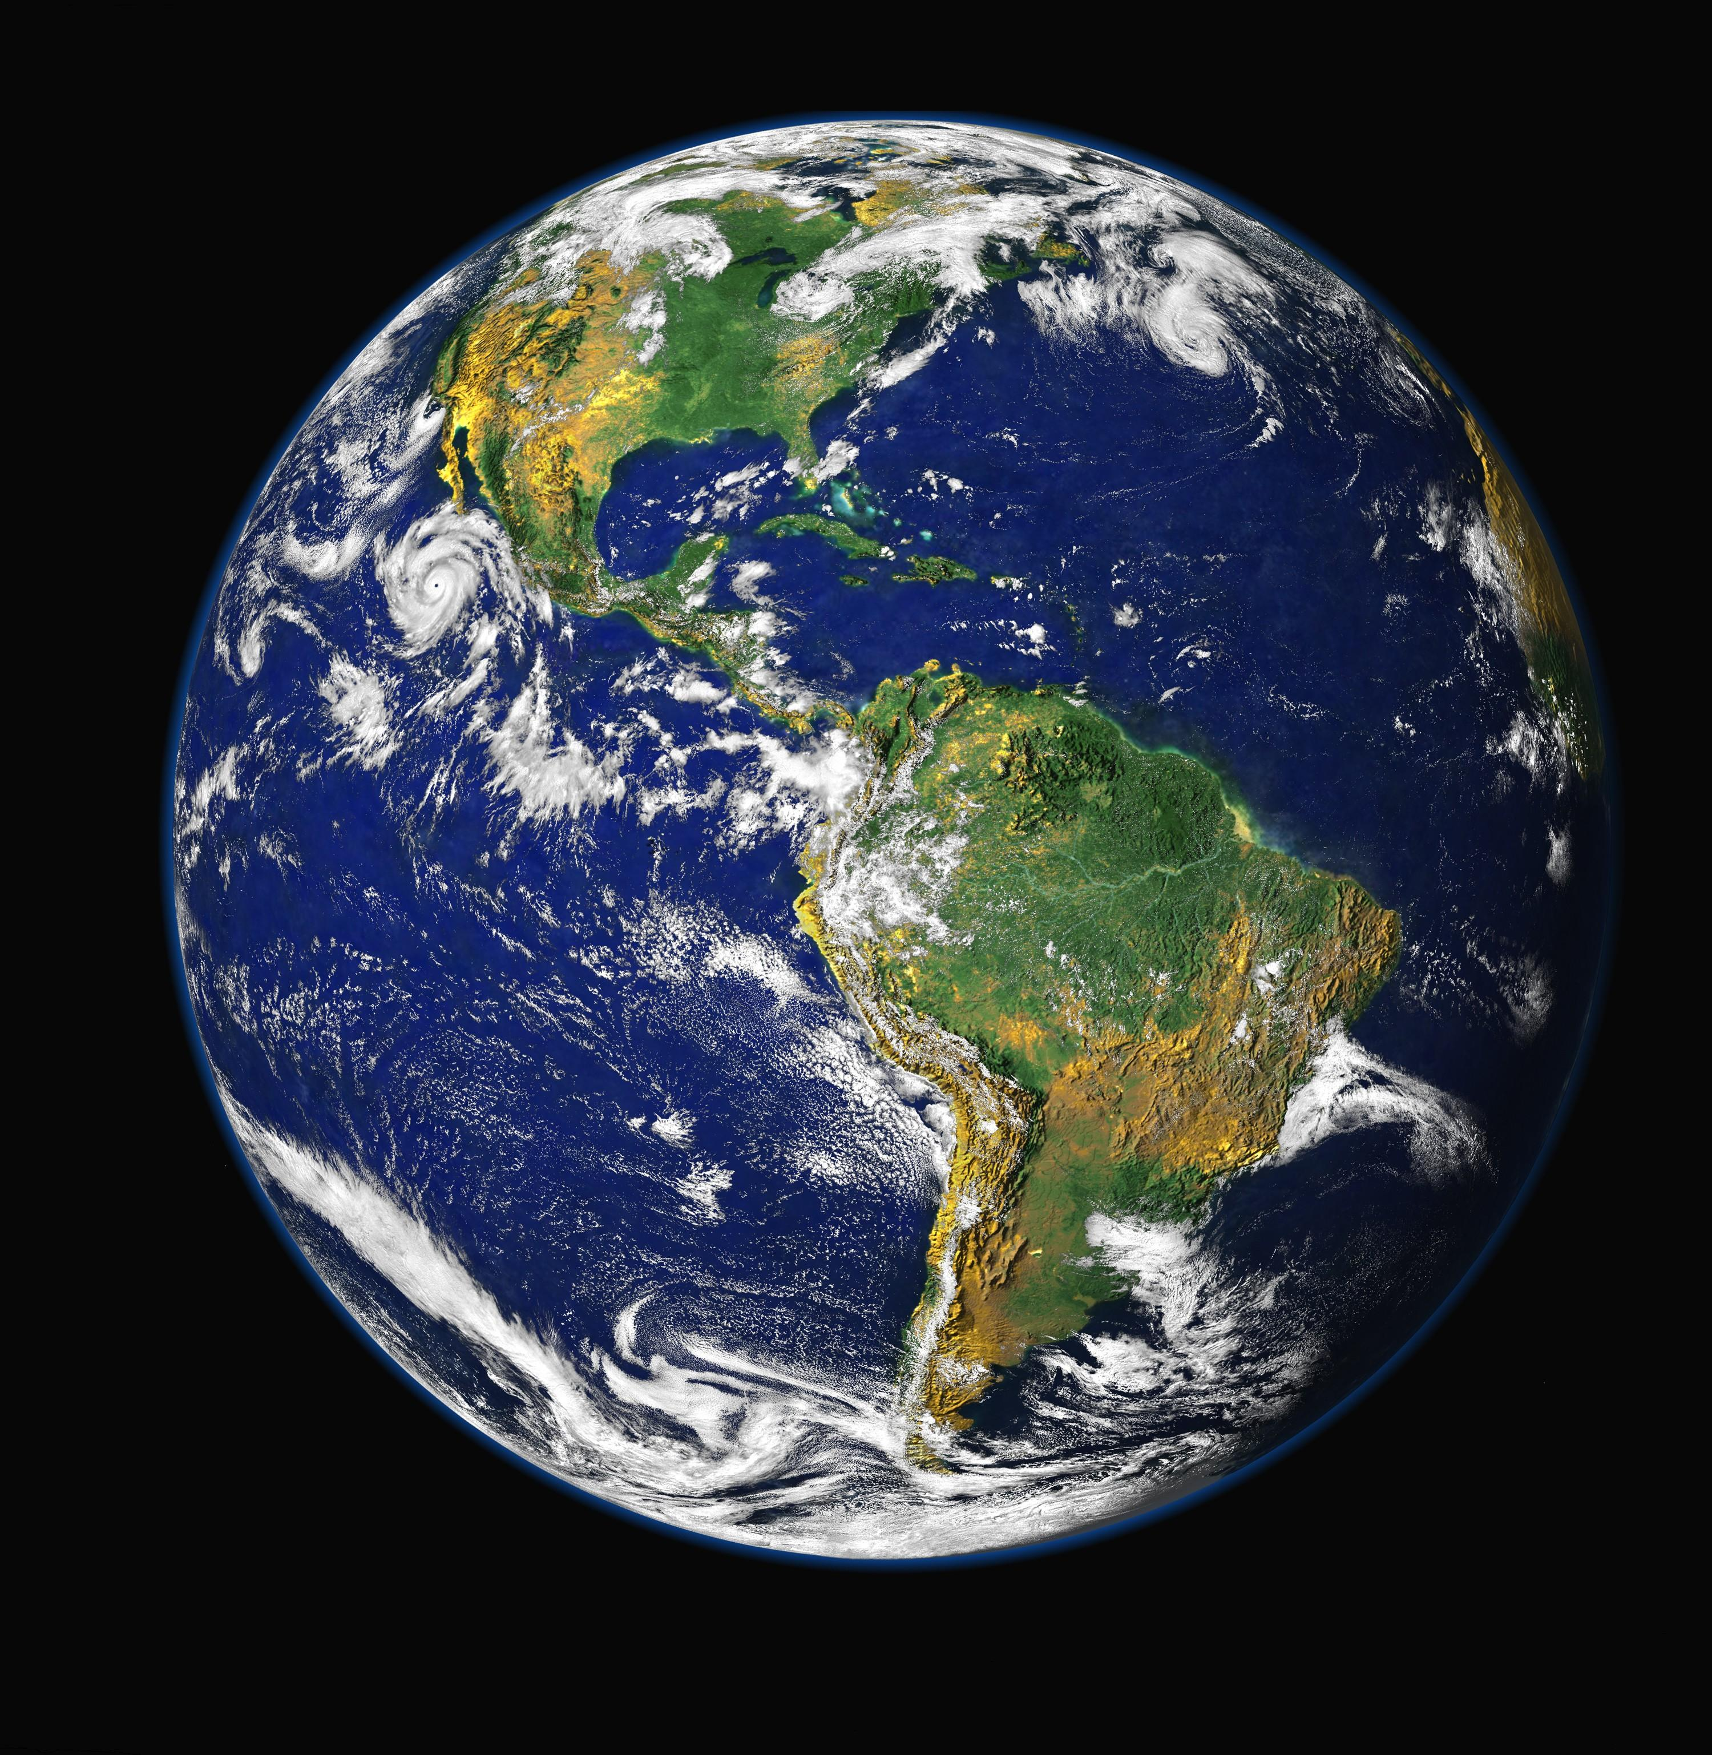
The world is filled with words!
Notes:
The world is filled with words. We see them everywhere!

Slide 2
Understanding words helps you understand what you read and what you are learning in your classes.
Notes:
Understanding new words will help you understand what you read and what you are learning in your classes.

Slide 3
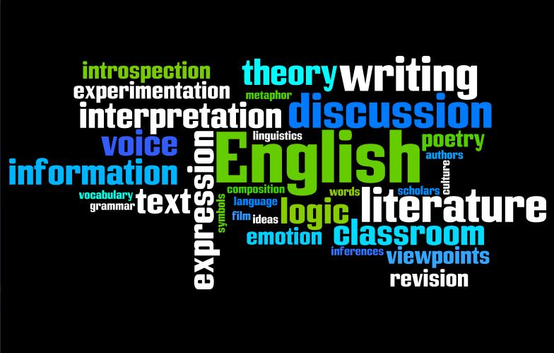
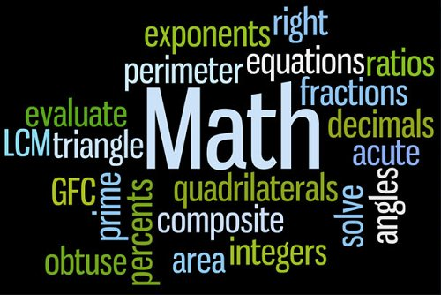
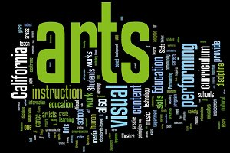
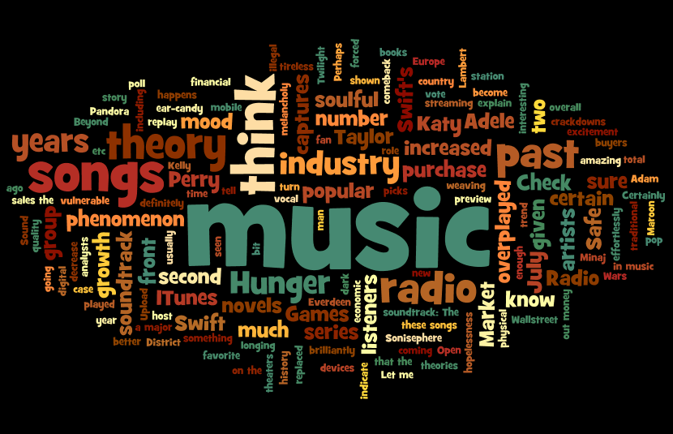
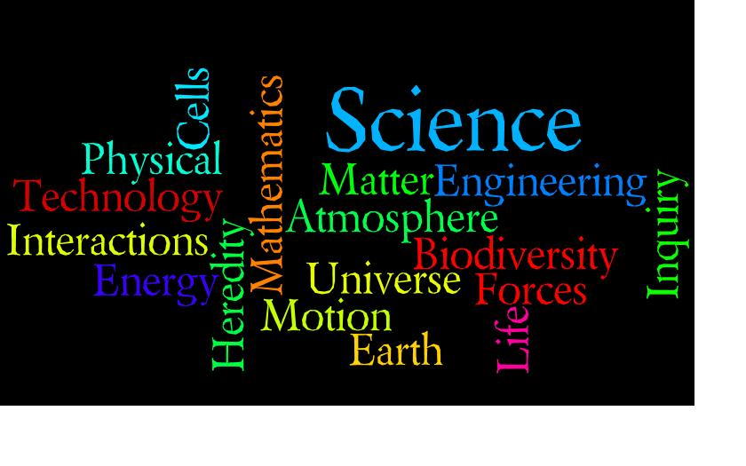
Notes:
All of your classes will introduce new words.

Slide 4
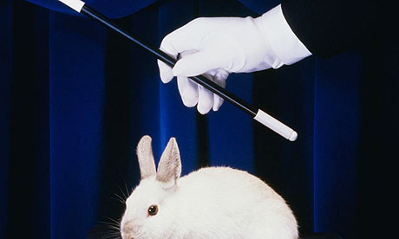
Figuring out words
isn’t
MAGIC!
Notes:
But figuring out new words isn’t magic.

Slide 5
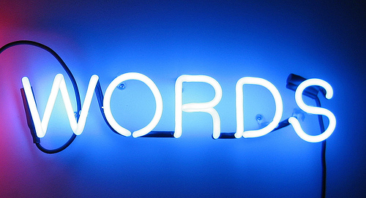
The
WORD MAPPING STRATEGY
will help you
UNDERSTAND New
Notes:
Using a strategy called the Word Mapping Strategy will help you understand new words.

Slide 6
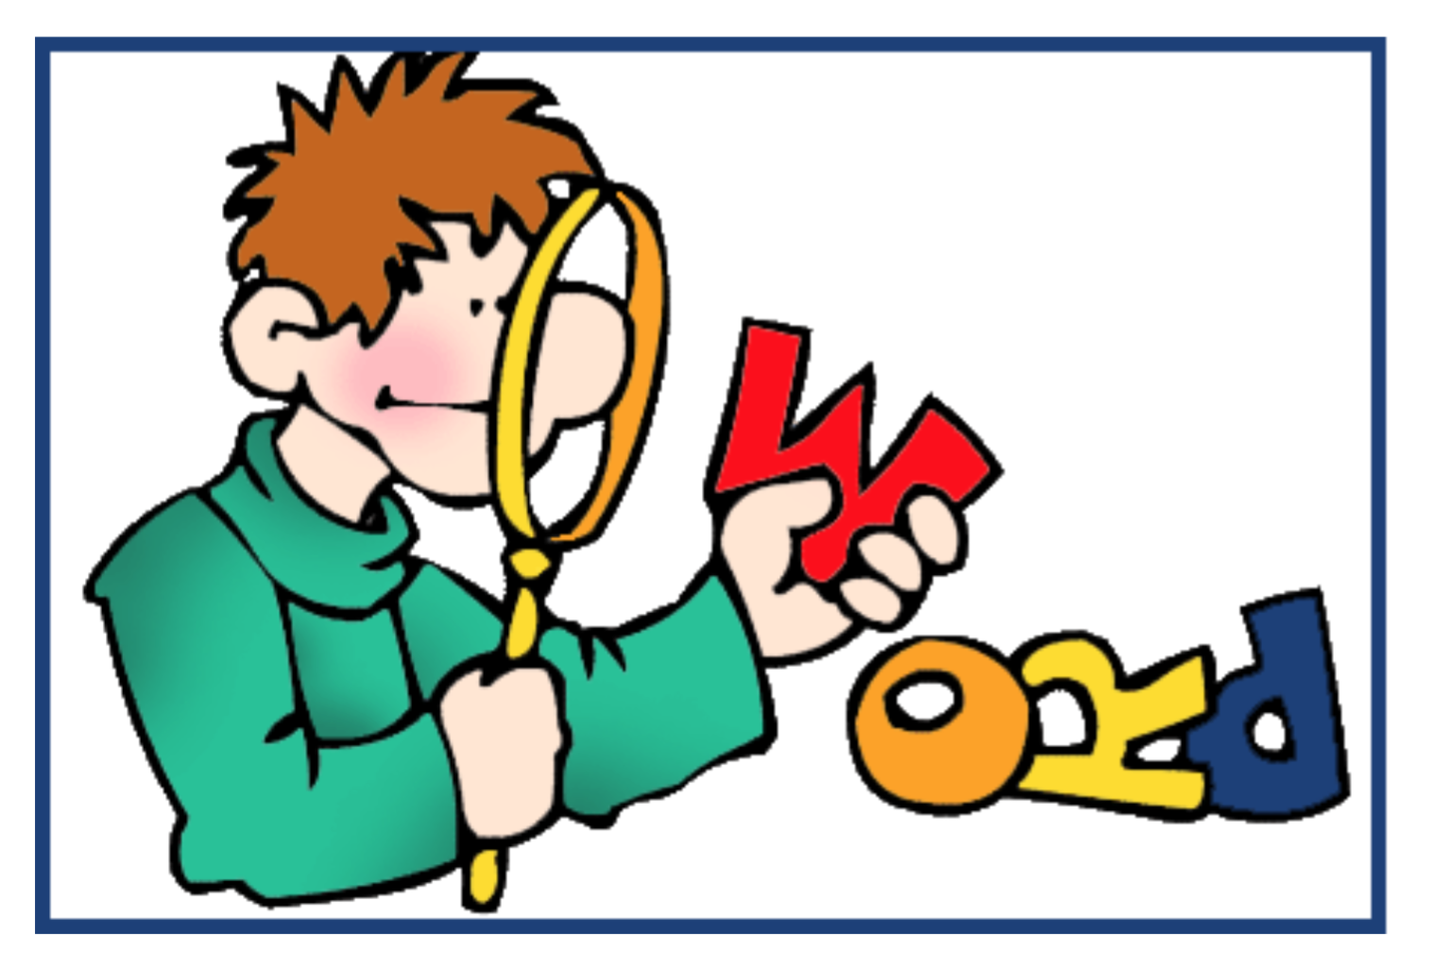
Let’s start by looking Prefixes.
Hint: As we go through this information , the words you see in red are words to add to your notes sheet for each lesson.
Notes:
So, let’s start at the beginning with lesson 1. (Click) First a hint to help you complete the notes sheets for the lessons. The words in red will help you fill out the blanks in your guided notes sheets.

Slide 7
Words are made of word parts called morphemes.
Morphemes
are word parts with meaning
Notes:
Words are made of word parts called morphemes. (Click) Morphemes are defined as word parts with meaning.

Slide 8
“un-” is a common morpheme; we see it in a lot of words.
Unable
Unafraid
Unreal
Uncluttered
Unexpected
Unbuttoned
The morpheme“un-” means not.
Notes:
“un “ is a common morpheme which is seen in a lot of words such as the ones that are listed here on the screen. If we stop to think about the morpheme un, we probably already know that “un” when it stands alone isn’t a word, but it does have meaning. (click) It means not, and, when added to a word, it changes the word’s meaning.

Slide 9
Morphemes are different from syllables.
Syllables are
word parts centered on a vowel sound that have no meaning.
Notes:
Morphemes are different from syllables. (click – click - click) Syllables are word parts also, but they are centered on a vowel sound that have no meaning. Syllables help us sound out or say the word.

Slide 10
Morphemes vs. Syllables
Let’s look at the word “Unladylike”
Syllables
un – la- dy - like
4 syllables
Morphemes
un – lady - like
3 morphemes
Notes:
Let’s consider the difference between morphemes and syllables. (click) Look at the word unladylike. (click) When you consider the number of syllables in the word, you find it has (click) 4 syllables Syllables help us pronounce a word.
But (click) when we look at the word parts with meaning in the word, or the morphemes, we see only (click) 3. Un is the first morpheme and it means not. Then we see lady, which has its own meaning. And next we see like which also has meaning. The word unladylike has 3 morphemes

Slide 11
There are three types of morphemes.
Prefixes
Beginning of a word
Roots
Beginning, middle or end of a word.
May be the entire word.
Suffixes
End of a word
unamicable
un- amic -able
Notes:
There are 3 types of morphemes. The three types are:
(click) Prefixes, which are at the beginning of a word
(click) Suffixes, which are at the end of a word
(click) Roots, which can be at the beginning, middle or end of a word. They can also be the entire word.
An example of a word that has all 3 types of morphemes is (click) unamicable.
(click) It has a prefix, which is un. We already know that un means not.
It also has the suffix a-b-l-e, which is pronounced “able” and means can do or can be done.
It has a root right in the middle of the word. The root is amic, and it means love or friend.
When you think about the meanings of all those morphemes put together, you come up with a meaning for the entire word.
You could guess that unamicable means not able to be loved, or not able to be a friend

Slide 12
Learning more about morphemes will help us later when we learn a strategy called
The Word Mapping Strategy
Notes:
Learning more about morphemes will help us later when we learn a strategy called (click) the Word Mapping Strategy. (click) It will help us look for the morphemes in words to figure out what new words mean.

Slide 13
Let’s start learning more about Prefixes
Prefixes are at the beginning of a word.
They change the meaning of the word.
Notes:
So let’s start by learning more about the first type of morpheme - prefixes. Remember (click) prefixes are at the beginning of a word and they change the meaning of the word.

Slide 14
Some common prefixes are “-re”, “-dis”, and “-un” Each one of these prefixes has meaning.
Re- means again or back
Dis- means not, apart or away
Un- Also means not
Notes:
Some common prefixes are re-, dis- and un- and each one of these prefixes has meaning.
(Click) Re means again or back. It actually has 2 different meanings.
(Click) Dis means not or apart or away. Notice that it has 3 different meanings.
(Click) Un, as we’ve already discussed, means not.
Some prefixes have more than one meaning, but some have only one.
As a personal challenge, let’s pause for a minute and see how many words you can think of that start with these prefixes. There’s a lot of them!!

Slide 15
Be Careful.
Watch for Tricksters!
Tricksters
are words that start with the same letters as prefixes
but don’t really have a prefix.
Notes:
But be careful and watch out for tricksters.
(click) Tricksters are words that start with the same letters as prefixes but don’t really have a prefix.
Can you think of one?

Slide 16
Check out this word …
READ
It looks like it has the prefix “re” ………but does it?
Notes:
Well, check out this word……..READ. It’s a familiar word.
(click) It looks like it has the prefix re-, but does it? No,it actually doesn’t. The word is read not re ad. In this case, r-e is not a prefix. It is part of the word, therefore, the word READ is a trickster.

Slide 17
Some words contain 2 prefixes. This is called a compound prefix.
These words have compound prefixes:
dis•con•nect
dis•com•fort
Notes:
Also watch out for some words that contain 2 prefixes. This is called a compound prefix.
(click) Both of these words have compound prefixes. If you look up prefixes on the prefix definitions list in the shared Google folder, you will find that dis, con, and com are all prefixes on the list.

Slide 18
When you practice looking for prefixes on your practice worksheets,
You will use a backwards “L” to mark the prefixes.
extracting
Notes:
When we practice looking for prefixes on our practice worksheets, (click) you will use a backwards “L” to mark the prefixes.
(click) For example, when looking for a prefix in the word extracting, we see it has the prefix ex. The backwards “L” (click) is used to identify that prefix. By the way, if you check the prefix definitions list, you will see that the prefix “ex” means take out. When it is added to the other word parts, “tract” which means pull and “ing” which means the act of, we can figure out that the word extracting means the act of pulling or taking out.

Slide 19
Lesson 2 provides a
On Suffixes
Notes:
Now let’s shift our focus to Lesson 2, which provides a crash course on the second type of morphemes – suffixes.

Slide 20
Suffixes
Are morphemes that are at the
end of a word.
Notes:
Suffixes are morphemes that are at the end of a word.

Slide 21
A word that has the suffix “-able” is
Loveable
The suffix “-able” means can do or can be done.
Notes:
A word that has the suffix –a-b-l-e pronounced “able” is loveable. The suffix “–able” means can do or can be done. Therefore loveable means can be loved.

Slide 22
There
are
Types
Of
suffixes
Inflectional
Derivational
Notes:
There are actually two types of suffixes. They are (click) inflectional and derivational.

Slide 23
Inflectional suffixes are morphemes that change:
Number
Point of view
Tense
OR show Possession (ownership) or comparison
Notes:
Inflectional suffixes don’t change the meaning of the word, but they change
(click) number
(Click) point of view
(click) tense or they show
(click) possession or comparison

Slide 24
The suffix “s” means more than one.
Book Books
Teacher Teachers
Banana Bananas
Car Cars
The meaning hasn’t changed, just the number.
Notes:
For example,
(click) The suffix –s means more than one. If we add an s to the words book, teacher, banana, and car, we haven’t changed the meanings of the words, (click) just the number.

Slide 25
Some inflectional suffixes change point of view. The suffix “–s ”can be added to show third person point of view.
I walk
You walk
He, She or It walks
Notes:
Some inflectional suffixes change point of view. The suffix “-s” can also be added to words to show third person. For example we say….
(click) I walk, you walk, but if we have to say he, she or it, we add an s to the word walk to show third person. I walk, you walk, he she or it walks ….with an s.

Slide 26
Some inflectional suffixes change tense. The suffix “–ed” means past tense.
Play Played
Walk Walked
Start Started
Travel Traveled
Notes:
Some inflectional suffixes change tense. The suffix “-ed” means past tense.
When we add –ed to these words, play becomes played, walk becomes walked, start becomes started and travel becomes traveled. The meaning of the word hasn’t changed, but the time frame or tense has changed.

Slide 27
Some Inflectional suffixes show possession.
‘s is a suffix that shows possession or ownership.
Look at the following sentence:
Mike’s new truck is black.
The ‘s is added to show that Mike possesses or owns the truck.
Notes:
And some inflectional suffixes show possession. (click) Apostrophe s is a suffix that shows possession or ownership. (click) Look at the following sentence. (click) Mike’s new truck is black. (click) The apostrophe “s” is added to the word Mike to show that Mike possesses or owns the truck.

Slide 28
Inflectional suffixes do not change the meaning of the word.
Notes:
Inflectional suffixes do not change the meaning of the word.

Slide 29
Derivational suffixes create a different form of a word, so the meaning of the word is changed.
Teach Teacher
Diction Dictionary
Notes:
Derivational suffixes, on the other hand, are different because they create a different form of a word, so the meaning of the word is changed. If we added the suffix e-r to the word teach, it becomes teacher. Teach is something we do, but teacher is a person. If we add the suffix a-r-y to the word diction, it now becomes the word dictionary. Diction is a style of speaking, but dictionary is a book or digital resource that lists words and their definitions.
Derivational suffixes do change the meaning of the word.

Slide 30
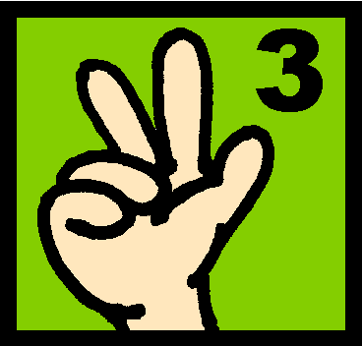
-er
-en
-ing
There
are
Suffixes
that are
both
Inflectional
and
derivational
Er – Belonging to, associated with (Farmer, smaller)
En – To become, or made of (Lengthen, wooden)
Ing – Something used in the action or process of (Lining, sleeping)
Notes:
Here’s a fun fact. There are 3 suffixes that can act either as an inflectional suffix or a derivational suffix. The 3 suffixes are (click) e-r, e-n and i-n-g.
(click) Here are some examples of how each of these suffixes can be used in both ways. Sometimes they change the form of the word, which changes the word’s meaning, but sometimes they don’t change the word’s meaning at all.

Slide 31
When adding suffixes remember these
Notes:
There are some rules when adding suffixes to the end of words. These rules will help you correctly spell words with suffixes.

Slide 32
Adding suffixes to words that end in “y”
If the letter before a final y is a vowel, the y doesn’t change when you add a suffix.
(Example: Play - Playing)
If the letter before a final y is a consonant, the y changes to an i before you add the suffix.
(Example: Carry - Carried)
EXCEPT when the suffix begins with an i.
(Example: Carry - Carrying)
babys
Notes:
The first set of rules applies to adding suffixes to words that end in “y”. You might think that adding the suffix “s” to the word baby is easy and look like this? (click) But there is a special suffix rule that applies here.(click) Here are the rules that apply in this situation. (click click Read the first one and discuss)
(Click – click Read the second one and discuss)
(Click– click Read the last one and discuss)

Slide 33
When adding suffixes to words that end in a single consonant with a single vowel in front of it …
Double the consonant if the suffix begins with a vowel.
(Example: Fit - Fitting)
Don’t double the consonant if the suffix begins with a consonant.
(Example: Fit - Fitness)
runing
Notes:
There are also rules when adding suffixes to words that end in a single consonant with a single vowel in front of it. You may think that adding “ing” to the word run looks like this (click). But there are certain rules for adding suffixes to words like this (click) Here are the rules.
(click – click Read the rule and discuss)
(Click- click Read the rule and discuss)
(Click- click Read the rule and discuss).

Slide 34
The term compound suffix refers to more than one suffix at the end of the word. All of these words have compound suffixes.
Helplessness
Endlessly
Loveliness
Professionalism
Respectability
Notes:
Words can have two suffixes, and that is called a compound suffix. (click) All of these words have compound suffixes. (click – click – click – click – click) Can you find them?

Slide 35
When you practice looking for suffixes on you practice worksheets,
You will use an “L” shape to mark the suffixes.
magnify
Notes:
When you practice looking for suffixes on your practice worksheets, (click) you will use an “L” shape to mark the suffixes.
(click) For example, when looking for a suffix in the word magnify, we see it has the suffix spelled i-f-y and pronounced ify. The “L” shape (click) is used to identify that suffix, which by the way, means to make. When you put that suffix with the other word part “magn” which means large, we can guess the meaning of the word is to make large.

Slide 36
Lesson Three:
Prefixes
Suffixes
ROOTS have meaning
Notes:
We have learned about the morphemes (click) prefixes and (click) suffixes. Now let’s turn our attention to lesson 3, and the third type of morpheme, which is (click) roots, and they also have meaning.

Slide 37
Roots
Can be at the beginning, middle or end of a word.
Roots can be the entire word.
Notes:
Roots can be at the beginning, middle or end of a word. Matter of fact, (click) Roots can be the entire word.

Slide 38
Scope is a word that can stand on its own and be the entire word.
SCOPE
Scoped Microscopic Telescope
Notes:
Scope is a root that can stand on its own and is an entire word. But it can also be at the front of a word (click) when we add the suffix e-d at the end to form scoped. Or it can be in the middle of the word when we add the prefix “micro” at the beginning and the suffix “ic” at the end to form the word microscopic. You will notice that adding the suffix changed the sound of the root just a bit. (click) Or scope can be at the end of the word when we add the prefix tele at the beginning to form the word telescope.
A root can be anywhere in the word or it can be the entire word.

Slide 39
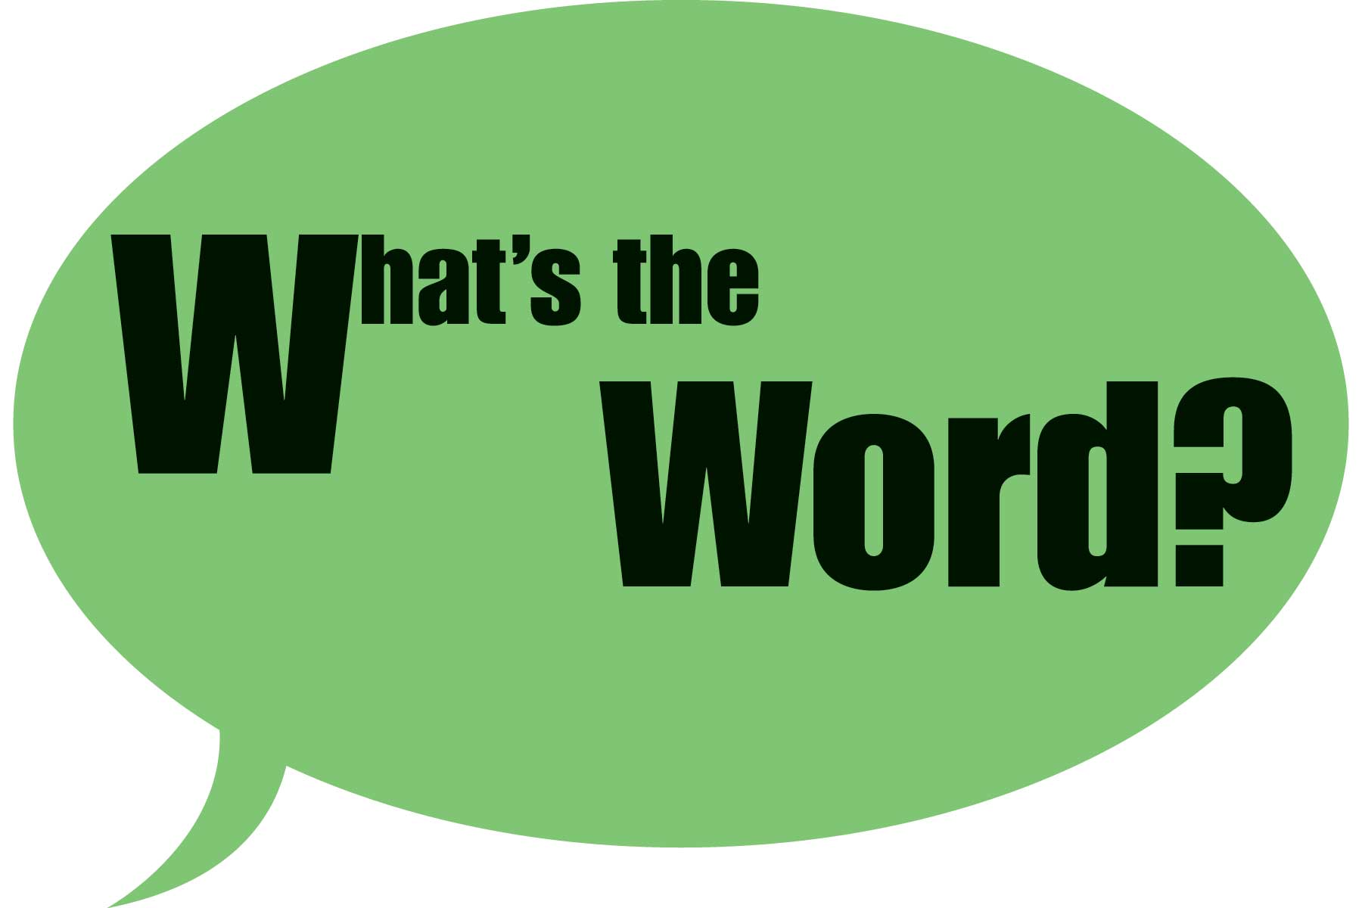
If you are wondering about a word’s meaning …
(Hint: Look for the root. Each root gives a word it’s main meaning.)
Notes:
If you are wondering about a word’s meaning, look for the root. Each root gives a word it’s main meaning.

Slide 40
For example: Root words “Aster” or “astro” mean star.
Asteroid
Astronaut
Astrosphere
Astronomy
Asterisk
Notes:
The root aster means star, but the root astro also means star. Sometimes you will find more than one root that means the same thing.
(click) and if you look at all of these words that have either aster or astro in them, you will see that they are words that all relate to stars. The words get their main meaning from the root.

Slide 41
Just like other morphemes, some roots have several meanings.
“Arch” can mean chief, most important or rule.
Examples:
Archbishop, Archenemy, Matriarch
Notes:
Just like other morphemes, some roots have several meanings.
(click) The root “arch” can mean chief, or most important, or rule.
(click) Take a look at these 3 words that have the root arch, which can sometimes be pronounced ark and see how each one has a slightly different meaning when combined with certain roots. Can you guess which meaning goes with each of the words? I would think that arch in the word archbishop means the chief bishop. The word arch in archenemy could mean the most important enemy, and the word arch, which is pronounced ark, in the word matriarch, means rule. Since matri means mother, the word matriarch means mother rules.

Slide 42
Different roots can have the same meaning but different forms. (Example: “micro” and “min” both mean small.)
Different roots can have the
same meaning with similar forms.
(Example: “aster” and “astro” both mean star.)
Notes:
Sometimes different roots can have the same meaning but different forms. An example would be the roots “micro” and” min”. They don’t look similar, but they have the same meaning. They both mean small.
(click) Sometimes different roots can have the same meaning and they also look very similar. They have similar forms. An example would be the roots aster and astro that we discussed earlier. They look a lot alike, and they mean the same thing. They both mean star.

Slide 43
ROOTS
Notes:
So…roots are very important morphemes because they anchor the word by holding the most basic meaning of the word.

Slide 44
Let’s
What are the 3 types of Morphemes
Notes:
So let’s have a quick review. What are the 3 types of morphemes? They are:
(click)

Slide 45
The 3 types of morphemes are:
Prefixes
Roots
Suffixes
Notes:
prefixes, (click ) suffixes and (click) roots.

Slide 46
Figuring out the puzzle of words will give students POWER over words.
Notes:
Word parts called morphemes are like parts of a word puzzle is important. When we put the meanings of all of the pieces or morphemes together, we can conquer and figure out new words.

Slide 47
Now that we have learned prefixes, suffixes and roots, let’s talk about a
Process to use what we have learned.
Notes:
Now that we have learned about prefixes, suffixes and roots, let’s talk about a (click) step by step process to use what we have learned.

Slide 48
Word Mapping Strategy
Map the word parts
Attack the meaning of each part
Predict the word’s meaning
See if you’re right!
Notes:
The process is called The Word Mapping Strategy provides that step-by-step approach. The steps to the strategy are
(click) Map the word parts
(click) Attack the meaning of each part
(click) Predict the word’s meaning and
(click) See if you’re right.
Look closely and you will notice that each step starts with an action word (click) that tells you what you will be doing during each step.
You will also notice that the first letters of the steps, when combined, (click) spell out the word MAPS. This word acts as a memory device to help you remember the steps in order, Let’s take a closer look at the MAPS Steps.

Slide 49
“Map the word parts” means that you find the word’s prefixes, suffixes, and roots.
Notes:
The “M” step stands for map the word parts. This step reminds you to carefully examine the new word and look for any familiar prefixes, suffixes and roots that are in the word. Check for prefixes first, because they are at the beginning of the words and easier to spot. Then look at the end of the word for familiar suffix endings. Once you have isolated any prefix or suffix, it is much easier to identify the root of the word.

Slide 50
Tips to give your students when looking for prefixes, suffixes and roots:
Tip #1:
Refer to the word parts lists when you perform the M step.
Tip #2:
When you think you have spotted a prefix or suffix, always check at least one more letter to make sure that you found the entire word part.
democracy
particle
Notes:
Here are some tips for when we do the “M” step.
(click) First, Tip #1 – Always use your word part lists when looking for word parts. You may not want to take the time to look through the lists, but using them over time will help you remember new word parts. Slow down to make sure that you are making good use of your lists.
(Click )Next, Tip #2 – “When you think you have spotted a prefix or suffix, always check at least one more letter to make sure that you found the entire word part.
For example (click), the word democracy looks like it has the prefix (click) d-e, pronounced dee, but if you go over one more letter, you will see that the actual prefix in this word is (click) d-e-m pronounced dem, which means people. If we hadn’t tried to include at least one more letter in our search for a prefix, we would never know that the word democracy has something to do with people. The same tip applies when looking for suffixes. The word (click) particle looks like it has the suffix “l-e” …but if you go back one more letter, you find that the suffix is actually “cle”.

Slide 51
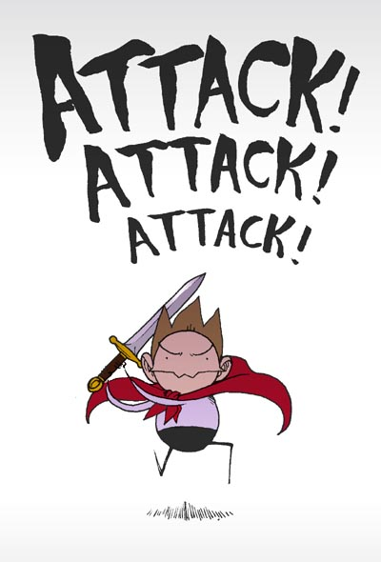
“Attack the meaning of each part” means that you translate each word part into its meaning.
Notes:
The “A” step requires you to Attack the meaning of each part. This means you will record the meanings of each of the word parts you find on your word part lists.

Slide 52
Tip to give your students when performing the “A” Step
Since you have to use your word part lists for both
Steps “M” and “A” combine the steps.
When you find a word part and write it
on your map (the “M” Step),
go ahead and write down
the meaning of the part too (the “A” step).
Notes:
Here is a tip when performing the “A” step
(click) Since you have to use your word part lists for both Steps “M” and “A”, combine the steps.
(click) When you find a word part and write it on your map, which is the “M” step, go ahead and write down the meaning of the part too, which is the “A” step. You get both steps done at the same time.

Slide 53
“Predict the word’s meaning” means that you put the three meanings together and make your best guess.
Notes:
The “P” Step calls for you to predict the meaning of the new word by putting together the meanings of all of the word parts. Make your best guess regarding the meaning of the new word.

Slide 54
Tip to give your students when performing the “P” Step
Reading the definitions of the word parts from left to right:
(The prefix meaning + the root meaning + the suffix meaning)
may not make sense.
Change the order around:
Start with the suffix, then try adding the root and prefix.
Notes:
Here is a tip when performing the “P” step
(click) Reading the definitions of the word parts from left to right, which would be the prefix meaning plus the root meaning plus the suffix meaning may not make sense.
(Click) It may be a good idea to change the order around and start with the suffix meaning, then the root meaning and the prefix meaning. Play around with the definitions and arrange them in the order that makes the most sense.

Slide 55
“See if you’re right” means that you check whether the definition fits in the context of the sentence.
Notes:
The “S” step reminds you to check to see if your prediction is correct. You need to check the context of the sentence where the word was located and think about the definition you came up with. You should ask yourself, “Does that definition make sense in this sentence?” Of course, you can also check for meaning by using their online dictionaries.

Slide 56
Students will practice the MAPS steps when trying to figure out what new words mean.
M
A
P
S
Notes:
We will practice the MAPS steps when trying to figure out what new words mean.

Slide 57
Students will use a Word Map to go through the steps.
Word
Prefix
Root
Suffix
M Step
A Step
P Step
See if you’re right!
Meaning
Meaning
Meaning
Prediction
Definition
Notes:
You will use this visual device called a Word map to go through the steps. Let me show you how to use this visual map.

Slide 58
Word Map
Word
synchronize
Prefix
Root
Suffix
M Step
A Step
P Step
S ee if you’re right!
syn
chron
ize
Meaning
Meaning
Meaning
with, together
time
make
Definition
Make time together
The dancers tried to synchronize their steps.
Notes:
First the new word is written in the box provided at the top of the page.
Next, for the “M” step, I use my prefix, suffix and root lists to look for the parts of the word. Since the lists are in alphabetical order, I begin by looking at the prefix list in the “s” section. I see that the prefix s-y-n, pronounced syn, is listed and I write that down in the box provided for prefix (click). Since the prefix list also provides the meaning of syn, I am going to go ahead and do the “A” step for the prefix and write in the meaning, (click) which is with or together.
Now I am going to check my suffix list. E isn’t listed as a suffix. I add another letter and look for ze. I don’t find that either. I’ll add one more letter and look for i-z-e. I found it…..That’s on the list. I write down that suffix (click), which is pronounced ize. and then I also write the meaning down, which is (click) make.
Now I am ready to write down my root. The letters that are left after separating the prefix and suffix are c-h-r-o-n. I check my root list for that and I find it, so I write that down in the box for the root (click) I also write the meaning (click) which is time. I have now completed the M and A steps, so I am ready to do the P step which is predict the word’s meaning. If I read the word part meanings from left to right it combines to say with or ogether , time, make. That doesn’t make much sense, so I will try it in the other direction from right to left. That combines to say make time together or with. That sounds a little better. I think my prediction will be (click) make time together. Now I can do the “s” step…see if I’m right. I will replace the word synchronize in this sentenc (click) with my prediction and and see if it makes sense. The dancers tried to synchronize their steps would now be (click) The dancers tried to make time together their steps. I think it makes some sense, but doesn’t sound quite right. Maybe I could say, the dancers tried to make their steps time together. I think that sounds better. It sounds even better if I say, “The dancers tried to time their steps together.” That sounds good.
I could also look up the word synchronize in the dictionary to see if I’m right. The dictionary says that synchronize means to occur at the same time or rate. I think that means to occur together. I think my prediction worked pretty well.

Slide 59
Tips for using the Word Map:
Word
If a word has a compound prefix or suffix divide the box in half like this
Prefix
Root
Suffix
M Step
A Step
P Step
See if you’re right!
Meaning
Meaning
Meaning
Prediction
Definition
Notes:
Here are some tips for using the word map.
(click) If a word has a compound prefix or suffix divide the box in half like this (click) to make room for both.

Slide 60
Another Tip:
Word
Cognition
If there are letters that don’t fit in any box, just write them in between boxes
Prefix
X
Root
Suffix
cogn
i
tion
M Step
A Step
P Step
See if you’re right!
Meaning
X
Meaning
Meaning
Act, result or
state of
To know
Prediction
Definition
Notes:
Another tip:
(click) If there are some extra letters in a word that don’t fit in any of the boxes, write the letter or letters between the boxes. Many times these letters serve the purpose of making pronunciation easier. One example of this is the word (click) cognition.
There’s no prefix, so I will draw an X through the prefix boxes to show that there isn’t a prefix. (click)
There is the suffix t-i-o-n, “tion”, so I will write that in the suffix box and fill out the meaning (click).
The root of the word is c-o-g-n and I will write that in the root box (click) and fill in the meaning below it. It means to know. But there is the letter I in the word that didn’t go in either the suffix box or the root box. I am going to place that I right in between the boxes (click). It is probably in the word to make pronunciation easier by connecting the cogn root with the tion suffix. It is pronounced cognition.

Slide 61
Notes:
Although not all words can be mapped, there are a lot of words that can be mapped. Working with word parts to figure out the meanings of unknown words will give you a power of words that will not only boost your level of vocabulary, but will help you understand new words around you.

