Slide 1
WORD ID
Authors: B. Keith Lenz, Jean B. Schumaker, Donald D. Deshler, and Victoria L. Beals
Presentation Compiled by Bonnie Palasak
Revised July 2020

Slide 2
WORD ID
Notes:
Insert link for Word ID podcast

Slide 3
DAY 1

Slide 4
Start-Up Activity
In your journal, write today’s date and as many words as you can think of starting with the prefix -un
Notes:
Word ID Teacher Notebook Day 1

Slide 5
Course Organizer
Notes:
Student Notebook page 1

Slide 6
Teacher:
The
Course Organizer
Student:
Time:
Course Dates:
This Course: Xtreme Reading
Grading Procedures
is
about
building the knowledge, strategies, and habits of learning that will make you a great reader and help you reach important goals.
Start-Up Activities
Participation & Discussion
Classroom Skills
Assignments
Book Study
Tests & Quizzes
Course Questions:
1. How does thinking about your dreams and possibilities for your life change the way you approach learning?
2. Why do good learners know and use several different reading strategies?
3. How can learning new words and spending lots of time reading improve the knowledge that you have?
4. Why is reading fluently important?
5. Why is developing good habits of learning important?
6. How does improving your reading help you reach your goals and dreams?
Notes:
Student Xpect to Achieve Notebook pages 1-3

Slide 7
Course Map
This Course:
Xtreme Reading
Student:
includes
Classroom
Expectations
Learning Routines
Tasks/Activities
Teamwork
Respect
Tolerance
Voice
Choice
Hard work
Discussions
Products
Quizzes
Classroom procedures Guided practice
Daily agenda Partner practice
Start-up activities Feedback sessions
Group participation Progress charting
Critical Concepts
Hopes and Dreams
Reading Strategies
Habits of Learning
Expert Reading
Learning
Community
Reading
Strategies
Learned in these
Units
Hopes
and Dreams
through
through
Highly Engaging
Literature
Highly Engaging
Literature
through
Highly Engaging Literature
Notes:
Student Xpect to Achieve Notebook notebook page 2

Slide 8
Notes:
Student Xpect to Achieve Notebook notebook page 3

Slide 9
Unit Organizer

Slide 11
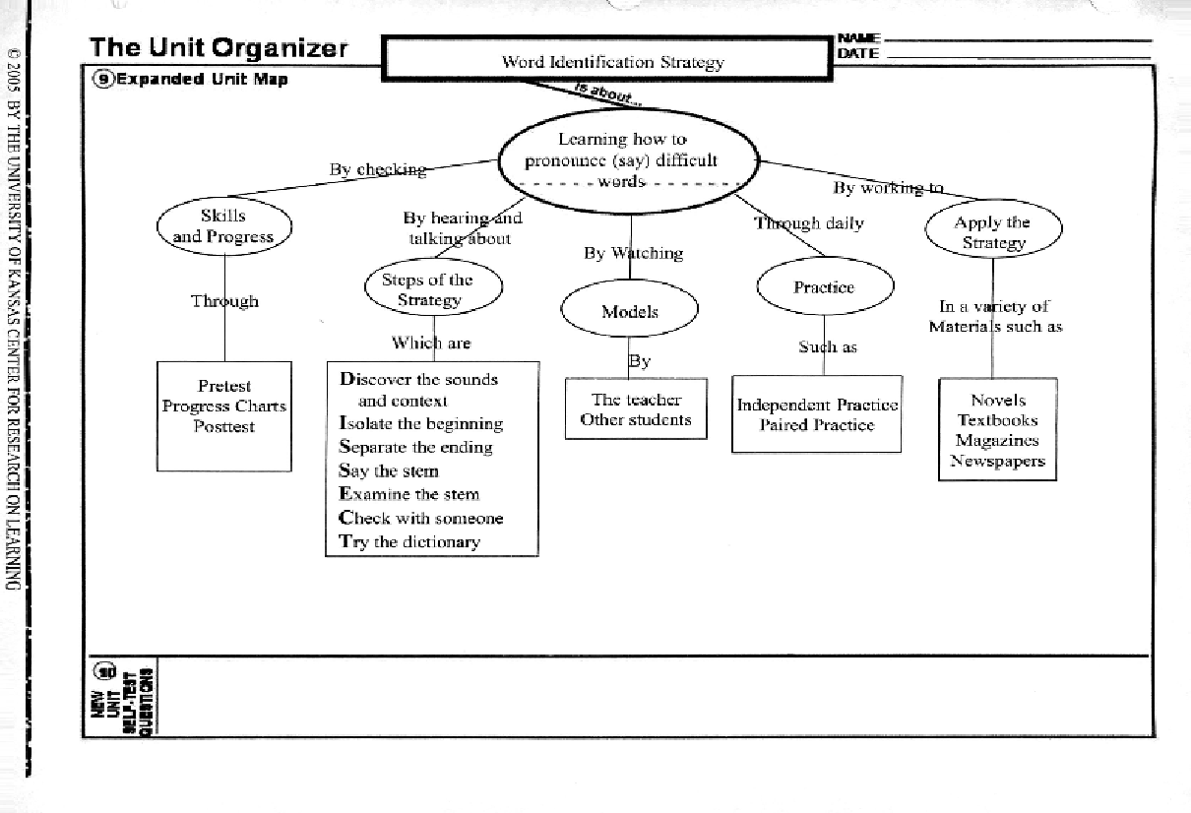

Slide 12
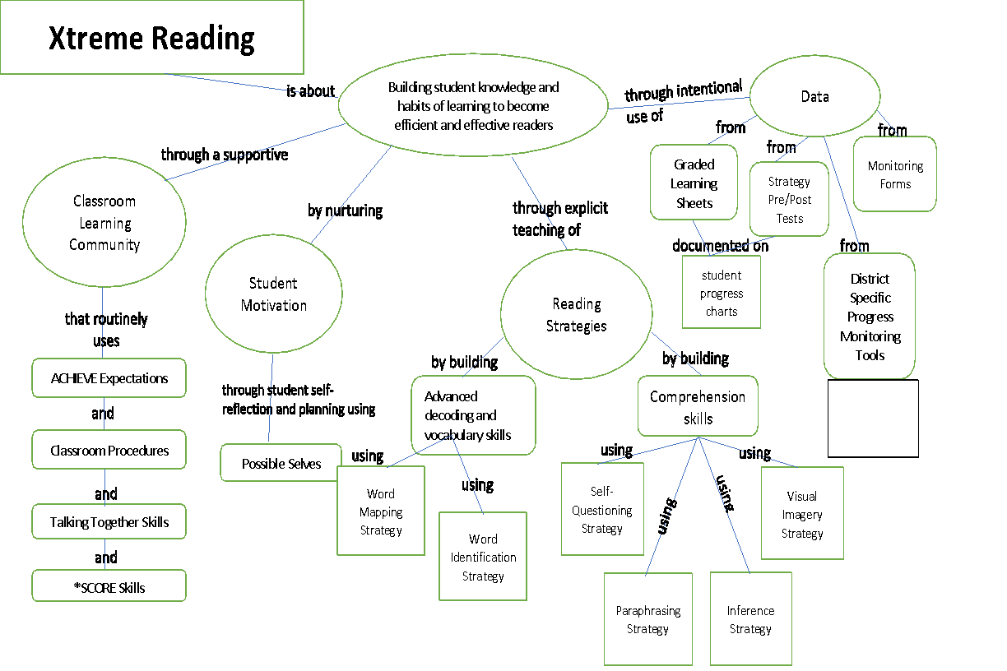
Notes:
Xtreme xpanded course organizer on Flash Drive

Slide 13
Today we are going to start work on a strategy that will help you pronounce or DISSECT long words that you encounter when you are reading.
It is called the Word Identification Strategy.
Notes:
Describe Setp Word ID pp. 19-30 in Word ID manual through Say the Step (top of page 30)

Slide 14
The Word Identification Strategy
DISSECT
DISSECT words …
NOT frogs!
Notes:
First Half of stage 3 pg. 19-30 in the Word ID Manual through steps 5

Slide 15
DISSECT
Does anyone know what DISSECT means?
Dissect means to divide something or cut it into several parts.
That’s exactly what you will be doing when you use the Word Identification Strategy.
You will be cutting up the words into short pieces that you can easily pronounce.

Slide 16
If you are able to pronounce any word you encounter, you will be more likely to understand and more able to discuss what you read.
How will this help you in classes such as English, science, and history?

Slide 17
You will be better able to answer a teacher’s questions in class.
You will be able to easily get through reading assignments.
You will be better able to complete assignments.
You may get better grades.

Slide 18
You can use the Word Identification Strategy any time you are reading something and come upon a long word you’ve never seen before.
Can you think of any examples?

Slide 19
Look at the reading materials I have gathered for you.
Why is it important to be able to read the things I have given you?
How can these things help you?

Slide 20
400 Word Reading Passage
Before Mastery | After Mastery
20 errors | 3 errors
40% correct on Comprehension Questions | 70% correct on Comprehension Questions

Slide 21
Word Identification Notes Sheet
(page 1)
Notes:
Student book Page 3 Word Beginnings and Endings Lists pages 5-8

Slide 22
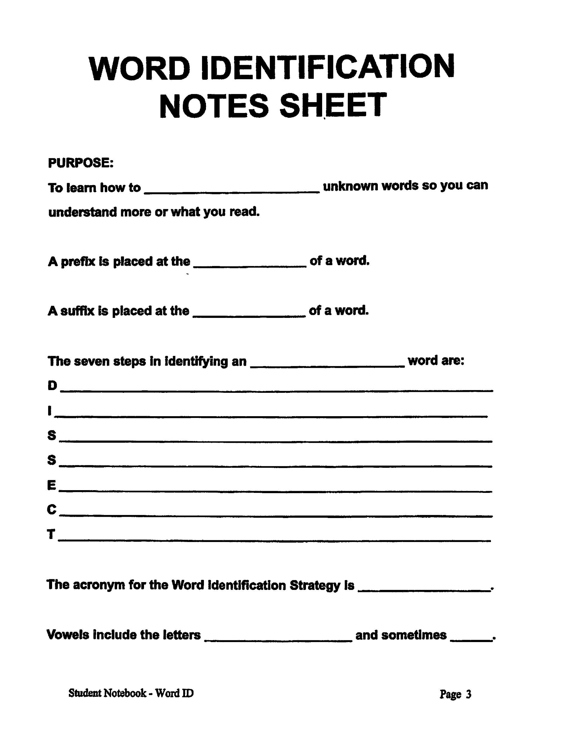
Notes:
Student book Page 3 Word Beginnings and Endings Lists pages 5-8

Slide 23
Purpose
To learn how to pronounce unknown words so you can understand more of what you read.

Slide 24
We will work with word parts such as …
Prefixes: A prefix is placed at the beginning of the word.
Suffixes: A suffix is placed at the ending of a word.

Slide 25
DISSECT
The first step involves taking an initial stab at pronouncing the word.
The next four steps involve dissecting the word (taking the word apart so that you can pronounce it).
The last two steps are steps of last resort.
If you can’t figure out the word on your own, you may need to ask for help from someone or look it up.

Slide 26
The Seven Steps of the Word Identification Strategy
Step 1: Discover the sounds & context
Step 2: Isolate the beginning
Step 3: Separate the ending
Step 4: Say the stem
Step 5: Examine the stem
Step 6: Check with someone
Step 7: Try the dictionary

Slide 27
Steps of the Word Identification Strategy
Step 1: Discover the sounds & context
Step 2: Isolate the beginning
Step 3: Separate the ending
Step 4: Say the stem
Step 5: Examine the stem
Step 6: Check with someone
Step 7: Try the dictionary

Slide 28
What do you normally do when you come to a difficult word?
Skip it? Ignore it?
Why would reading the whole sentence help you figure out a word?
CONTEXT
If you cannot think of word that fits within the context of the sentence.

Slide 29
Step 1: Discover the Sounds and the Context
Give the word your best shot by sounding it out, saying at least a few of the sounds to yourself, and reading to the end of the sentence.
If the sounds you pronounced form a word that fits the context, keep reading. If not, Go to Step 2.
The dentist was extracting the molar
when the power went off.

Slide 30
Steps of the Word Identification Strategy
Step 1: Discover the sounds & context
Step 2: Isolate the beginning
Step 3: Separate the ending
Step 4: Say the stem
Step 5: Examine the stem
Step 6: Check with someone
Step 7: Try the dictionary

Slide 31
Step 2: Isolate the Beginning
If the word you said doesn’t make sense in the context, look at the beginning of the word to see if there is a word part you can say. Isolate the beginning with a backwards “L” marked like this.

Slide 32
You are all aware of prefixes now, and you’ve been learning the meaning of some of the prefixes.
The first step includes determining whether there is a prefix at the beginning of the word that you might be able to pronounce immediately.

Slide 33
What does isolate mean?
How would we isolate the prefix?

Slide 34
DISSECT
Discover the Sounds
AND the Context
The dentist was extracting the molar
when the power went off.
Isolate
the
Beginning
extracting
Take out
Notes:
Write depart and make L
Make guess about suffix

Slide 35
Don’t forget about compound prefixes!

Slide 36
Steps of the Word Identification Strategy
Step 1: Discover the sounds & context
Step 2: Isolate the beginning
Step 3: Separate the ending
Step 4: Say the stem
Step 5: Examine the stem
Step 6: Check with someone
Step 7: Try the dictionary

Slide 37
What does the word separate mean?
To take something away from something else.
Ask yourself, “Is there a suffix or some other ending that I know?”
How do you think we will separate the ending?

Slide 38
Step 3: Separate the Ending
Look at the ending of the word to see if there’s a word part that you can easily say. It might be a suffix or a syllable that is easy to say. Separate the ending with an “L” shape.

Slide 39
DISSECT
Discover the Sounds
AND the Context
The dentist was extracting the molar when the power went off.
Separate
the
ending
Isolate
the
Beginning
extracting
Take out ________ the act of
Notes:
Write depart and make L
Make guess about suffix

Slide 40
Don’t forget about compound suffixes!

Slide 41
There may be more than one word ending!

Slide 42
Say the Stem, Step 4
Try to say the stem (the letters that are left after you isolated the beginning and separated the ending).
If you can say the stem, blend the beginning and the ending with it to say the word. Check to see if makes sense in context. If so, read on.

Slide 43
ROOTS/STEMS
After you have identified the stem, what might you see in the stem?
A root might be the whole stem, or part of the stem.
Keep your eyes peeled for those roots and bring their meaning to mind each time you see one.

Slide 44
DISSECT
Discover the Sounds
AND the Context
The dentist was extracting the molar when the power went off.
Separate
the
ending
Isolate
the
Beginning
extracting
Say the stem
Take out – pull - the act of
Notes:
Write depart and make L
Make guess about suffix

Slide 45
The doctors all say I need complete rest with no strenuous exercise and no emotional excitement.
Discover the Sounds
AND the Context
Separate
the
ending
Isolate
the
Beginning
excitement
Say the stem
Notes:
Connecting with reading will increase connection and retention of word

Slide 46
DISSECT
Separate
the
Endings
Isolate
the
Beginning
de
part
ment
al
Say the Stem
Notes:
Story in Weighty Word Book page 3-4
Use white boards

Slide 47
GUIDED READING
Notes:
Guided Reading coach Carter…identify vocabulary words with prefixes, suffixes Script on Pages 13-17 of Word ID manual. Provide a min-model of the strategy (DISSECT)

Slide 48
DAY 2

Slide 49
Start-Up Activity
In your journal, write today’s date and as many words as you can think of starting with the prefix -ex

Slide 50
Go over pretests and chart on Progress Chart
Notes:
Progress Chart Page 9 Student Notebook Teacher Notebook page 7

Slide 51
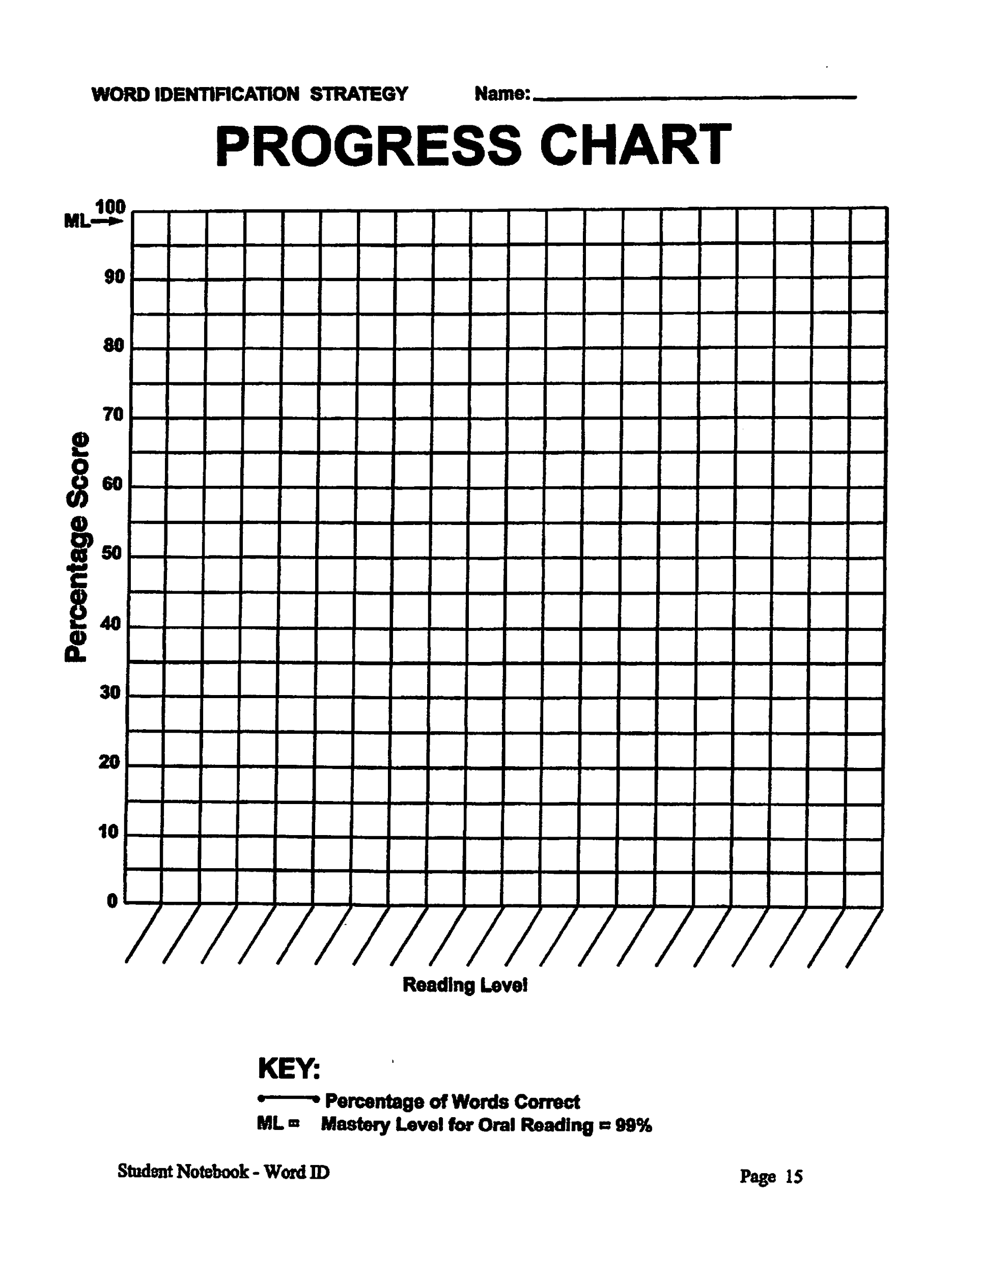

Slide 52
Word Identification Notes Sheet
(page 1) & (page 2
Notes:
Student Notebook page 3 Script for teacher pages 53-58 Copy Cue Cards in Teacher Notebook pages 39 & 40 give to students to keep in their notebooks in plastic sleeves.

Slide 54
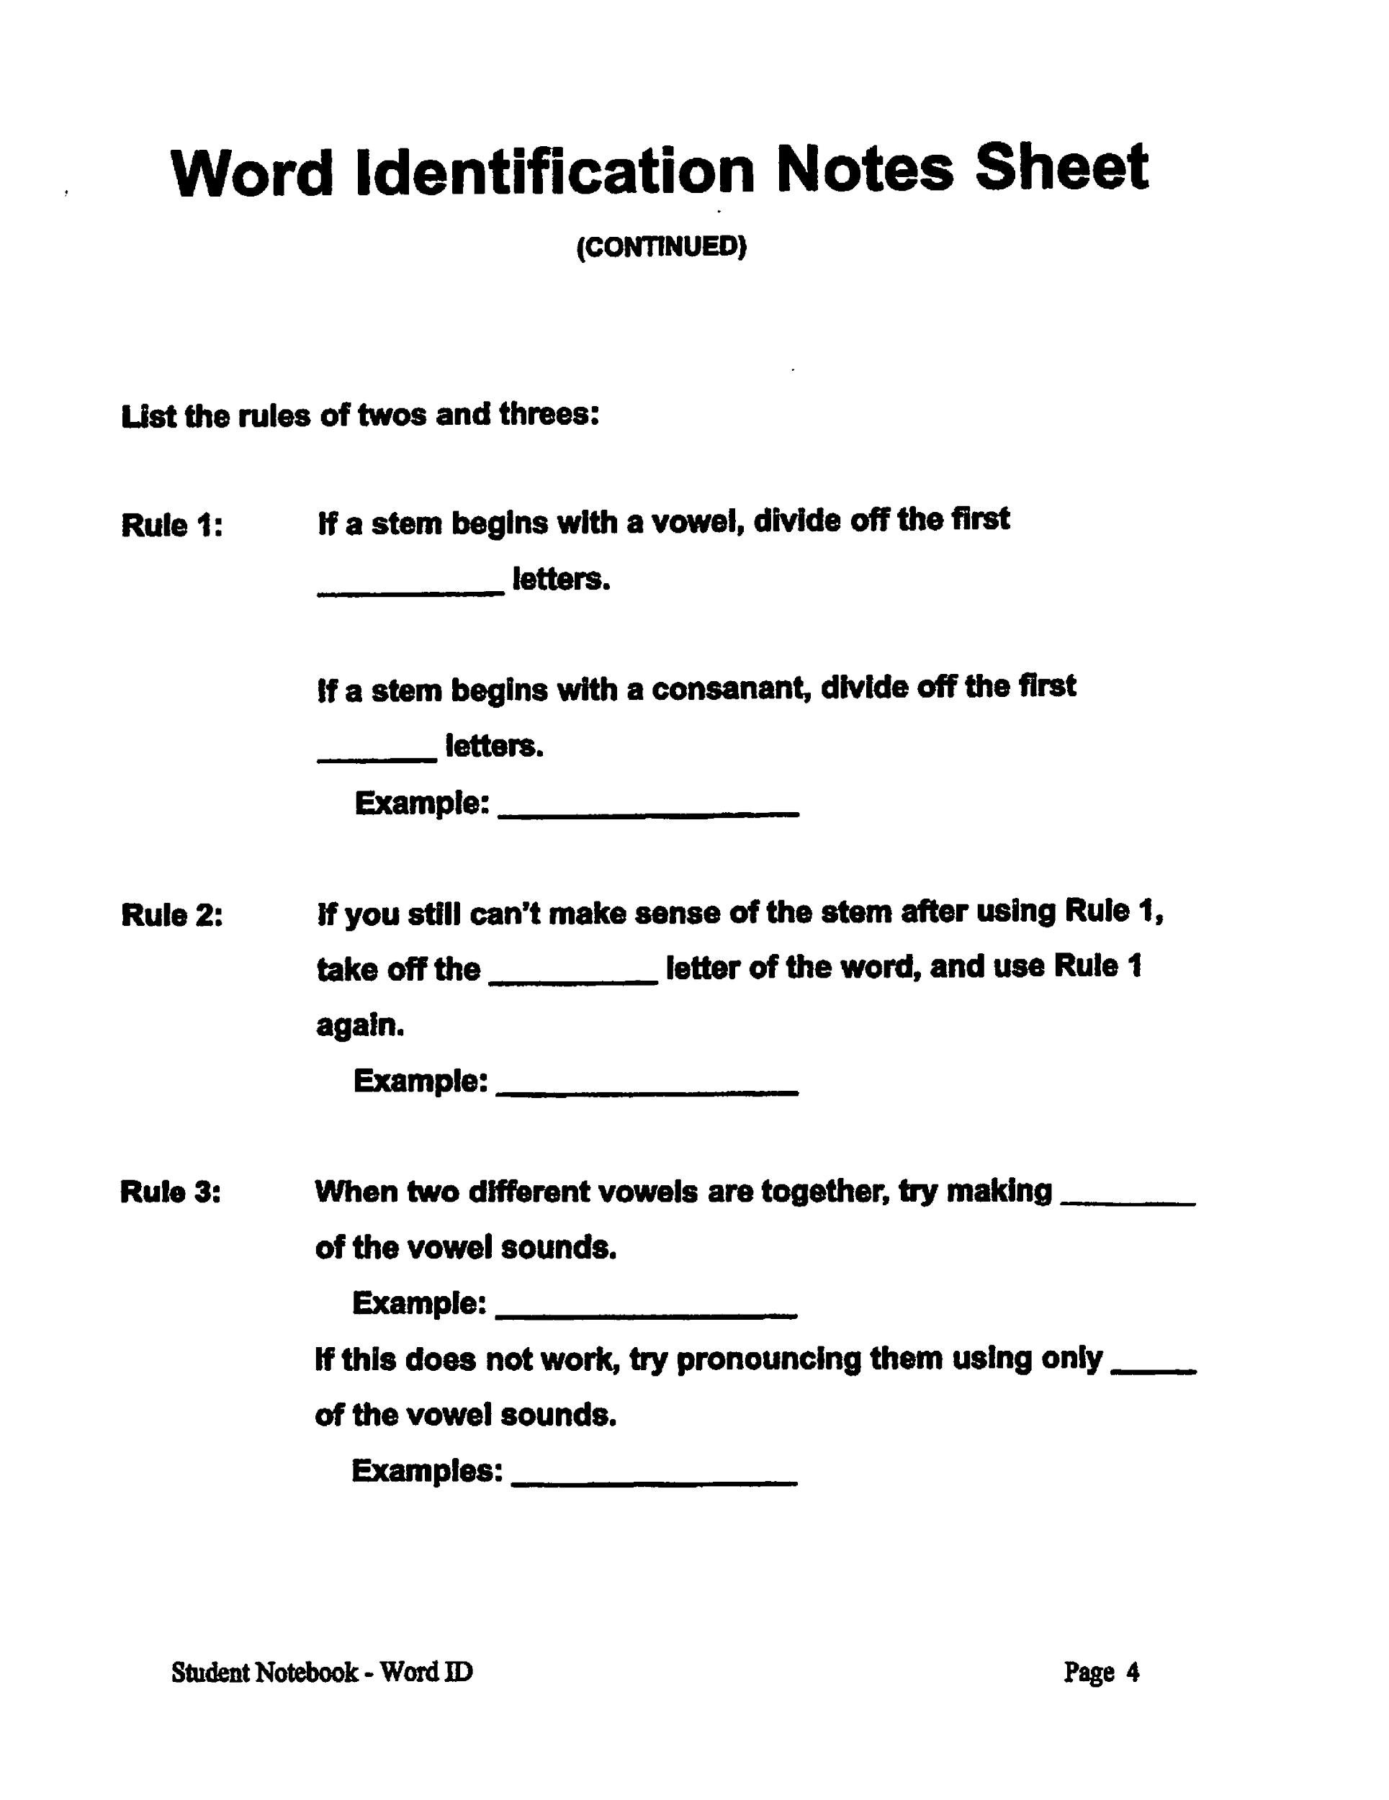

Slide 55
Steps of the Word Identification Strategy
Cue Card # 1
Step 1: Discover the sounds & context
Step 2: Isolate the beginning
Step 3: Separate the ending
Step 4: Say the stem
Step 5: Examine the stem
Step 6: Check with someone
Step 7: Try the dictionary
Notes:
Cue Cards are in Teacher notebook pages 39-40 Make copies for Students or have them make them in their journals or notebooks

Slide 56
Examine the Stem, Step 5
DISSECT
If it doesn’t make sense, use the Rules of Twos and Threes to take apart the stem.
Notes:
Word ID manual pg.s 30-38

Slide 57
The Rules of Two’s and Three’s requires us to look for vowels and consonants:
Vowels are:
Consonants are: Everything else!

Slide 58
Rule 1: The first Rule of Twos and Threes is:
If a stem or part of the stem begins with:
• A vowel, divide off the first two letters
• A consonant, divide off the first three letters
bom bar d
cat ar act
as pir in

Slide 59
Let’s try to think of a way to remember that the number 2 goes with vowels and 3 goes with consonants…

Slide 60
Rule 2:
If you can’t make sense of the stem after using Rule 1
Take off the first letter of the stem
Use Rule 1 again
clench
C lench
Try this word:
scandal
Notes:
Ceph al op od--science word--Check with the science teacher

Slide 61
Rule 3:
When two different vowels are together, try making both of the vowel sounds.
meander
diet
suicide
If this doesn’t work, try pronouncing them together using only one of the vowel sounds.
fiery
believe
faint

Slide 62
DISSECT
Isolate the Beginning
Separate the Ending
fluttering
nonsense
ablaze
censorship
transform
mindlessness
Isolate the beginning and separate the ending of these words. Can you say the stem?
insanity
illumination
noncombustible
unclenched
Notes:
Remember to do I do it ----- We do it ----You do it
Bottom -blue group--do in groups-- white boards

Slide 63
Examine the Stem Worksheet
INSTRUCTIONS:
On your worksheet the prefixes have been isolated and the suffixes have been separated. Examine the stems using the Rules of Twos and Threes.
Notes:
Teacher notebook page 42 make copy for students
Optional Add On from Tom Blount: Have students write the Rule # they used on each word.

Slide 64
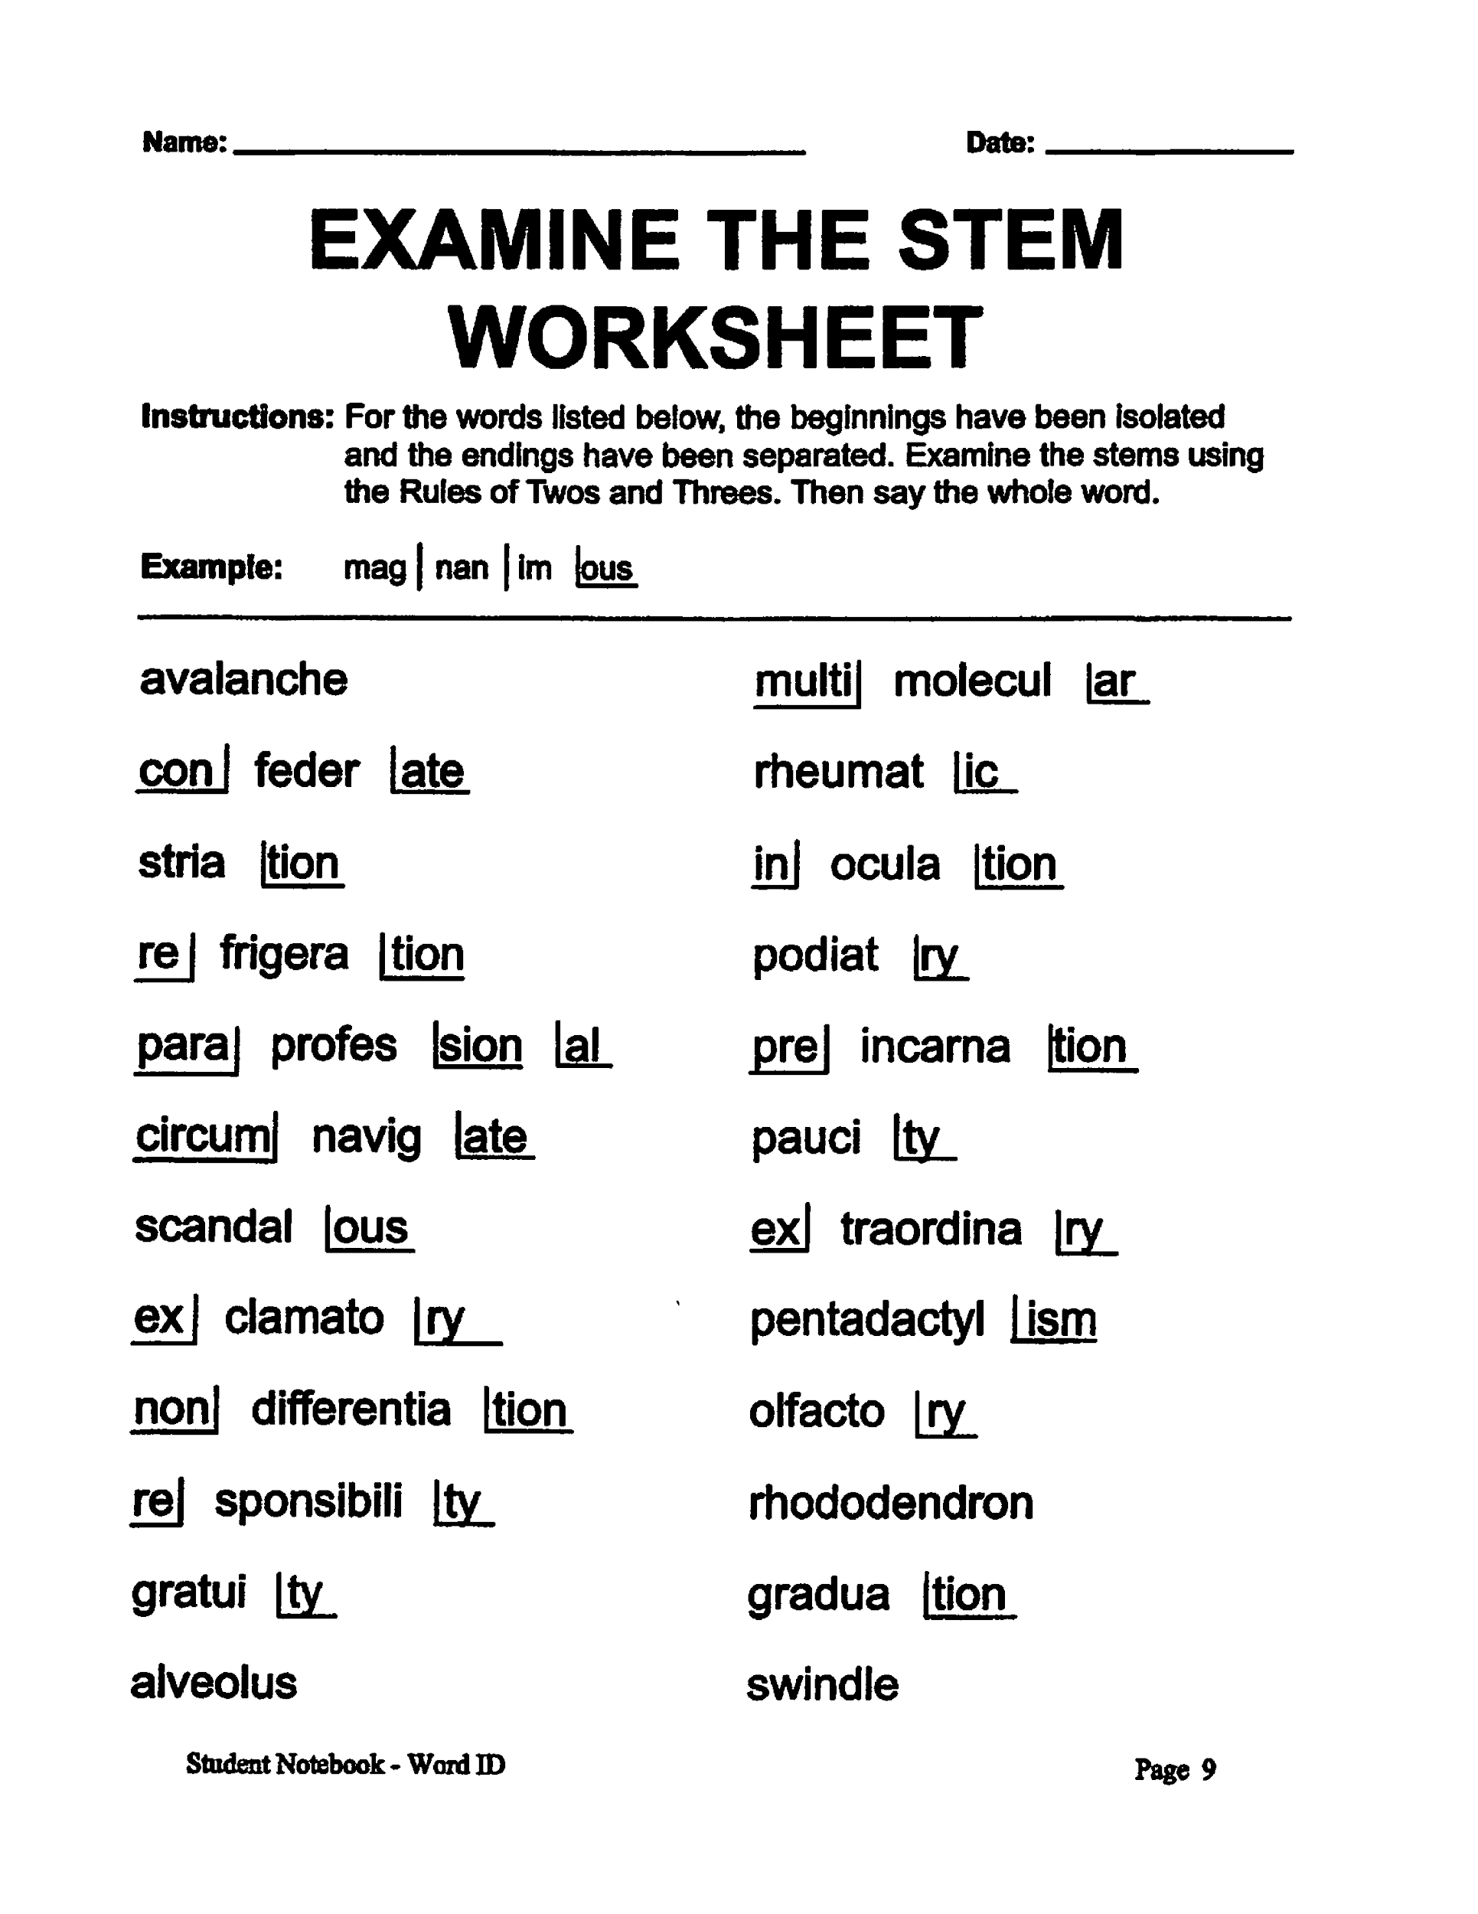

Slide 65
Steps of the Word Identification Strategy
Step 1: Discover the sounds & context
Step 2: Isolate the beginning
Step 3: Separate the ending
Step 4: Say the stem
Step 5: Examine the stem
Step 6: Check with someone
Step 7: Try the dictionary

Slide 66
Check with Someone, Step 6
DISSECT
If you have tried the first five steps and still can’t figure out how to pronounce the word, you may check with someone.

Slide 67
Steps of the Word Identification Strategy
Step 1: Discover the sounds & context
Step 2: Isolate the beginning
Step 3: Separate the ending
Step 4: Say the stem
Step 5: Examine the stem
Step 6: Check with someone
Step 7: Try the dictionary

Slide 68
Despite the tension in my stomach, I eat as much as I can, although none of the delectable food makes any impression on me.
The Hunger Games, Page 144
delectable
de
lect
able
Notes:
Uise white boards to guess the base word----share Weighty Word book
Work in pairs to add prefixes and suffixes to selected base words.
Variation- like stack words---start with base word and add either a prefix, suffix, or base word.
At end of game write out words.

Slide 69
Try the Dictionary, Step 7
DISSECT
If no one can help you pronounce the word, try this website:
www.howjsay.com
The meaning of the word can also be checked in the dictionary. Go to:
www.dictionary.com
Definition: Delightful, very pleasing, enjoyable

Slide 70
Find a word to pronounce for the class
 | Seat # 1 | Seat #2 | Seat #3 | Seat #4
 | parsimony | adjective | funicular | mercantile
 | macadam | participate | herbivore | insurgency
Notes:
Kagan activity. Table of 4 each students do 2 words, then share on whiteboards. If virtual, put students in chat rooms and students dissect words and explain to each other.

Slide 71
Using the DISSECT steps will help you figure out how to say difficult words that you don’t recognize.

Slide 72
For two days, we have begun to learn about the Word Identification Strategy.
It consists of seven steps that we can remember by using the mnemonic device, DISSECT.
Tomorrow, we well do the MODEL stage of instruction.
I will give you a demonstration of how to use the steps in this strategy.

Slide 73
DISSECT words …
NOT frogs!
Leitzell –NC CLC Project

Slide 74
GUIDED READING
Notes:
Prompt students to use steps of the strategy on words Teacher Manual Scpgs. 13-17

Slide 75
DAY 3

Slide 76
Start-Up Activity
In your journal, write as many words as you can think of that end with the suffix “-tion”

Slide 77
Review
Steps of DISSECT?

Slide 78
Review
Step 1: Discover the sounds & context
Step 2: Isolate the beginning
Step 3: Separate the ending
Step 4: Say the stem
Step 5: Examine the stem
Step 6: Check with someone
Step 7: Try the dictionary

Slide 79
Review
RULES OF TWOS AND THREES

Slide 80
Rule 1: The first Rule of Twos and Threes is:
If a stem or part of the stem begins with:
• A vowel, divide off the first two letters
• A consonant, divide off the first three letters
bom bar d
cat ar act
as pir in

Slide 81
Rule 2:
If you can’t make sense of the stem after using Rule 1
Take off the first letter of the stem
Use Rule 1 again
clench
C lench
Try this word:
scandal

Slide 82
Rule 3:
When two different vowels are together, try making both of the vowel sounds.
meander
diet
suicide
If this doesn’t work, try pronouncing them together using only one of the vowel sounds.
fiery
believe
faint

Slide 83
Review
When should you check with someone?
If you have tried the first five steps and still can’t figure out how to pronounce the word, you may check with someone.

Slide 84
Review
Where should you use the Word Identification Strategy?

Slide 85
Last class period, we talked about a strategy for figuring out the meaning of words.
We did that by taking apart the words and figuring out the meaning of each part.
Today, I am going to demonstrate how to use the Word Identification Strategy.
I am going to read aloud everything I am thinking while I use the strategy.
I will want you to do the same thing when you read unknown words.

Slide 86
Model
What is a model? (think hobby lobby or science class)
What does imitate mean?
A model is only useful if you imitate it.
Notes:
Stage 4 Model Word Id manual 52-59

Slide 87
As I demonstrate how to use the Word Identification Strategy, listen carefully to what I say and think about.
Watch carefully what I do, so you can imitate my thoughts and actions.
Notes:
Stage 4 Model Word Id manual 52-59

Slide 88
You will need to follow the ACHIEVE guidelines for whole-class activities.
I will be asking you to participate in demonstrating how you think and act after I complete my demonstration.
Later, when you start practicing on your own, you will do everything I do, but you will not have to read aloud. You will read silently.

Slide 89
MODEL
BRIDGING THE GAP
Notes:
Stage 4 Model Word Id manual 52-59

Slide 90
Bridging the Gap¹
Bridges come in a few basic styles. There are beam, arch, cantilever and suspension bridges. The first two are thousands of years old. The others are not much newer. The bridge is man’s oldest building achievement. Even early man built bridges.
Simple beam bridges were not hard to make. Dragging the rocks into place only needed some effort. Today in England, huge slaps of rocks still stand on piers across streams. These simple bridges were also found on long-dry stream beds. They’ve been there since prehistoric times.
¹This passage, which is shown in its entirety, came from Spargo, E., & Williston, G. R. (1980). Times Readings, Book 1. Providence, RI: Jamestown Publishers

Slide 91
Bridging the Gap
The arch was used in temples and tombs long before it was used for bridges. Roman engineers built stone-arch bridges all over their empire. The most famous stone-arch bridge was Old London Bridge. This was built in 1176. It was made of 19 semicircular stone arches of different lengths. These arches were mounted on thick piers in the Thames River. Soon buildings appeared on the famous bridge. Although loaded with houses and shops, Old London Bridge never fell down. It was always fixed just in time. In the 1820s it was replaced by a new stone-arch bridge. In turn, this was also replaced in the 1960s in order to handle more traffic.
In bridge terms, a cantilever is a diamond-shaped structure. It is balanced on a pier. Two cantilevers, linked by a short support, form a very strong bridge.

Slide 92
Bridging the Gap
We can only guess that man built suspension bridges at an early date. These early bridges were made of tough vines hung over a gorge. Branches were laid across the vines to form a roadway. In China long ago, kites were used to fly the vines across the gorge. Hundreds of such bridges were also built in South America.
Suspension bridges are compared in length of main span. The main span refers to the suspended path between two towers. New York’s Verrazano Bridge is the world’s longest suspension bridge. Suspension bridges were once weak structures. They often fell down at any time. They crumpled under the marching feet of soldiers. They fell under droves of cattle. Even heavy loads of snow could make them collapse. They blew down in storms and scared travelers with their swaying. Then, a stronger metal support was added. Suddenly suspension bridges became strong and secure.
Can you imagine traveling over a swaying bridge? It’s a good thing the suspension bridge improved.

Slide 93
Today, you saw a model of how to use the Word Identification Strategy.
You have all participated in DISSECTING some words.
You have seen how I talk to myself as I use the strategy.
You have shown me and each other how you would follow the steps.

Slide 94
Get out your prefix and suffix word lists for Word ID
Also get out your WORD ID notes sheet #1 & #2
Notes:
Teacher Notebook pages 47-50 Student Notebook pages 5-8

Slide 95
Word Identification Strategy
Word Beginnings List
Prefix Example Prefix Example Prefix Example
a- a| pathy
ab- ab normal
abs ab stain
ad- ad jacent
ambi- ambi dextrous
an- an onymous
ana- ana thema
ante- ante cedent
anti- anti social
apo- apo logy
auto- auto biography
bene- bene fit
bi- bi weekly
circum- circum ference
co- co operate
col- col lective
com- com munity
con- con fide
contra- contra dict
de- de scend
dem- dem ocracy
di- di chotomy
dia- dia meter
dis- dis comfort
dys- dys function
em- em brace
en- en able
epi- epi center
eu- eu phoric
ex- ex hale
extra- extra ordinary
extro- extro verted
fore- fore warn
hetero- hetero geneous
homo- homo geneous
hydro- hydro foil
hyper- hyper charge
hypo- hypo dermic
il- il legal
im- im perfect
in- in visible
inter- inter state
intro- intro duce
ir- ir regular
mal- mal nutrition
male- male-factor
micro- micro scope
mis- mis fortune
mono- mono logue
multi- multi story
non- non intervention
ob- ob struct
pan- pan orama
para- para medic
per- per fect
peri- peri meter
post- post pone
pre- pre cede
pro- pro mote
pseudo- pseudo nym
re- re vise
retro- retro active
se- se cede
semi- semi circle
sub- sub marine
sur- sur pass
super- super human
syl- syl lable
sym- sym phony
syn- syn thesis
tele- tele vision
trans- trans port
tri- tri angle
ultra- ultra violet
un- un willing
up- up grade
Notes:
The Challenge

Slide 96
Word Identification Strategy
sufffix Example sufffix Example sufffix Example
Word Endings List
-able obtain able
-age wreck age
-al natur al
-an Europe an
-ance assist ance
-ancy vac ancy
-ant assist ant
-arian libr arian
-arium aqu arium
-ary bound ary
-ate collegi ate
-cle parti cle
-cule mole cule
-cy bankrupt cy
-dom wis dom
-ed paint ed
-en height en
-ence confid ence
-ency urg ency
-ent presid ent
-er smart er
-er report er
-ery slav ery
-ese Chin ese
-ess heir ess
-ence confid ence
-est warm est
-ful play ful
-fy electri fy
-hood child hood
-ia bulem ia
-ial fac ial
-ian comed ian
-ible vis ible
-ic platon ic
-ical hyster ical
-ice just ice
-ify magn ify
-il per il
-ile juven ile
-ing swimm ing
-ion opin ion
-ise exerc ise
-ish boy ish
-ism social ism
-ist pacif ist
-itis appendic itis
-ity celebr ity
-ium calc ium
-ive abus ive
-ize idol ize
-less heart less
-logy bio logy
-ly heaven ly
-ment amend ment
-ness happi ness
-ology morph ology
-or doct or
-ory advis ory
-ous graci ous
-s garden s
-ship friend ship
-sion impres sion
-sis analy sis
-tion cancella tion
-tude grati tude
-ty loyal ty
-ular cell ular
-ule glob ule
-y string y
Notes:
The Challenge

Slide 97
Tomorrow, we will do the Verbal Practice Stage of Instruction. That means that you will practice talking about the strategy and saying the steps of the strategy.
You will need to be able to say the steps in sequence if you are to tell yourself what to do.
I will be giving you a quiz next week over the steps and what they mean.
You will need to answer them all correctly, in order to achieve mastery.

Slide 98
GUIDED READING

Slide 99
DAY 4

Slide 100
Start-Up Activity
In your journal, DISSECT these words:
convulsive
independent
incompetence
ministrations

Slide 101
Yesterday, I modeled for you how to use the Word Identification strategy, because I wanted you to see how you have to talk to yourself to use the strategy.
Today we will discuss what you have learned and ensure that you have learned and ensure that you know what to do as you use each step of the strategy.

Slide 102
If you understand and can name the steps, you will be able to tell yourself what to do when you are trying to use the strategy while reading.
I expect you to pay close attention and to participate when I call on you.
I will give each of you a quiz.
You will need to answer all of my questions correctly in order to move on to the next stage of instruction.

Slide 103
Review
What is the major purpose of the word identification strategy?
To what kinds of reading materials might you apply this strategy?
In a nutshell, what are you doing as you use the Word Identification Strategy?

Slide 104
Review
In your own words, what are you to do as you use Word ID?
Why do suppose you use Word ID when you come upon a word you don’t understand instead of waiting until the end of the passage?
What does isolate the beginning mean?

Slide 105
Review
What does separate the ending mean?
What does examine the stem mean?
Why do we have the rules of 2’s and 3’s?
Who should you ask for help?
When should you ask someone to help?
What are 2 ways the dictionary can help you?

Slide 106
Review
Step 1: D
Step 2: I
Step 3: S
Step 4: S
Step 5: E
Step 6: C
Step 7: T

Slide 107
Review
Step 1: Discover the sounds & context
Step 2: Isolate the beginning
Step 3: Separate the ending
Step 4: Say the stem
Step 5: Examine the stem
Step 6: Check with someone
Step 7: Try the dictionary

Slide 108
Rapid-Fire Verbal Rehearsal
Notes:
Guide the stdudents through verbal elaboration Word ID manual 61-64

Slide 109
Small Group Verbal Rehearsal
Notes:
. Review ACHIEVE Expectations for moving into and back from the whole class to a small –group activity.Guide the students to practice in small groups. Select one student from each group to name the steps.

Slide 110
Word ID Verbal Quiz #1
Notes:
Teacher Word ID manual page 70 Answer Key page 71 make copies for each student

Slide 111
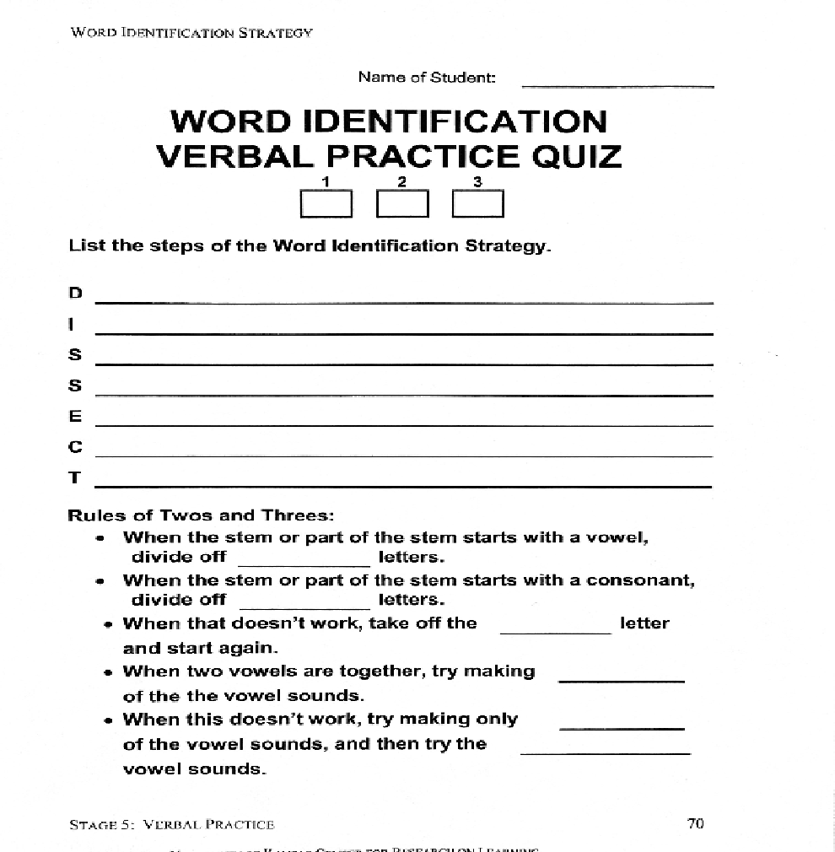

Slide 112
DAY 5
Notes:
Word ID manual pages 73 & 74 Independent Practice

Slide 113
Start-Up Activity
In your journal, DISSECT these words:
environment
pandemonium
precipitate
perpendicular

Slide 114
Please get the following out of the Word ID section of your notebook:
Assignment Sheet
Word Beginnings List (both pages)
Word Endings List (both pages)
Word Identification Strategy Worksheet (only one page)
Notes:
Assignment Sheet page pg. 10 Student notebook

Slide 115
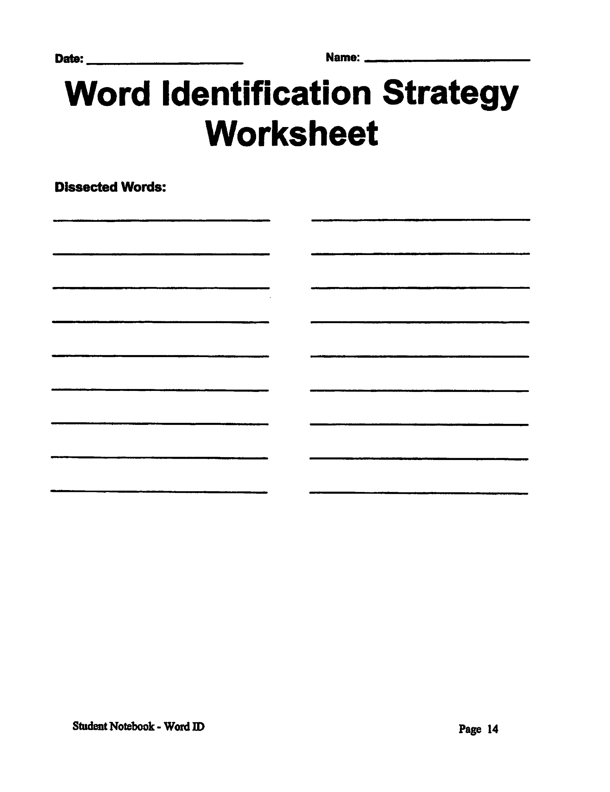
Notes:
Student Notebook page 14

Slide 116
Within all the passages that we will be reading, there are 16 words that have been highlighted.
You will stop and use the strategy each time you come to a word that has been highlighted.
You will write your dissections on the Word Identification Strategy Worksheet.
Notes:
Choose passages from the student materials based upon instructional level. Use the San Diego results to determine where to start students. Make copies. To save paper, place copies in acetate sheets. Students can write their answers to the comprehension tests on the worksheet.

Slide 117
You will also dissect four additional words of your choice for a total of twenty words.
You will do the entire passage by yourself. I will review your paper and give your points for words that you have correctly dissected.
Be sure to carefully mark in your ‘Ls’ and backward ‘Ls’ and vertical lines.
Remember to use the rules of 2’s and 3’s.

Slide 118
When you have completed dissecting 20 words, take the comprehension quiz.
Circle the letter of the correct answer.

Slide 119
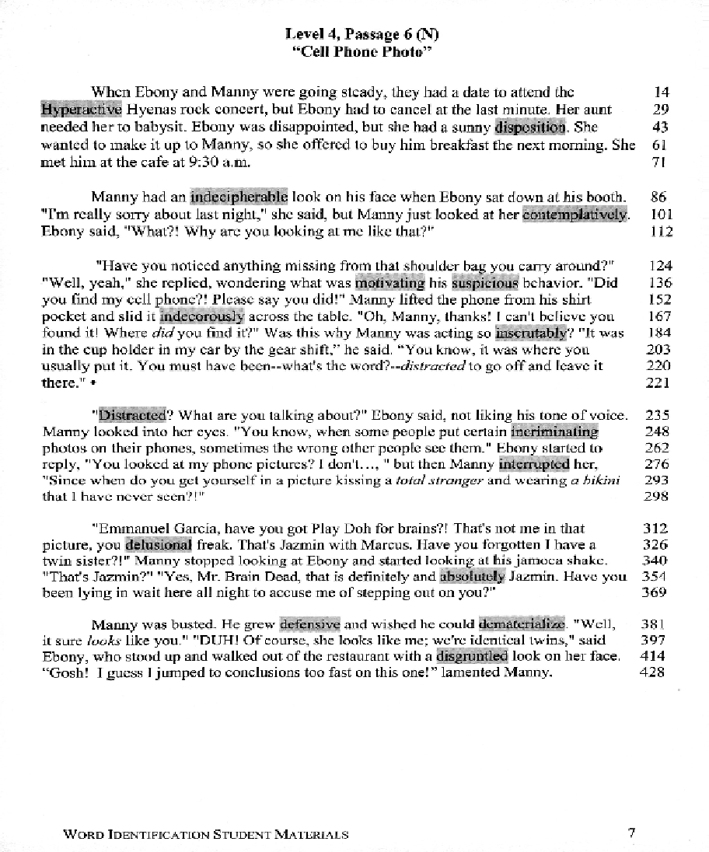
Notes:
This is a passage from the student practice materials page 7 (4th grade level)

Slide 120
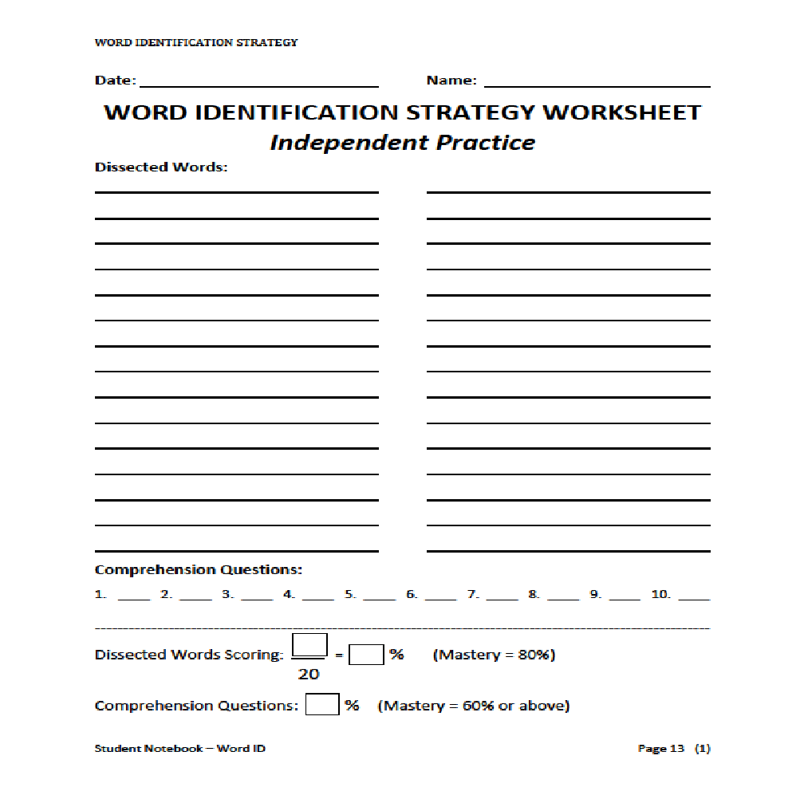
Notes:
Independent Practice worksheets on page 13 of Student notebook in Word ID section. The fillable PDF is on the Florida Xtreme flash drive in the Word ID folder.

Slide 121
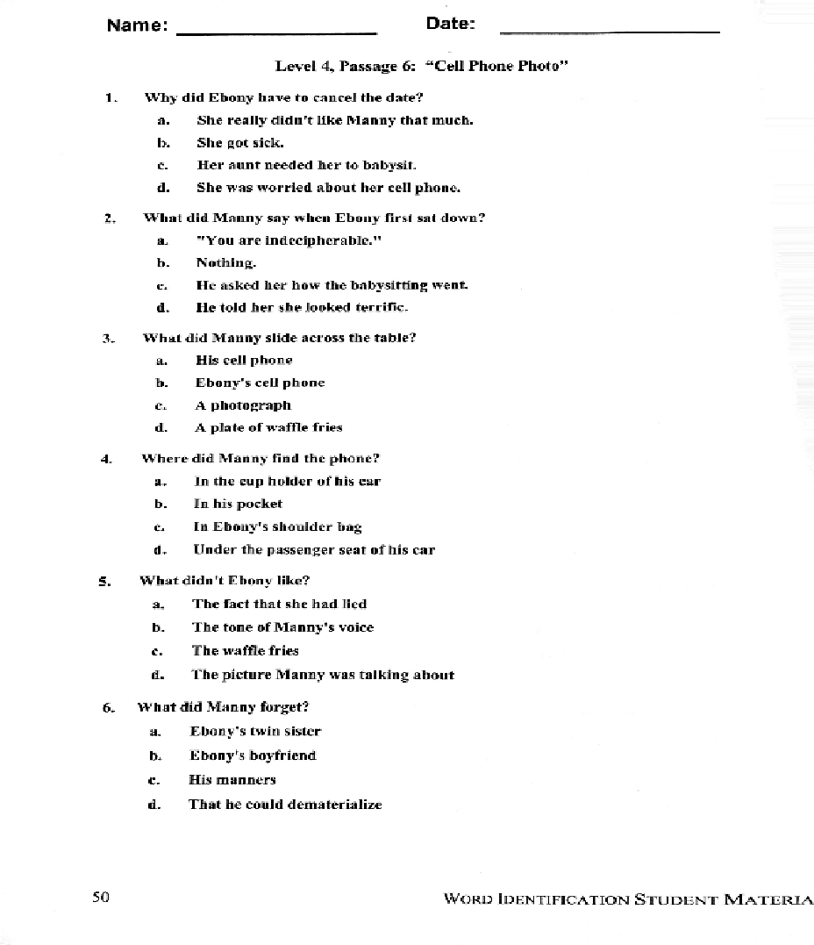
Notes:
Answers 1-c 2-b 3-b 4-a 5-b 6-a

Slide 122
Trade papers with your shoulder partner.
Each person will check their partner’s paper.
If you disagree with the dissection, write the word at the bottom of the page.
Notes:
If you do not want students to write on the question page, ask students to number 1-6 and write answers at the bottom of the sheet.

Slide 123
Work together with the person you exchanged paper with to try and decide the correct way to dissect the word(s).

Slide 124
GUIDED READING
Notes:
See instructions on pg. 14 of Word ID manual in the Teachers Word ID notebook.

Slide 125
DAY 6
Notes:
Paired Practice

Slide 126
Start-Up Activity
In your journal DISSECT the words:
imagination
entertained
admirable
inflationism

Slide 127
REVIEW
What does the word dissect mean?
What are the steps of the Word Identification Strategy?
What is the ruled of 2s and 3s?
When should you “Check with Someone”?
Where will you use the strategy?

Slide 128
GET READY
Please get out the following pages from your WORD ID section, then take everything else off of your desk :
Prefix and Suffix Lists
Paired Practice Checklist for students
Reading Passage
Notes:
Instructions are in the Word ID manual Stage 7 Paired practice 89-90

Slide 129
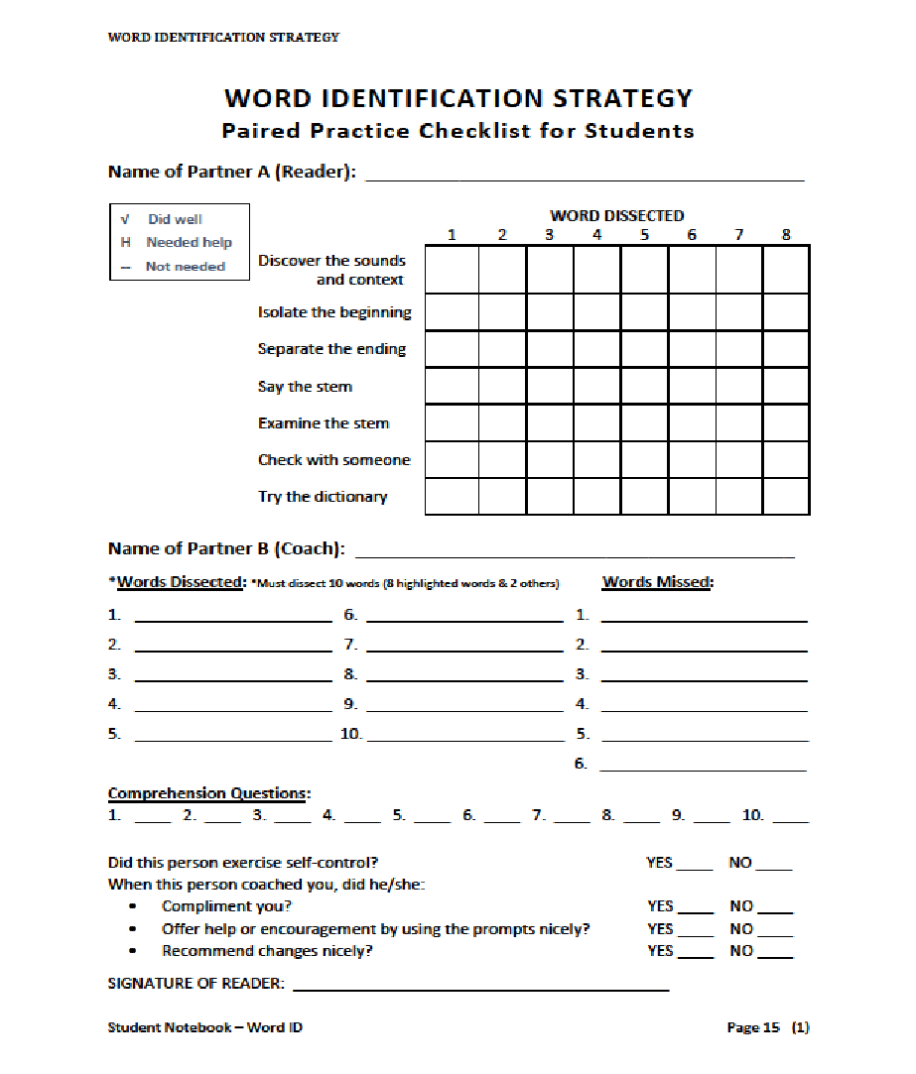
Notes:
Page 15 of Student Notebook in Word ID Section. Fillable PDF is on Florida Xtreme Flash drive in Word ID folder

Slide 130
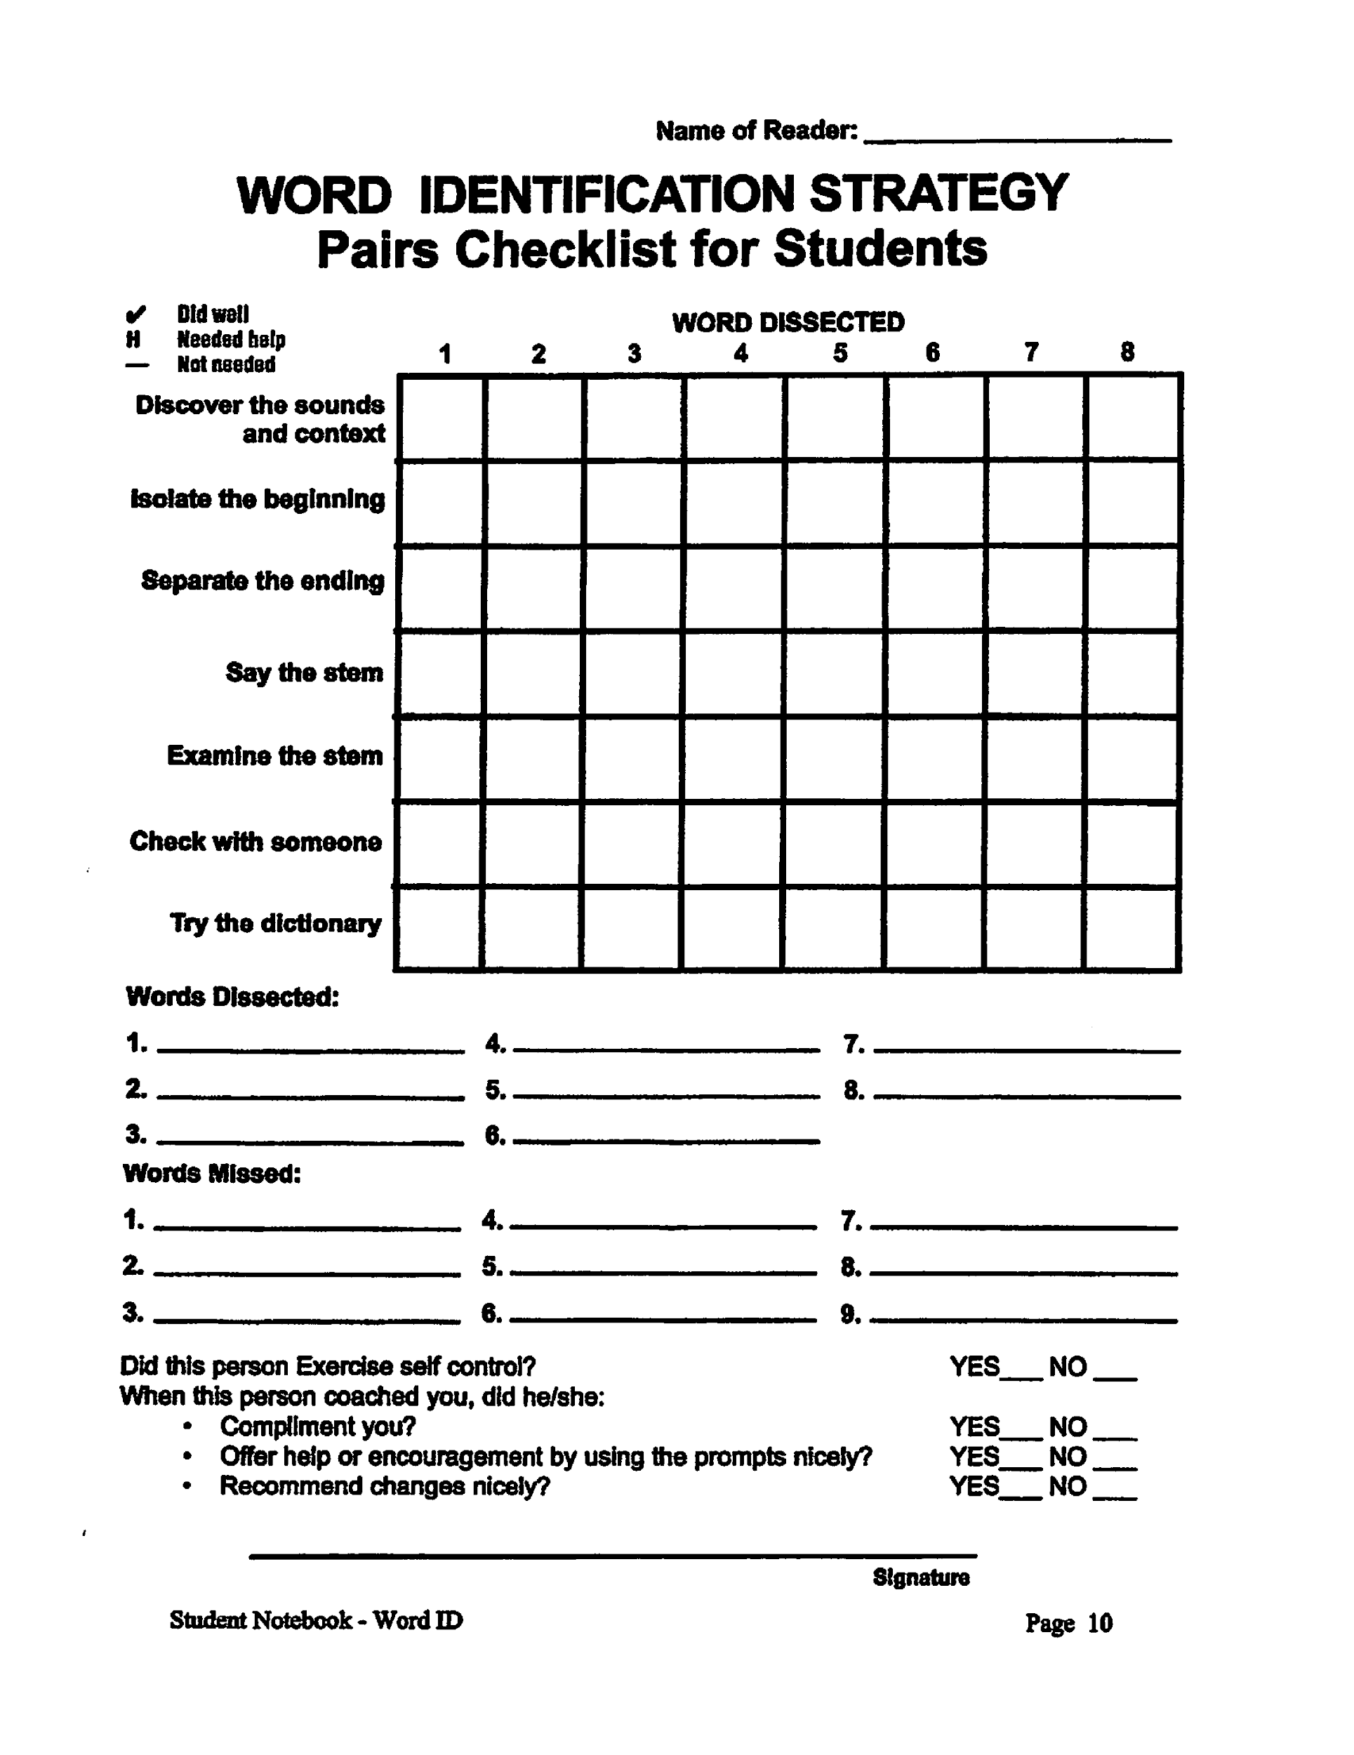

Slide 131
Today, you will be practicing using the Word Identification Strategy with a partner.
You will work with your shoulder partner.
You will work together and help each other learn to apply the strategy to more and more difficult reading materials over the next few days.

Slide 132
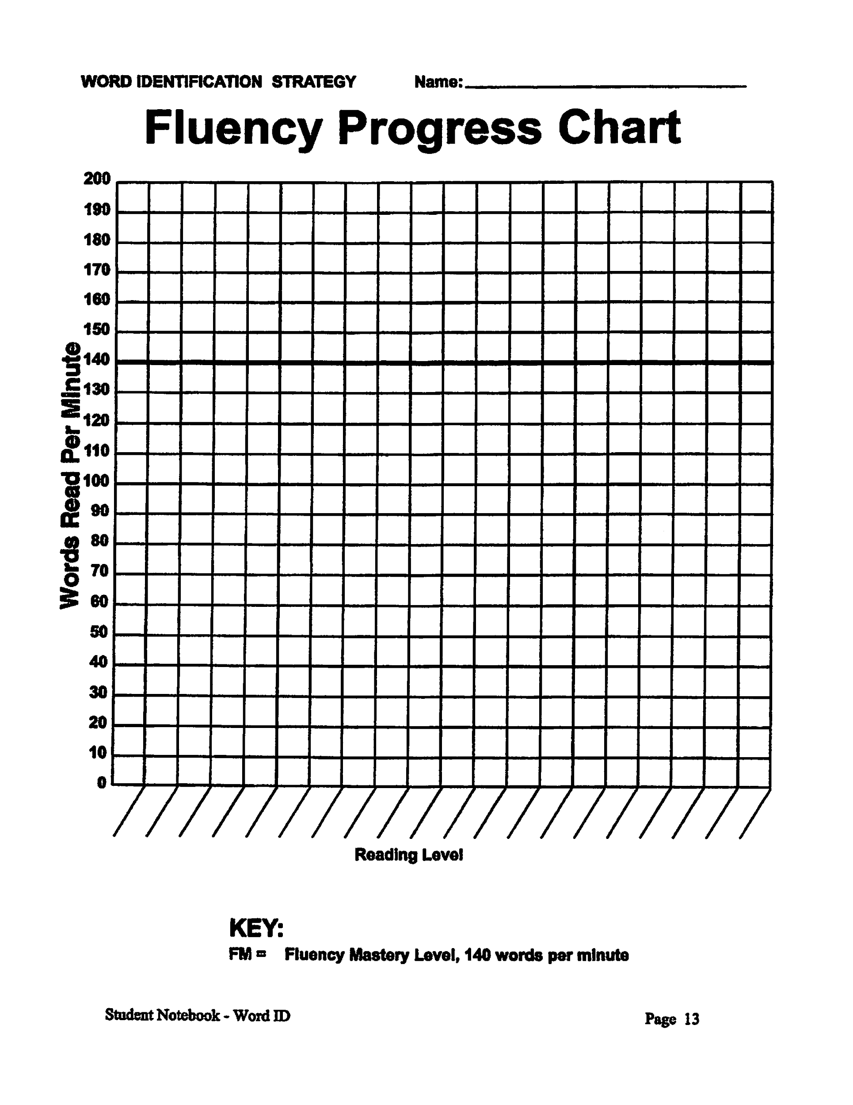
Notes:
Student notebook page 12

Slide 133
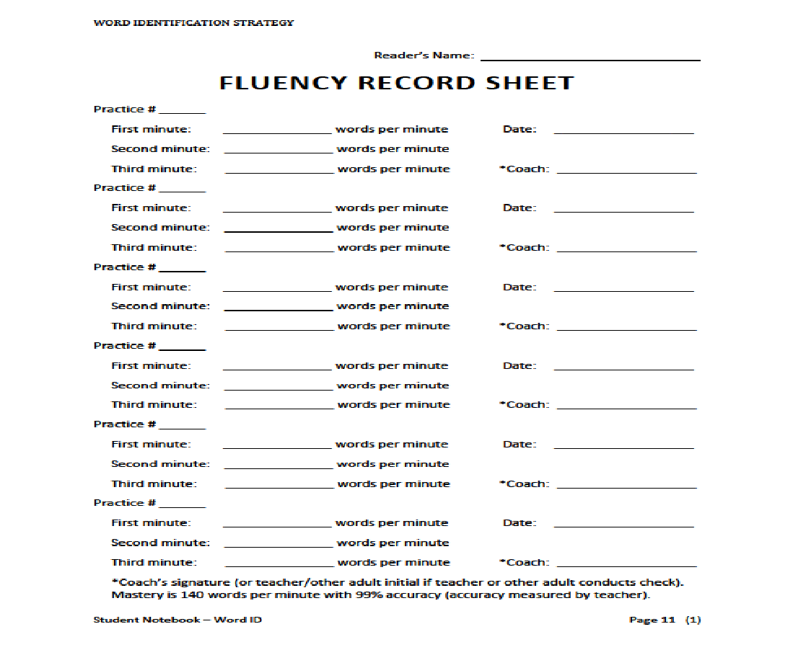
Notes:
Page 11 of student notebook. Fillable PDF is on Xtreme Florida Flashdrive in Word ID folder

Slide 134
Your goal, across all paired-practice activities that you will be completing, is to make sure that both you and your partner can eventually apply all parts of the strategy without any hints or any type of help.
Another goal of this activity and others that we will be doing is to work up to applying the strategy to materials written at your grade level.

Slide 135
You will start applying the strategy to the easiest reading materials, so you can concentrate on using the strategy steps with your partner.
As you progress, you will read more difficult materials.
Notes:
Page 87 Word ID Manual ( Step C involves another step discussing bonus points – please add if this is appropriate for your classroom)

Slide 136
There are two types of activities you will do with your partner.
First, you will do the reading aloud activity.
Second, you will do the fluency activity.
Notes:
Word ID Manual page 88

Slide 137
2 Roles
READER’S ROLE
COACH’S ROLE
The first reader will read aloud from the beginning of the passage up to the dot and will dissect 8 highlighted words and any other unknown words on the Paired Practice Practice Checklist.
When you are the reader, be sure to read the entire sentence.
Do all the DISSECT steps you need to do in order to pronounce the words correctly.
You must dissect at least 10 words when you are the reader.
The coach will help by giving the prompts on the Partner Sheet if necessary.
The coach will also serve as the person you can ask for help in the “Check with Someone” step.
If neither of you knows the word, you will look it up in the dictionary.
After you look it up, you will add it to your vocabulary journal, so that you will remember its meaning.
The coach will also provide feedback and record the reader’s performance of the steps on the Paired Practice Checklist.
Notes:
To determine pairs, look at your San Diego Results and put your students in order from highest reader to lowest. Pair up students where one is a bit stronger, but not so much higher. Designate the stronger reader in the Pair as the first reader always.

Slide 138
Once you have been the reader, then you will stay with your partner and assume the coach’s role.
The reader will start at the dot and will dissect all 8 highlighted words and any unknown words on the paired practice checklist.
The reader must dissect at least 10 words.
The second coach will provide help by using the prompts on the sheets as necessary.
The second coach will also provide feedback and record the second reader’s performance of the steps on the checklist.

Slide 139
Things to Remember
Coach
Reader
When you are a coach, remember to compliment your partner when he/she does well and to recommend changes nicely and provide help and encouragement when it is needed.
When you are the reader, remember to exercise self-control and stay calm as your coach helps or makes suggestions.

Slide 140
Scoring System
To record how your partner performs each step of the strategy each time he/she dissects a word, you will make a mark on the checklist.
Partner correctly completes the step
H
Partner needed a hint from the coach about what to do next
-
The step was not needed

Slide 141
DISSECTING WHILE READING
When the reader dissects a word, the reader will write the word in the section labeled ‘Word Dissected.’
Then DISSECT the word right there on the Paired Practice Sheet.

Slide 142
In the section labeled ‘Words Missed,’ the coach will write any words the reader skipped or mispronounced and did not stop to DISSECT.
If you skip over it or mispronounce it and don’t go back to DISSECT it, your coach will write it on this list.
If your coach has to suggest that you go back and DISSECT a word, he will record the word on this list and will write an “H” next to the first step of the strategy.

Slide 143
At the end of the activity, your partner will rate the job you did as a coach.
He/she will check off whether you complimented him/her, whether you recommended changes nicely, and whether you were helpful and encouraging.
He/she will do this on the record sheet that he/she will make when you use the strategy as a reader.

Slide 144
MODEL READ-ALOUD
Notes:
Select a student to model this with you. Have the student read first so that you can model coaching using the score sheet. Then, flip it . Don’t forget comprehension quiz.

Slide 145
Paired Practice
Notes:
Novel.

Slide 146
GUIDED READING
Notes:
Novel.

Slide 147
DAY 7

Slide 148
Start-Up Activity
In your journal, DISSECT the following words:
impoverish
implement
furnishing
exultation

Slide 149
GET READY
Please get out the following pages from your WORD ID section, then take everything else off of your desk :
Fluency Progress Chart
Fluency Record Sheet
Word Identification Paired Practice Checklist
Prefix and Suffix Lists
Reading Passage from our last class
Notes:
Fluency Record Sheet Page 11 Student Notebook

Slide 151
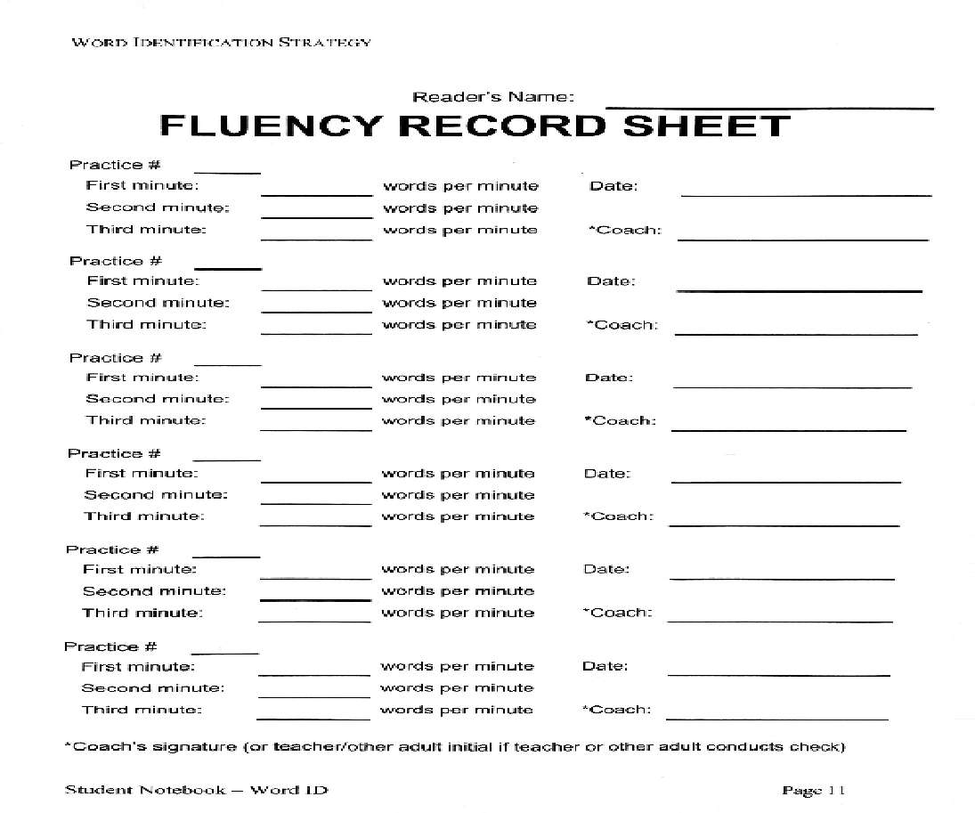
Notes:
Pg. 11 student notebook

Slide 152
FLUENCY
After you finish the paired practice checklist sheet, you will do a fluency activity.
What is fluency?
What is expression?
The first time you go through a passage, you probably won’t be very quick or smooth while reading it, and your voice won’t have much expression because you will be stopping to dissect the words.
Notes:
Word ID manual 90-95

Slide 153
Doing the fluency activities will help you become fluent readers.
You will gradually learn to read more and more difficult material with fluency.
In this activity, you and your partner will each read as quickly and smoothly and with as much expression as you can in 1 minute.

Slide 154
You will use timers to read for one minute. The coach will set the timer, so the reader can focus on reading.
Start reading after the dot on your page.
The coach will tell the reader when one minute is up.
The reader will mark a line after the last word that they read.
Notes:
Timers can be desk timers, Google Extension timers, or phone timers

Slide 155
Each line has the number of words at the end.
You may need to subtract a few words if you didn’t read to the end of the line.
Your coach will record the number on the fluency record sheet.

Slide 156
Then the first reader will read the same part of the passage again for one minute, and the coach will record the number of words on the Fluency Record Sheet in the blank next to the words ‘Second Minute.’
Then the first reader will read the same part of the passage again for one minute, and again the coach will record the number of words read on the blank next to the words ‘Third Minute.’

Slide 157
You will then switch roles.
The second reader will read three times for one minute each time, starting at the dot.
Be sure to stop after each minute to record the number of words read each time.
You will need to subtract the number of words from where you started to the number of words where you ended to determine the number of words read.

Slide 158
Fluency Progress Chart
At the end of the exercise, you will have each read three times for one minute each.
Your goal is to increase the number of words you read, the smoothness with which you read, and the expression you use each time that you read.
Each day, you will try to beat your last record.
You will record the highest number of words read per minute each time you do fluency practice the Fluency Progress Chart.
Notes:
Emphasize that this is not a race. They are trying to be the most fluent reader. This does not mean the fastest.

Slide 159
MODEL FLUENCY PRACTICE
Notes:
Use the same passage as Independent Practice, or select another.

Slide 160
PARTNER FLUENCY PRACTICE

Slide 161
GUIDED READING
with Word ID

Slide 162
DAY 8

Slide 163
Start-Up Activity
In your journal, DISSECT the following words:
obdurate
monotonous
insubordination
anthropology

Slide 164
Differentiated Practice
Today, I will be working individually with students at my desk.
When I call your name, come over to work with me individually.
While I am working with someone individually, I expect everyone to be completing their assigned independent practice activity.
Notes:
Word ID Manual 111-114

Slide 165
Differentiated Practice
While I am working with you individually, I expect you to show me your very best performance of the strategy steps.
I will explain to you what you need to do in order to perform the strategy better.
I expect you to exercise self-control when accepting my feedback.

Slide 166
Differentiated Practice
I will give you a grade on your performance for the day as well as tell you whether you can move to the next level or whether you have mastered the strategy.

Slide 167
Differentiated Practice
Teacher will work with students individually
Independent Practice:
Assignment Sheet
Word ID passage
Comprehension quiz
Word ID Independent Practice Score Sheet
Prefix/Suffix Lists
Notes:
Word ID manual Stage 8 pages 110-114 Independent Score sheet page 116 Achieve Expectations for Differentiated Practice. Student must read 99% of words correctly to go to the next level. Mastery is 99% words correctly on grade level passages. This is the post test.

Slide 168
GUIDED READING

Slide 169
DAY 9
Notes:
Starting Word Mapping..will need to run off Prefix Lessons 1 & 2 for students on pages 45 &46 & quizzes pages 165,166

Slide 170
Start-Up Activity
In your journal, DISSECT the following words:
impoverish
implement
furnishing
exultation

Slide 171
Notes:
Word Mapping Manual : Teacher lesson with table pg. 45 & 46 Quiz pg. 165 Student worksheet prefix lesson 1 page 147. On flash drive, there is a chart for students to use for each lesson as you display the affix, meanings and example words. Otherwise, students make a T- chart in their journals.

Slide 172
Paired Practice
Get out:
A blank Word ID paired practice checklist for students
Your first Word ID paired practice sheet
Your Word ID fluency record sheet
Your Word ID fluency progress chart
Word ID Assignment Sheet
Word Mapping Prefix and Suffix Lists

Slide 173
We will be finishing up our Paired Practice #2 today.
Please get with your partner to finish the Paired Practice Checklist and the Fluency Check.
When that is completed, see Mrs. Palasak to get a comprehension quiz.
Turn all of the things into the basket listed at the bottom of today’s agenda.
Then, read your new independent novel while we wait for everyone to finish.

Slide 174
DAY 10

Slide 175
Start-Up Activity
Complete Activity #2 on your Prefix Lesson 1 Learning Sheet.
Isolate the prefixes on all the listed words.
Notes:
Teacher lesson with table pg. 45 & 46 Quiz pg. 165 Student worksheet prefix lesson 1 page 147.

Slide 176
Differentiated Practice
Teacher will work with students individually
Independent Practice:
Assignment Sheet
Word ID passage
Comprehension quiz
Word ID Independent Practice Score Sheet
Prefix/Suffix Lists

Slide 177
GUIDED READING

Slide 178
DAY 11

Slide 179
Start-Up Activity
In your journal, make a Word Map for these words:
illegal
irregular

Slide 180
Paired Practice

Slide 181
GUIDED READING

Slide 182
DAY 12

Slide 183
Start-Up Activity
In your journal, make a Word Map for these words:
dislocating
manuscript

Slide 184
Independent Practice

Slide 185
GUIDED READING

Slide 186
DAY 13

Slide 187
Start-Up Activity
Complete Activity #3 on your Prefix Lesson 1 Learning Sheet
Show that you know the meaning of each word by filling in the blanks.
Notes:
Teacher lesson with table pg. 45 & 46 Quiz pg. 165 Student worksheet prefix lesson 1 page 147.

Slide 188
Paired Practice Vocabulary Verbal Rehearsal

Slide 189
Paired Practice
Notes:
Paired Practice Word ID .

Slide 190
Prefix Quiz #1

Slide 191
DAY 14

Slide 192
Start-Up Activity
Notes:
Teacher lesson with table pg. 45 & 46 Quiz pg. 165 Student worksheet prefix lesson 1 page 147.

Slide 193
Independent Practice
Notes:
Word ID Independent Practice and Differentiated Practice. Individual practice with 2 students.

Slide 194
DAY 15

Slide 195
Start-Up Activity
Complete Activity #2 on your Prefix Lesson 2 Learning Sheet

Slide 196
Paired Practice

Slide 197
GUIDED READING

Slide 198
DAY 16

Slide 199
Start-Up Activity
In your journal, make a Word Map for these words:
enslave
empower

Slide 200
Independent Practice

Slide 201
GUIDED READING

Slide 202
DAY 17

Slide 203
Start-Up Activity
In your journal, make a Word Map for these words:
illuminate
bibliography

Slide 204
Paired Practice

Slide 205
GUIDED READING

Slide 206
DAY 18

Slide 207
Start-Up Activity
Complete Activity #3 on your Prefix Lesson 2 Learning Sheet

Slide 208
Paired Practice Vocabulary Verbal Rehearsal
Word Mapping Prefix Lesson 1 & 2

Slide 209
Independent & Differentiated Practice

Slide 210
Prefix Quiz #2

Slide 211
End of Word ID

