Slide 1

The Self Questioning Strategy
ASK IT

Slide 2

The Self Questioning Strategy will help you
Understand and Remember
What you read.

Slide 3


You can use the strategy when you read
Novels or stories
Textbooks

Slide 4
The strategy will help you learn to
Ask yourself a question
And then
Make a prediction about the answer.

Slide 5

Students who learned the strategy raised their grades!
Grades went from F’s to B’s!

Slide 6
Steps for the
Self-Questioning Strategy
Step 1: A ttend to clues as you read
Step 2: S ay some questions
Step 3: K eep predictions in mind
Step 4: I dentify the answers
Step 5: T alk about the answers

Slide 7
Steps for the
Self-Questioning Strategy
Step 1: Attend to clues as you read
Step 2: Say some questions
Step 3: Keep predictions in mind
Step 4: Identify the answers
Step 5: Talk about the answers

Slide 8
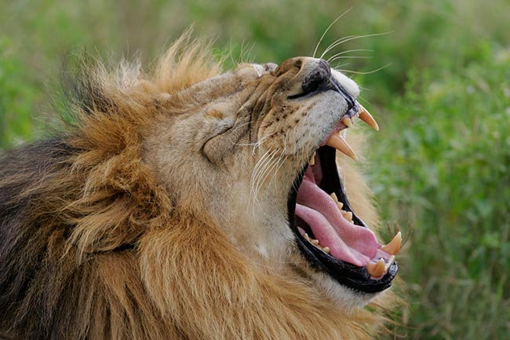
Clues make you wonder.
Look at the picture. What clues make you wonder?

Slide 9
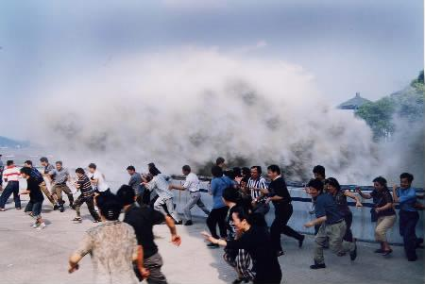
What clues make you wonder?

Slide 10

STEP 1
Look for these things:
Title
First Sentence
Visual Clues – Bold Letters or Italics
Word Clues – Nouns, Verbs, Adjectives, Adverbs

Slide 11
What Do You Wonder?
Titles
  "Mountain Madness"
  "Partners in Grime"
  "Miracle at Midnight"
  "Invisible Again”

Slide 12
Authors often use the first sentence of a passage or paragraph to give you clues about its meaning.

Slide 13
Look for word clues.
“I’d never given much thought to how I would die- though I’d had reason enough in the last few months- but even if I had, I would not have imagined it like this.
I stared without breathing across the long room, into the dark eyes of the hunter, and he looked pleasantly back at me”
  Twilight by Stephanie Meyer
Notes:
Table share – what words make you wonder? List on post it

Slide 14
Attend to Visual Clues
The pilgrims had tough lives. (bold type)
The American constitution was adopted in 1787.
Our national anthem is The Star-Spangled Banner. (italics)
The first book in the Harry Potter series was Harry Potter and the Philosopher’s Stone.
Notes:
Text features, parts of speech

Slide 15
Sometimes parts of speech can act as clues.
Nouns (person, place, thing,)
Verbs (action words)
Adjectives (describing words)
Adverbs (words that tell when, where, how)

Slide 16
Look for word clues – different types of words.
The boy wandered aimlessly among the trees.
Kathy's mother sent her to the store.
Two new toys have become available for teenagers.
The mission ran into a major problem.

Slide 17
Steps for the
Self-Questioning Strategy
Step 1: Attend to clues as you read
Step 2: Say some questions
Step 3: Keep predictions in mind
Step 4: Identify the answers
Step 5: Talk about the answers

Slide 18

STEP 2
Say a question related to your clues.

Slide 19
What kind of questions could you ask?
Y
Who Why
What Which
When How
Where
H

Slide 20
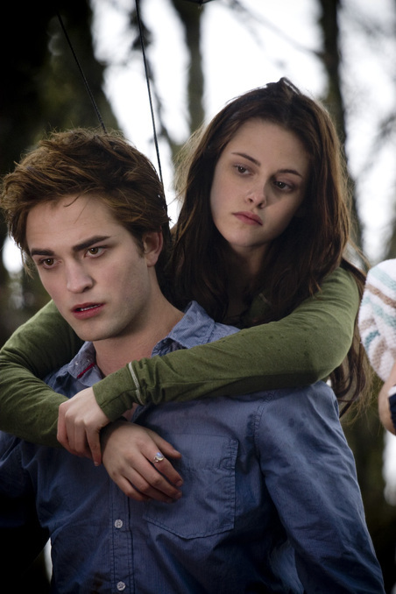

Look for clues. What do you see?
Questions?

Slide 21
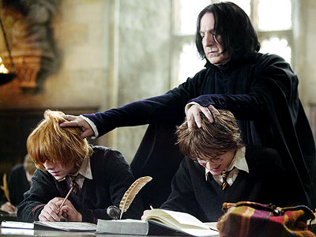
Look for clues. What do you see?
Questions?

Slide 22
Steps for the
Self-Questioning Strategy
Step 1: Attend to clues as you read
Step 2: Say some questions
Step 3: Keep predictions in mind
Step 4: Identify the answers
Step 5: Talk about the answers

Slide 23

STEP 3
Questions
Lead to
Predictions

Slide 24
A prediction is an educated guess

Slide 25
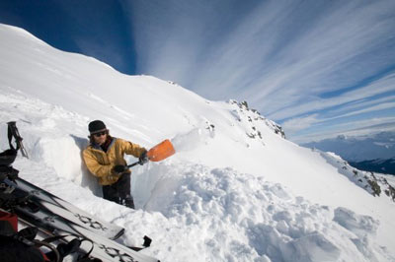
Clues … Questions … Predictions
(What clues do you see? What questions do you have? What are your predictions?

Slide 26
I’m going to show you a passage.
Attend to clues
Say some questions.
Keep predictions in mind.

Slide 27
They look like aliens from a Star Wars movie. They wear body armor from their shoulders down to their shins. Thick pads shield their chests, hips, arms, and legs. The special gloves they wear have padding on each finger.
On their heads they display space-age helmets designed to protect the face as well as the head.

Slide 28
Steps for the
Self-Questioning Strategy
Step 1: Attend to clues as you read
Step 2: Say some questions
Step 3: Keep predictions in mind
Step 4: Identify the answers
Step 5: Talk about the answers

Slide 29

STEP 4
Keep reading to see if your predictions are correct.

Slide 30
They look like aliens from a Star Wars movie. They wear body armor from their shoulders down to their shins. Thick pads shield their chests, hips, arms, and legs. The special gloves they wear have padding on each finger.
On their heads they display space-age helmets designed to protect the face as well as the head.
Meet the daredevils known as downhill mountain bike racers.

Slide 31


Slide 32
Steps for the
Self-Questioning Strategy
Step 1: Attend to clues as you read
Step 2: Say some questions
Step 3: Keep predictions in mind
Step 4: Identify the answers
Step 5: Talk about the answers

Slide 33


STEP 5
Let’s talk!
Talk to a classmate.
Talk to a friend.
Talk to yourself … (but not out loud)

Slide 34
SELF-QUESTIONING STRATEGY STEP SEQUENCE
Attend to Clues
Identify the
Step 1:
Step 4:
as you read
answers
Say some
Talk about the
Step 2:
Step 5:
questions
answers
Keep predictions
Step 3:
in mind
and
Notes:
34
The Challenge

Slide 35

Steps for the Self-Questioning Strategy
Read a paragraph, then
Step 1: Attend to clues as you read
Step 2: Say some questions
Step 3: Keep predictions in mind
Step 4: Identify the answers
Step 5: Talk about the answers AND
Keep Repeating the Steps
Read the next paragraph, then

Slide 36

The Self Questioning Strategy will help us understand what we read.
Leitzell –NC CLC Project

