Slide 1
The Possible Selves Strategy
Authors:
Michael Hock
Jean Schumaker
Donald Deshler
Presentation Compiled By: Bonnie Palasak
Revised July 2020

Slide 2
The Possible Selves Strategy
Notes:
Mike 10 minutes

Slide 3
Day 1

Slide 4
Get out your journal (spiral notebook).
Think about yourself.
In your journal, make a list of at least 8 words that people who know you would use to describe you.
Start-Up Activity

Slide 5
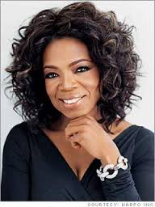
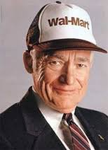
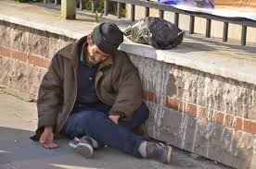
For the next few weeks, we will examine what makes some people successful, and what keeps others from achieving success.
We will do this through a program called possible selves.

Slide 6
I believe that you will find this program to be one of the most important learning experiences you will have this school year.
In fact, I believe the level of success you experience in school and later on in life could be directly related to your participation in this program.

Slide 7
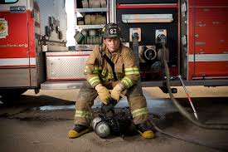
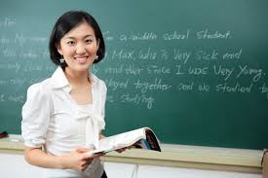
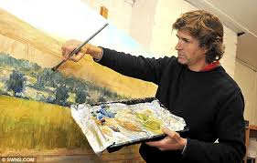
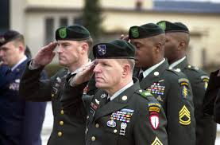
Do your best to be open-minded, and be willing to participate as we explore what your future holds for you.

Slide 8
Possible selves are ideas about what you might become in the future.

Slide 9
Fear of the Future
“Next year I hope to be in school, legally at home, and stop using drugs.”
“I expect to be using drugs and alcohol, be involved in crime, start fencing again, and be at home.”
“I’m fearful I might start using morphine or heroin, doing worse crimes like armed robbery, and living on the streets.
Paul
a 16 year-old boy
living in a maximum security school for delinquents
Notes:
Possible Selves page 54
What do you think the future holds for this young man? Why? What does he hope will happen to him? What does he expect will happen to him? What does he fear will happen to him? Does he seem to have a plan to improve his life? If you could give this young man some advice, what would you say to him?

Slide 10
I Have a Dream
“When I grow up I want to be a judge.”
“First, I will need to become a good lawyer, so I have to study hard now and finish high school with good grades.”
“Then, I will be able to go to a good college and, later, to a good law school.”
Jamaal
14 year-old boy
Urban area
Participant in the “I Have a Dream” program.
Notes:
What do you think the future holds for Jamaal? Why? What does Jamaal hope will happen to him? What does he expect will happen to him? Does he seem to have a plan to improve his life? If you could give this young man some advice, what would it be?

Slide 11
Compare/
Contrast Paul and Jamaal

Slide 12
Success starts
with a
DREAM

Slide 13
SO

Slide 14
The power of a dream …

Slide 15
https://www.youtube.com/watch?v=IjMTiKtwyKk&app=desktop
October Sky
https://www.youtube.com/watch?v=Qoh3YkxuwVo
Rudy
https://www.youtube.com/watch?v=UZb2NOHPA2A
The Pursuit of Happyness
https://www.youtube.com/watch?v=mk82j1jQw_8
Rocky Balboa

Slide 16
GOAL FOLDERS

Slide 17
Hope and a Dream+ Mentor + Effort = Success

Slide 18
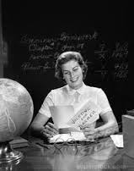
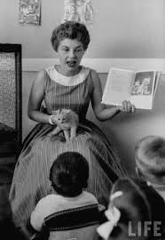
Jamaal had a mentor.
This year I will serve as your mentor and help you establish and reach goals that will eventually allow you to accomplish your dreams.

Slide 19
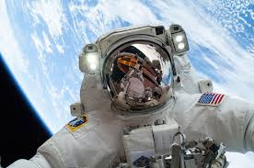
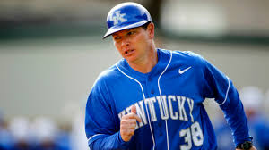
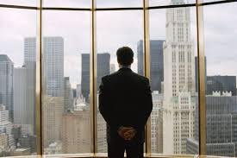
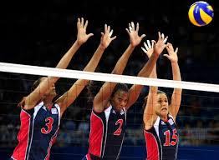

Slide 20
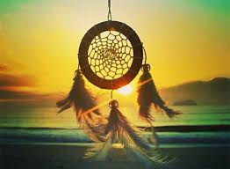
As legend has it, long ago, a young Native American maiden was taught to weave a web, much like a spider does.
Afterward, she wove a web into the form of a dream catcher.
This dream catcher when hung in her lodge would catch all her dreams, good and bad.
The bad dreams would be caught in the webbing, where they would be burned off by the morning light.

Slide 21
The good dreams would also be caught, but they would find their way to the center of the web and filter down into feathers attached to the web.
There they would be held only to return another night and be dreamed again.
As these good dreams were repeated over and over, they became real.

Slide 22
Unit Organizer

Slide 23
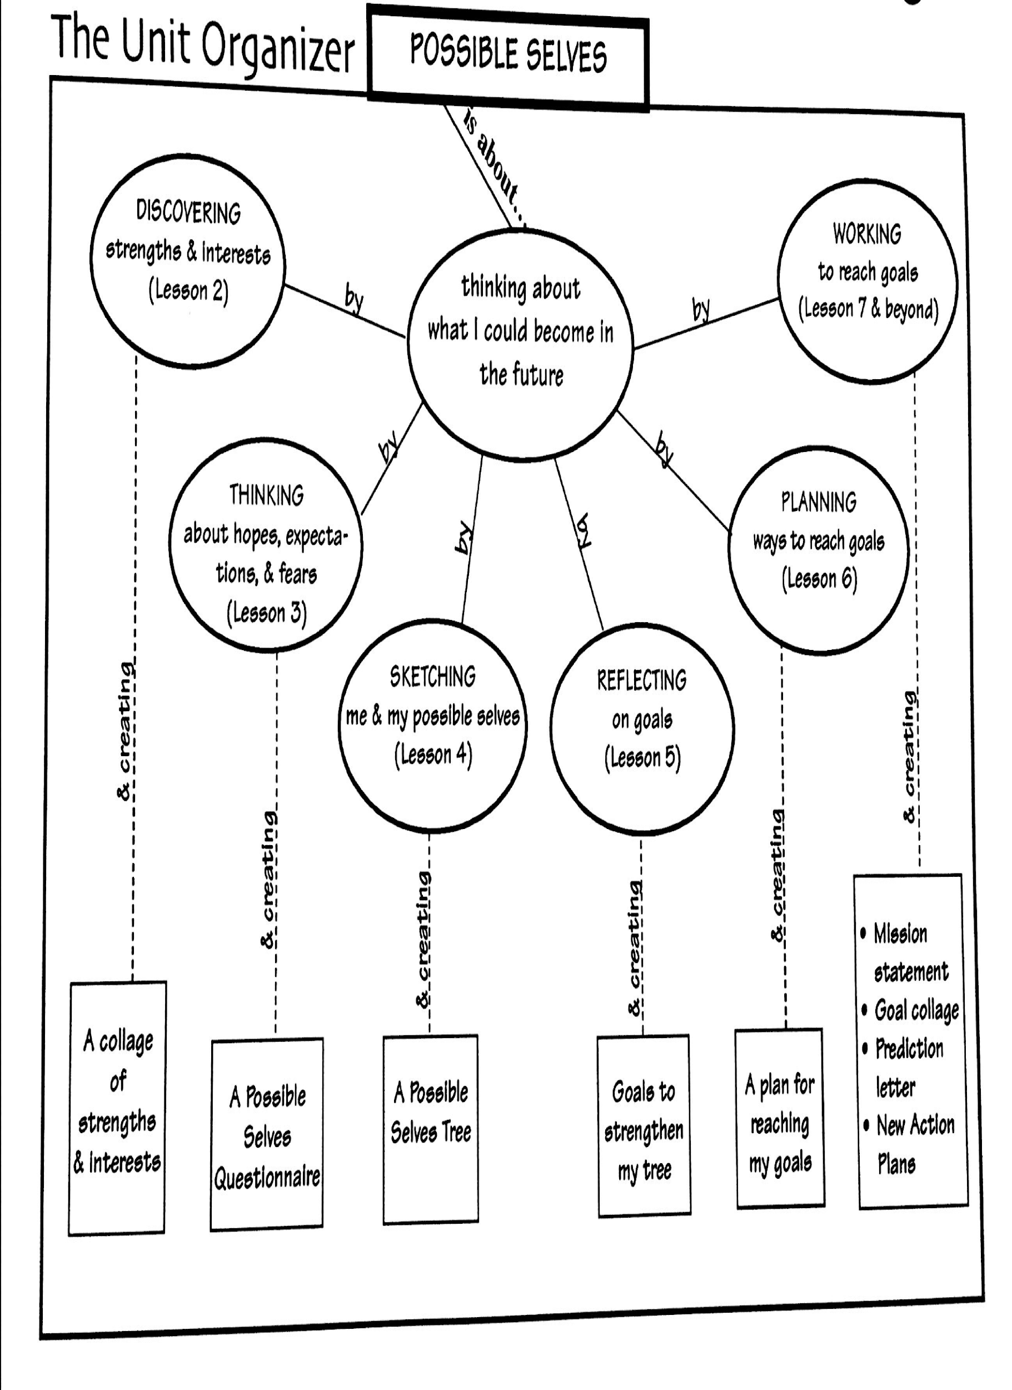

Slide 24
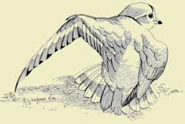
Dreams
Hold fast to Dreams
For if Dreams die
Life is but a broken-
winged bird
That cannot fly
-Langston Hughes

Slide 25
Guided Reading

Slide 26
Day 2

Slide 27
Make memory maps for the prefixes “un” and “dis”
Start-Up Activity

Slide 28
Questionnaire Vocabulary
Individual Strengths
Learner
Person
Individual Strengths

Slide 30
Think about your individual strengths, interests, and dreams.
Think about all of the areas and activities in which you are interested and feel that you have some skill or knowledge.

Slide 32
Section 1: Individual Strengths
What is one thing you are good at doing?
Use words or phrases to describe you in this area.
What are some things you hope to achieve in this area?

Slide 33
Identify your interests …

Slide 34
Guided Reading

Slide 35
Day 3

Slide 36
Think about yourself as a student or learner.
In your journal, write two complete sentences that describe your strengths as a learner.
Start-Up Activity

Slide 37
Questionnaire Vocabulary
Hopes
Expectations
Fears
Individual Strengths
Learner
Person
Learner

Slide 38
Guided Reading

Slide 39
Day 4

Slide 40
Make a word map for the words:
disability
dislocate
Start-Up Activity

Slide 41
Questionnaire Vocabulary
Hopes
Expectations
Fears
Individual Strengths
Learner
Person
Person

Slide 42
Guided Reading

Slide 43
Day 5

Slide 44
Make a list of places you would like to work.
Start-Up Activity

Slide 45
Questionnaire Vocabulary
Hopes
Expectations
Fears
Individual Strengths
Learner
Person
Worker

Slide 46
Guided Reading

Slide 47
Day 6

Slide 48
Make a word map for the words:
enslave
discomfort
Start-Up Activity

Slide 50
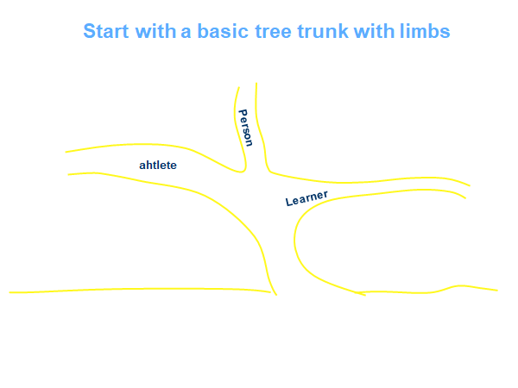

Slide 55
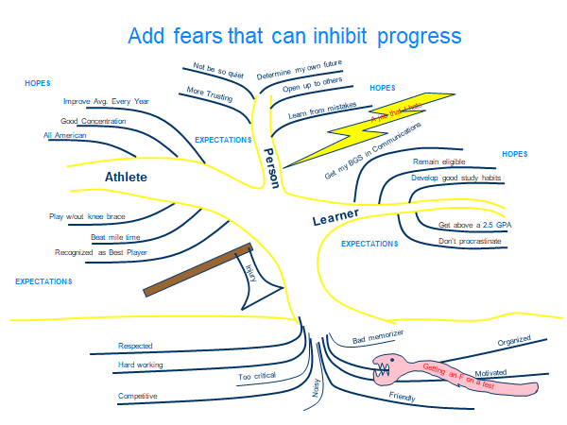

Slide 56
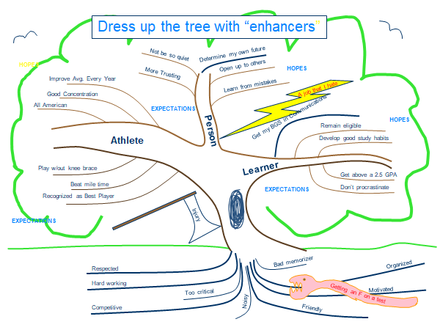

Slide 57
End of Possible Selves

