Slide 1
The Inference Strategy
will help you understand what you read.

Slide 2
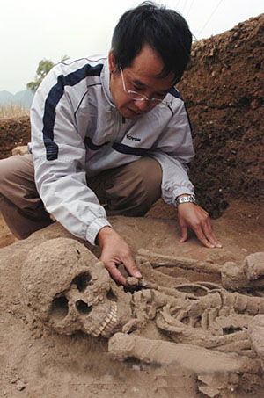
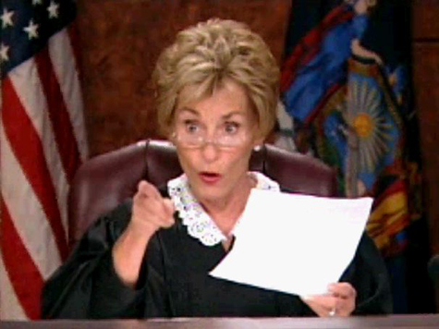
What does infer mean?
Crime scene investigators do it.
Judges do it.
Archeologists do it.
Scientists do it.

Slide 3
Good Readers do it!
Infer means to make a conclusion or guess about something
based on hints or facts that you have learned.

Slide 4
You can use the Inference Strategy to do your best….
On College
Entrance Exams
On Tests
To show what you know

Slide 5
INFERence Strategy
Interact with the questions and passage.
Note what you know.
Find the clues.
Explore any supporting details.
Return to the questions

Slide 6
First step: Interact with the questions and passage.
This means to think about or work with the questions.

Slide 7
Second Step: Note what you know.
Figure out the type of question and write a code letter next to it.
What kind of question
Is this?

Slide 8
There are 2 types of questions:
Factual – The answer is right there.
Think and Seek – You must think and look for clues to figure out the best answer.
There are 3 types of Think and Seek questions.

Slide 9
Think and Seek Questions
Big Picture Questions – Code B
Predicting Questions – Code P
Clarifying Questions – Code C

Slide 10
types of questions altogether.
Factual
Big Picture
Predicting
Clarifying

Slide 11
Third Step: Find the clues.
Look for clues to help answer the questions.

Slide 12
Fourth Step: Explore any supporting details.
Look for more details to support your answer.
Keep
Looking

Slide 13
Fifth Step: Return to the question.
Remember to answer the question!

Slide 14
End of Note Sheet #1 Now Practice Lesson 1

Slide 15
There are Factual and Think and Seek Questions
A FACT is something that is true or real.
A Factual Question will have an answer that is right there in the passage.

Slide 16
A Factual Question may begin with words like …
Who
What
Where
When
How
Factual questions will always ask for something
that is right there in the passage.

Slide 17
Attending to facts in a passage will help you be a better reader.

Slide 18
When you answer a factual question,
Make sure that the answer you choose is the same as or directly related to the information in the passage.

Slide 19
When you read a factual question,
Be sure to attend to key words in the question, so you know what clues to look for while you are reading,

Slide 20
After you read a factual question,
You need to look for key words and clues that are in the passage to help you answer correctly.

Slide 21
The Steps of the Inference Strategy
Interact with the questions and passage.
Note what you know.
Find the clues.
Explore any supporting details.
Return to the questions

Slide 22
End of Note Sheet #2 Now Practice Lesson 2

Slide 23
There are Factual Questions and Think and Seek Questions
The first type of Think and Seek Question is:
Big Picture - B

Slide 24
The Big Picture Question will ask for the
It may also ask for a summary or information on setting and tone.

Slide 25
Key words in Big Picture Questions:
Main idea
Purpose
Summary
Message
Theme
Setting
Tone

Slide 26
Main Idea
The big idea in a paragraph or passage.
Purpose
Author’s reason for writing the passage.

Slide 27
Summary
A short statement that tells about a long passage.
Message
The author’s communication in writing to the reader. What the author wants the reader to know or understand.

Slide 28
Theme
Another word for “message” or what the author wants the reader to know.
Setting
The place in which the story is located.

Slide 29
Tone
The feeling of the passage. The emotions the author is expressing through the use of certain words like adjectives and adverbs.

Slide 30
There are 3 reasons authors write:
Inform
Entertain
Persuade

Slide 31
The Steps of the Inference Strategy
Interact with the questions and passage.
Note what you know.
Find the clues.
Explore any supporting details.
Return to the questions

Slide 32
End of Notes Sheet #3 Now Practice Lesson 3

Slide 33
There are Factual Questions and Think and Seek Questions
The first type of Think and Seek Question is
Big Picture. The second type is Predicting.
Predicting- P
Guess
Forecast
the Future

Slide 34
A predicting question will require you to forecast what will happen next or in the future in relation to information already read.

Slide 35
Key words in Predicting Questions:
Next
Likely
In the future

Slide 36
When you make a prediction, you have to make sure that it is a complete statement, that is related to the clues in the passage, and that it answers the question.

Slide 37
You should read the whole passage and find all of the clues before you respond to the question.
Your prediction should relate to the clues and information in the passage. If it doesn’t then you must revise the prediction.

Slide 38
The Steps of the Inference Strategy
Interact with the questions and passage.
Note what you know.
Find the clues.
Explore any supporting details.
Return to the questions

Slide 39
End of Notes Sheet #4 Now Practice Lesson 4

Slide 40
3 Types of Think and Seek Questions
Big Picture Questions – Code B
Predicting Questions – Code P
Clarifying Questions – Code C

Slide 41
Clarifying is making something clear.
A Clarifying Question will require you to make something easy
to understand. It will require you to make sense of something.

Slide 42
Some examples of clarifying questions are …
What do you think the author meant when…
How do you think…
What does XX mean by…

Slide 43
Good readers clarify things as they read.
Pause
Rewind
Go Back and make sense of what’s confusing.

Slide 44
If a question asks you what a certain word means, you will need to look for that word and figure out what it means in that particular sentence. This will help you clarify what it means.

Slide 45
You can always go back and look for more clues.

Slide 46
The Steps of the Inference Strategy
Interact with the questions and passage.
Note what you know.
Find the clues.
Explore any supporting details.
Return to the questions

Slide 47
End of Notes Sheet #5 – Now Practice Lesson 5

Slide 48
Good Readers Use The Inference Strategy

